Slide 1
VOICE & AI 2023
Breakout session
Transforming the Conversational AI Lifecycle with Generative AI and LLMs
September 2023
Victor Rojo (he/him)
Principal Tech Lead
AWS Conversational AI Competency

Slide 2
Topics
Visionaires…
“I don’t know that”
Adding Gen AI salt and spice
Implications
Examples
Notes:
User opens the skill and requests to contact support
Amazon Alexa starts a call to a phone number configured in the ChimeSDK PSTN Audio Servcie using the Alexa communications API on behalf of the user, and inside the skill.
The SIP Media application applies the configured rules in the

Slide 3
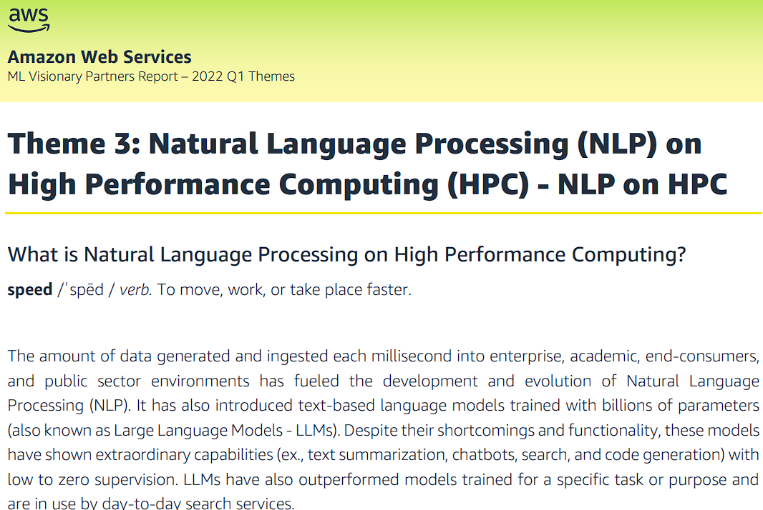
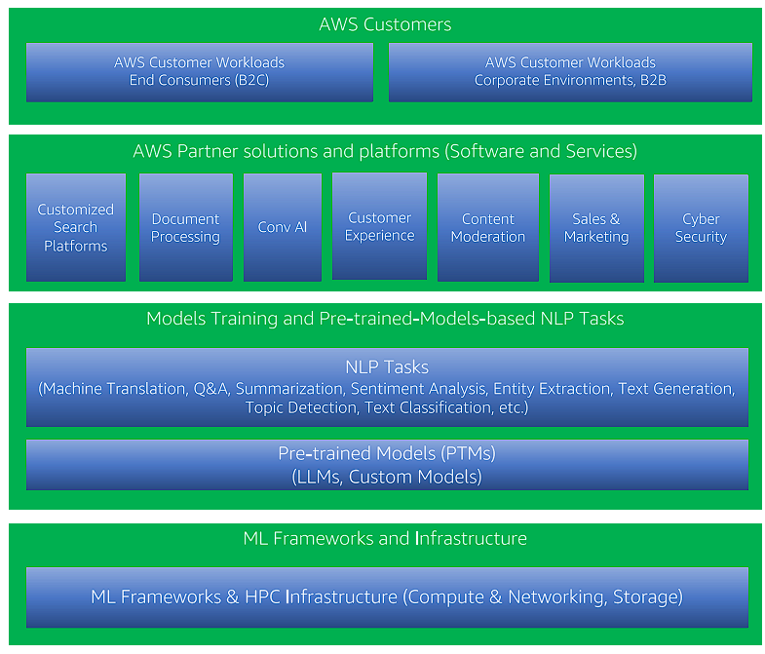
Q1 – 2022 – Large Language Models were already there…

Slide 4

Conversational AI (CAI) is more than a Chatbot 🤖
Discovery
Design
Build
Test
Deploy
Monitor
Optimize
Conv. Flow
VUI, UI (multimodal)
Interaction Scripts (human – bot)
Test Cases (UAT)
Launch the CAI solution to production
Backend Platforms
Interaction channels
Digital assets
Microsites
Adoption
Interaction Model (Intents, Slots, Utterances, Slot Types, Language)
State management (Context, Session, Usage)
Intent fulfillment
Integrations (CRM, ERPs, DBs)
Digital assets
Backend conditioning (3rd party, core platforms)
Security
Technical (Latency, Concurrency, Load,)
Use cases and variations
User (UAT)
Multi-channel
Multimodal
Certification
Personality
Performance
Availability
NLU Frictions
Exceptions
User Feedback
Business Reporting
Channels
Active users
Recurrent users
Frequent paths
Frequent requests
Solve Frictions (Utterances,
Slot values, Intents)
Reduce steps
Add/update intents
User reviews tracking
Frequent channels
Long term usage (1 year)
Business Problem
Scope
Prioritization
Education
Eligibility
I don’t know that!

Slide 5
Adding Gen AI “spice” to your CAI projects…
Narrow down the business problem
Write problem statements
Write ideas narratives
Create deliverables outlines/content
Conv. AI Flows creation
(Phrases, Values, Synonyms, dictionaries)
Code Generation
(Intent detection, fulfillment, request handling, validation, integrations, authentication, translation, test clients, observability, reporting, guardrails)
Content Generation
(text, images, audio, video, test data, tone, style, channel, issue descriptions)
Pre-canned Assistants
Contact Center, Human Resources, IT, FinServ, Banking, Healthcare
Observability / D&A
Code Generation
IaC (Infrastructure as Code)
Deliverables
Deployment guides
Deployment plan
Rollback plan
Validation plan
Troubleshooting
Analysis
Response, Logs
Interactions, Exceptions, Alerts, Attacks
Deliverables
Issue management
Alert management
Reports
Costs
Prompts
Models
Process
Tools
Agents
Solution Features
Discovery
Design
Build
Test
Deploy
Monitor
Optimize
Conv. Flow
VUI, UI (multimodal)
Interaction Scripts (human – bot)
Test Cases (UAT)
Launch the CAI solution to production
Backend Platforms
Interaction channels
Digital assets
Microsites
Adoption
Interaction Model (Intents, Slots, Utterances, Slot Types, Language)
State management (Context, Session, Usage)
Intent fulfillment
Integrations (CRM, ERPs, DBs)
Digital assets
Backend conditioning (3rd party, core platforms)
Security
Technical (Latency, Concurrency, Load,)
Use cases and variations
User (UAT)
Multi-channel
Multimodal
Certification
Personality
Performance
Availability
NLU Frictions
Exceptions
User Feedback
Business Reporting
Channels
Active users
Recurrent users
Frequent paths
Frequent requests
Solve Frictions (Utterances,
Slot values, Intents)
Reduce steps
Add/update intents
User reviews tracking
Frequent channels
Long term usage (1 year)
Business Problem
Scope
Prioritization
Education
Eligibility

Slide 6
Implications and challenges
Global
(Multilanguage)
Efficient
(Best practices)
Privacy, Sec
(PII, Regulations)
Multichannel
(SMS, Chat, Voice, Social)
Flexible
(Changes, New Tech)
Speed
(Time to Market, Competitors)
Expertise
(Designers, Developers, Linguists, Testers, Tools )
Input Data
(Copyright, Data Sources, Amount of data, origin of data, type, quality, biases, harmful)
Prompt Eng
(Clarity, Context, Completeness, Creativity, Tone, Open-Ended, Closed-Ended)
Validation
(A/B Testing, benchmarks vs previous versions)
Outputs
(Relevance, Coherence, Accuracy, Bias, Creativity, Errors, Harmful, False P/N)
Tech Selection/Priorities
(experiment, few/zero shot, budget, tasks, expertise, frameworks, fine-tune, train, CoE)
Discovery
Design
Build
Test
Deploy
Monitor
Optimize
Your question requires human intervention
Conv. Flow
VUI, UI (multimodal)
Interaction Scripts (human – bot)
Test Cases (UAT)
Launch the CAI solution to production
Backend Platforms
Interaction channels
Digital assets
Microsites
Adoption
Interaction Model (Intents, Slots, Utterances, Slot Types, Language)
State management (Context, Session, Usage)
Intent fulfillment
Integrations (CRM, ERPs, DBs)
Digital assets
Backend conditioning (3rd party, core platforms)
Security
Technical (Latency, Concurrency, Load, Exceptional, Normal, and Alternative flows)
User (UAT)
Multi-channel
Multimodal
Certification
Personality
Performance
Availability
NLU Frictions
Exceptions
User Feedback
Business Reporting
Channels
Active users
Recurrent users
Frequent paths
Frequent requests
Solve Frictions (Utterances,
Slot values, Intents)
Reduce steps
Add/update intents
User reviews tracking
Frequent channels
Long term usage (1 year)
Business Problem
Scope
Prioritization
Education
Eligibility
Do you want to speak with the support team?

Slide 7
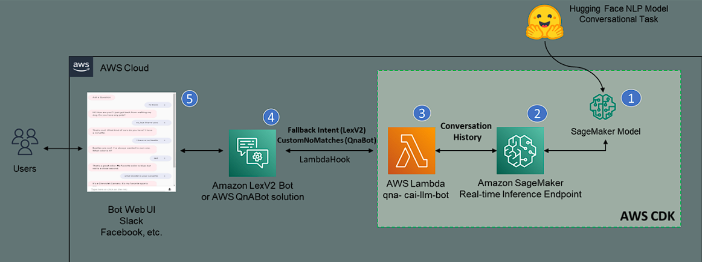
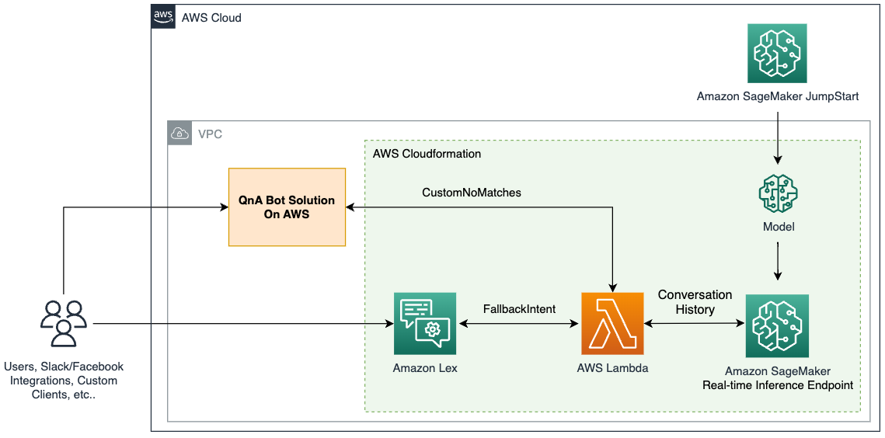
Large Language Models were already there…
Amazon Lex + BlenderBot – June 2022
Amazon Lex + FLAN-T5 – June 2023

Slide 8



Example
Requests/Responses
Data Enrichment
Summarization
Agent Assistance
Call Analytics
Agents!
ChimeSDK
SIP Media Application (Alexa Client,
Lambda Function)
1
2
3
4
5
Amazon
Alexa Device
Amazon Alexa
Custom Skill
ChimeSDK
PSTN Audio Service
Amazon Lambda
Amazon Connect
7
6
64%
Phone Numbers
Resolution time
Quality of Service
Training Quality
Augmented Procedures
Categorization
Customer Satisfaction
Would consider switching to a company’s competitor due to ONE bad customer experience.
Notes:
User opens the skill and requests to contact support
Amazon Alexa starts a call to a phone number configured in the ChimeSDK PSTN Audio Servcie using the Alexa communications API on behalf of the user, and inside the skill.
The SIP Media application applies its configured SIP rules and triggers the lambda function
The lambda function returns a welcome message and forwards the call to Amazon connect
In Amazon connect, an agent answers the call
We played an audio to simulate the agent response
The user finishes the call

Slide 9

Victor Rojo
Principal Tech Lead
AWS Conversational AI Competency
vicrojo@amazon.com
Victor’s LinkedIn

