Slide 1


SYNTHETIC MEDIA, GEN AI & THE NEW INDUSTRIAL REVOLUTION
How generative AI has the capacity to innovate and advance the human condition beyond automation
Ryan Steelberg
CEO
Veritone
Copyright © 2023 Veritone, Inc. All rights reserved. CONFIDENTIAL. Trademarks are the property of their respective owners.

Slide 2



UNDERSTANDING OUR CURRENT CONTEXT
WE ARE LIVING IN, SHAPING, & FUELING THE 5th INDUSTRIAL REVOLUTION
1.0
2.0
3.0
4.0
Steam Power and Mechanization of Production
Electricity and
Mass Production
Digital
Technology
Physical/Digital Convergence and Datafication
Quarry Bank Mill
1st to benefit from technology to create textiles.
Transformed manufacturing through electricity and assembly lines.
Advances in electronic testing, measurement tools, and computer development
Transformed the way we understand, organize and engage customers
Each revolution marked by significant improvements
in human capabilities and quality of life
Common Theme:
Notes:
We are living in, shaping and fueling the fifth industrial revolution (it’s fully underway)
All three prior industrial revolutions were defined by tech and innovation.
1: Steam power and mechanization of production
Quarry Bank Mill – first to benefit from technology to create textiles.
2: Electricity and Mass Production
Ford – transformed manufacturing through electricity and assembly lines.
3: Digital Technology
HP – orchestrated the movement to electronic testing, measurement, growth of computer usage
4: Physical/Digital Convergence and Datafication
Salesforce – SaaS-based, customer-centric software development; transformed the way we understand, organize and engage customers
Beyond technology and innovation, each revolution shares the same theme of improving lives for humans by extending their capabilities.

Slide 3

GENERATIVE AI:
5.0
POWERING INDUSTRY 5.0
As we enter the fifth industrial revolution, we can expect to see similar elements – technology, innovation, and enhanced human capabilities.
Notes:
As we enter Industry 5.0, we can expect to see similar elements – technology, innovation and enhanced human capabilities.
Marked by purpose-driven technology that is human-centered and sustainable
However, we are at an inflection point - we have the elemental tools to innovate at a scale like never before, but companies are struggling with the possibility, risk, and scope.
The unveiling of ChatGPT is merely the beginning of the synthetic media era in which algorithms can learn and extend their capabilities beyond what was explicitly programmed. The capacity to reflect on its output and modify responses based on ongoing conversation gives GenAi a new level of cognitive prowess.
According to the “Generative AI Revolutionizes Marketing Creativity” blog post by Forrester Analyst Jay Pattisall, “large language models bring tremendous computing power, speed and scale to the human act of creativity and ideation.”
When it comes to creating content, AI technology can help:
Enhance human reasoning with machine intelligence (e.g. using image generation to help execute meaningful advertising campaigns with significance and scale).
Amplify creators’ work (e.g. aid creative teams with idea generation, content development and evaluation).
Add scale and speed to creative quality (e.g. using AI, you can produce entire advertising campaigns in less than 10 minutes that are ready to publish to multiple social APIs at the click of a button, increasing the efficiency and velocity of content development).

Slide 4

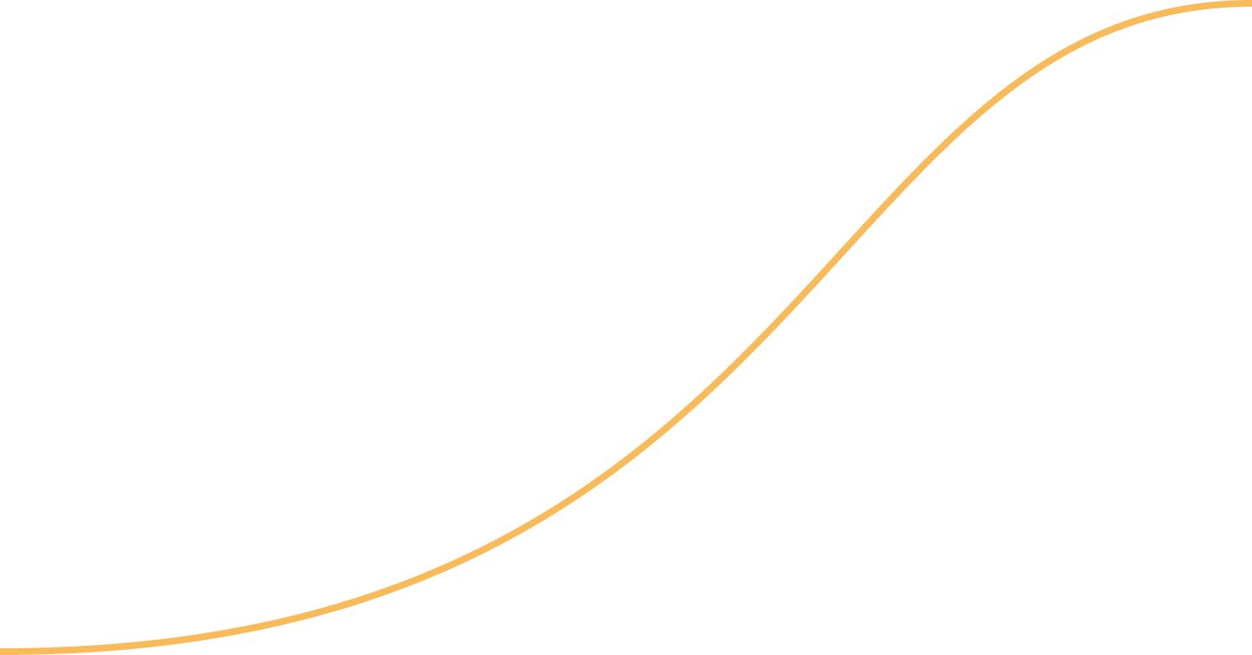
INDUSTRIAL REVOLUTIONS:
TIME TO ADOPTION
Eli Whitney
100
POPULATION: 8B
Henry Ford
1750 - 1850
Number of Years to Widespread Adoption
50
1860 - 1930
David Packard
Marc Benioff
1960 - 2000
???
2000 - 2020
2020+
SKEPTICISM LAG
1.2B
1.0
2.0
3.0
4.0
5.0
0
Notes:
As we continue to work our way into the fifth industrial revolution, I believe some of the key differences we will see compared to previous revolutions is increased speed of adoption and accelerated skepticism, which can lead to significant risks
In previous industrial revolutions, while the population was smaller, it still took longer for users to understand, integrate and benefit from new technologies
The lengthy lag between the arrival of new technology and its broad adoption that humans experienced in previous industrial revolutions is significantly shortened
However, in the digital age, it’s easier than before to gather and share information, increasing the speed of adoption and accelerating disbelief, fear or mistrust in technology
As first movers in AI, we have the ability to overcome the skeptics by embodying the characteristics of the revolutionary icons listed here
Each of the icons played a significant role in shepherding new technology to the masses because of their commitment to advancing society and humans:
1.0 Eli Whitney (Cotton Gin, mass increase in agricultural productivity)
2.0 Henry Ford (production assembly)
3.0 David Packard (electronic testing/measurement/computers)
4.0 Marc Benioff (customer-centric solutioning, mass datafication)
5.0 ???? (The person to be featured in this graphic for Industry 5.0 could literally be in this room today!)

Slide 5
PACE OF ENTERPRISE AI ADOPTION
Marketing and Advertising
37%
Technology
35%
Consulting
30%
Teaching
19%
Accounting
16%
Healthcare
15%
5%
10%
15%
20%
25%
30%
35%
40%
Share of Respondents
SOURCE: STATISTA, AUG 2023
Notes:
A key indicator in increased adoption is the speed at which business are already integrating AI into their processes:
37% of marketing and advertising companies have already integrated AI technology to help with work related tasks
35% of technology companies and 30% of consulting organizations have also integrated AI into their business processes

Slide 6
Individual /
Collective Knowledge
Individual / Collective Creativity (Outputs)
REINFORCING THE HUMAN ELEMENT:
GENAI IS NOT REPLACING HUMANS, IT’S UNLOCKING HUMAN POTENTIAL
AI-Augmented Knowledge
AI-Informed Creativity (Outputs)
Notes:
There is a nagging fear around AI replacing humans, but as with the four previous industrial revolutions, AI is already improving human output and quality of life.
While that may seem threatening to the creative industry, we believe that creatives will lead this new frontier.
This is driven by the premise that GenAI unlocks exponential opportunities to expand creativity.
Pattisall also shares in a recent interview with SHRM that, "While generative AI can enhance or assist creative-problem solvers by speeding up and scaling their work, AI cannot replace creative thinking or creative-problem solving. Our forecast finds that the least likely job trait to be automated is originality."
But it’s not just about quantity. QUALITY is going to be the bigger outcome:
A recent article by Harvard Business Review articulates this POV: “Humans have boundless creativity. However, the challenge of communicating their concepts in written or visual form restricts vast numbers of people from contributing new ideas. Generative AI can remove this obstacle.”
HBR goes on to outline 5 key ways GenAI promotes creativity:
Promotes Divergent Thinking
Challenges Expert Bias
Assist in Idea Evaluation
Support Idea Refinement
Facilitates Collaboration

Slide 7


“HUMAN IN THE LOOP”
"Human In The Loop" (HITL) is a term used in various fields, including machine learning, data science, and human-computer interaction, to describe systems where human judgment is integrated into automated processes.
In the context of artificial intelligence (AI), a human-in-the-loop system typically involves a feedback loop where an AI algorithm and a human collaboratively work to perform a task or make a decision.
IN THE LOOP

Slide 8
HUMAN ON THE LOOP
“Human On The Loop” (HOTL) refers to systems or processes where machines do the bulk of the work, and human involvement becomes more of a check, to ensure processes are running normally and to verify accuracy
We want to move as many people from in the loop to on the loop as possible
More humans on the loop means more productivity and efficiency
ON THE LOOP

Slide 9
HUMAN OUT OF THE LOOP
"Human Out Of The Loop" (HOOTL) refers to automated systems where human intervention is minimal or entirely absent.
In the context of artificial intelligence (AI), this signifies that an AI system operates autonomously, making decisions, and executing actions without requiring human approval, oversight, or input at each step.
HOOTL systems are designed to function without human interference, often because they are better equipped to handle the high speeds, massive datasets, or complex computations involved.
OUT OF THE LOOP

Slide 10

Even with all of the benefits of AI, there are still risks:
WITH GREAT POWER
COMES GREAT RESPONSIBILITY
There isn’t a playbook on how to adapt and change our technical skills on how to interact with AI technology
Open source means anyone can access the technology, leaving the door open for the wrong people to cause harm and wreak havoc
Garbage in, garbage out
Good news travels fast, but bad news travels faster and one misstep with technology this advanced can set us all back
If we don’t manage it, it will be managed for us
Notes:
Even with all of the benefits of AI, there are still risks
Earlier, I talked about the lengthy lag between the arrival of new technology and its broad adoption that humans experienced in previous industrial revolutions is significantly shortened
While it’s still early, corporate technology managers are already sampling generative AI software at an unprecedented rate
The increased speed of adoption can lead to risks, especially when humans feel a connection to a machine that is interacting with them and speaking in a natural language
If we don’t manage it, it will get managed for us (government)
Risks
There isn’t a playbook on how to adapt and change our technical skills on how to interact with AI technology
Open source means anyone can access the technology, leaving the door open for the wrong people to cause harm and wreak havoc
The volume of new content being generated by Chat GPT and LLM, some of which contains hallucinations, is polluting the quality of the data from which models learn. Learning from erroneous data will have compounding adverse effects.
Good news travels fast, but bad news travels faster and one misstep with technology this advanced can set us all back
So, how do we help mitigate these risks?

Slide 11
TIME FOR STEWARDSHIP
Fear
+
Risk
Empowerment
+
Accountability
(Catalyst: AI Governance)
Notes:
Empowerment and accountability
As a leader, you have to go beyond just passively using the technology, you also have help shape how this technology will be used
This means empowering one another to democratize AI and actively use the power of open source to guide the future of the technology
We also have to hold each other accountable and lead by example, by ensuring AI is used in a way that is clear, compliant and consenting
We can achieve this by abiding by guardrails like transparency, trust, security and compliance
With the right governance and right approach, eventually fear and risk will be replaced by accountability
Because if we don’t manage it, it will be managed for us and we may lose the ability to safely enjoy AI and all of its benefits

Slide 12



ULTIMATELY, EVERYONE BENEFITS
AI for Individuals
AI for
Companies
AI for
Society
Notes:
Individuals
Empowerment: People using GenAI will become the teachers, the orchestrators and the “engineers” that will design and evolve synthetic media to improve business processes and meet the insatiable demand for personalized experiences.
Companies
Speed: Move the collection, organization and delivery of data faster through the organization.
Scale: Expand analysis, outputs and activations without adding resources.
Creativity: Generate, harness, and evaluate more ideas from individuals across the organization.
Employee Experience: Provide tools that empower employees across multiple functions with more intelligence, creative contributions and better workflows.
Customer Experience: Deliver more personalized brand experiences across multiple channels and languages.
The net result is that companies will create more powerful brand experiences for employees and customers alike, increasing engagement and loyalty, while getting to market faster and keeping costs contained.
Society
Ultimately, GenAI will have a massive cultural impact on the way we:
Learn: Improved access to and the process of learning. More individuals accessing a greater pool of knowledge.
Create: More trusted, relevant content at scale.
Engage: “Always on” brand-consumer and consumer-consumer relationships that keep people engaged.
Experience: Highly personalized, seamless, immersive human experiences across digital and real-world environments.
Thrive: The line between synthetic and real is already blurring and soon it will fade to enable unfathomable breakthroughs and advances for mankind.

Slide 13
“
There is no [person] living who isn’t capable of doing more than [they] think [they] can do.”
– Henry Ford
…with AI
Notes:
Early innings of the fifth industrial revolution but we see endless opportunities to improve the quality of life of humans.
Henry Ford quote: “There is no [person] living who isn’t capable of doing more than [they] think [they] can do.” … with AI.

Slide 14

ETHICAL AI
Guardrails to ensure AI is used for good:
Transparency
Trust
Security and Compliance
Empowerment
Notes:
As first movers, we must be committed to maintaining the discipline required to ensure our AI technology is being used for good.
We are responsible for ensuring AI is used in a way that is clear, compliant and consenting.
To ensure our AI technology is used for good, I recommend the following guardrails:
Transparency: Ensuring AI is easily explainable and produces outputs that are intended, reliable and understandable within the boundaries of what is possible with the technology.
Trust: Ensuring AI and the outcomes it drives are designed to uphold fairness and avoid discrimination against those who use, engage and interact with it while mitigating the improper use of bias in AI models and their results.
Security and compliance: Designing and continuously reviewing all AI systems in accordance with security best practices to protect data, including following compliance guidelines and standards and adhering to current laws and operationalizing policies.
Empowerment: Democratizing AI technology to empower people to make an impact by doing more with less.

Slide 15
OUR COLLECTIVE CHALLENGE
WE ARE A PART OF THIS AND WE HAVE A
RESPONSIBILITY
Notes:
Everyone is this room is here because they are a leader – you are important to the success of this technology
Which means, you have a responsibility to take these concerns seriously and scrutinize what you will hear from your colleagues and experts over the coming days
In the coming days, let’s hold each other accountable to ensure we’re using the technology responsibly so we all have the opportunity to experience the benefits of AI

Slide 16
THANK YOU

