Slide 1

The Power of Conversational AI to Make the Best Hire
Keisuke Inoue, Director of Data Science

Slide 2






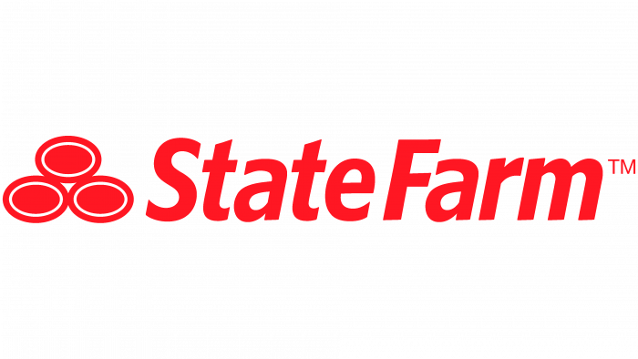




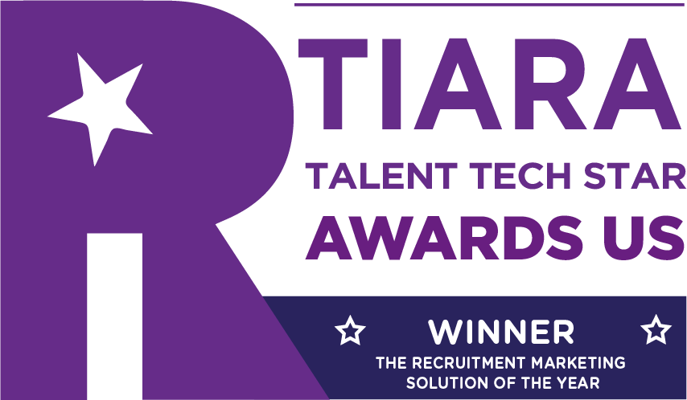


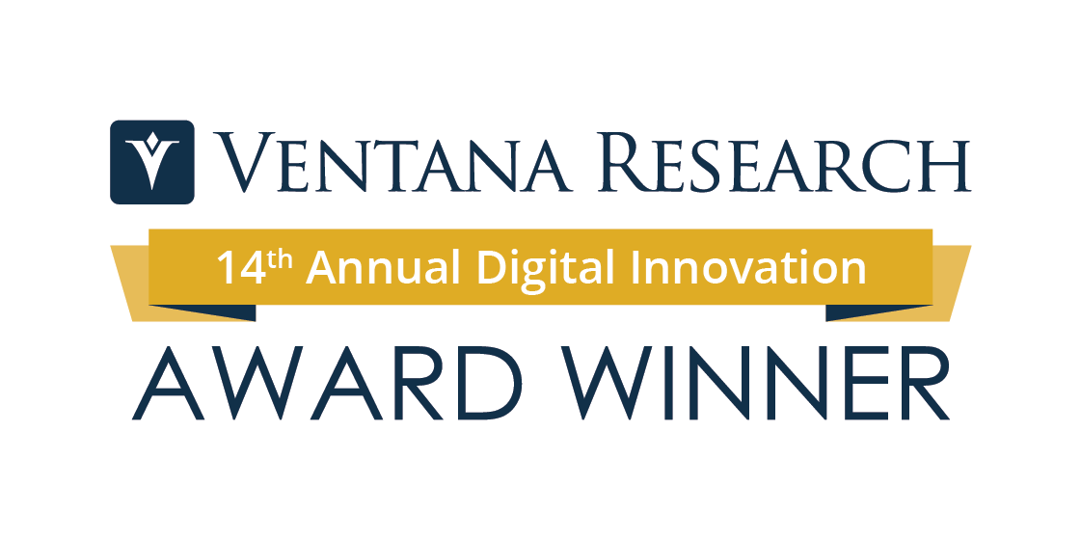
About PandoLogic
pandoIQ
Awards
Customers
95%
of roles filled
50%
applicant increase MoM
314%
career site visit increase
8
day decrease in time to hire
Acquired by Veritone, a leader in enterprise AI software and services, in 2021
Completed third-party bias audit for AI technology in 2023
Leading recruitment platform that optimizes candidate acquisition through programmatic job advertising and conversational AI
Fully automates the recruitment process through sophisticated AI and machine learning using a proprietary normalized dataset
Serves employers of all sizes through direct and channel sales (RPO, Franchise, Agency)

Slide 3



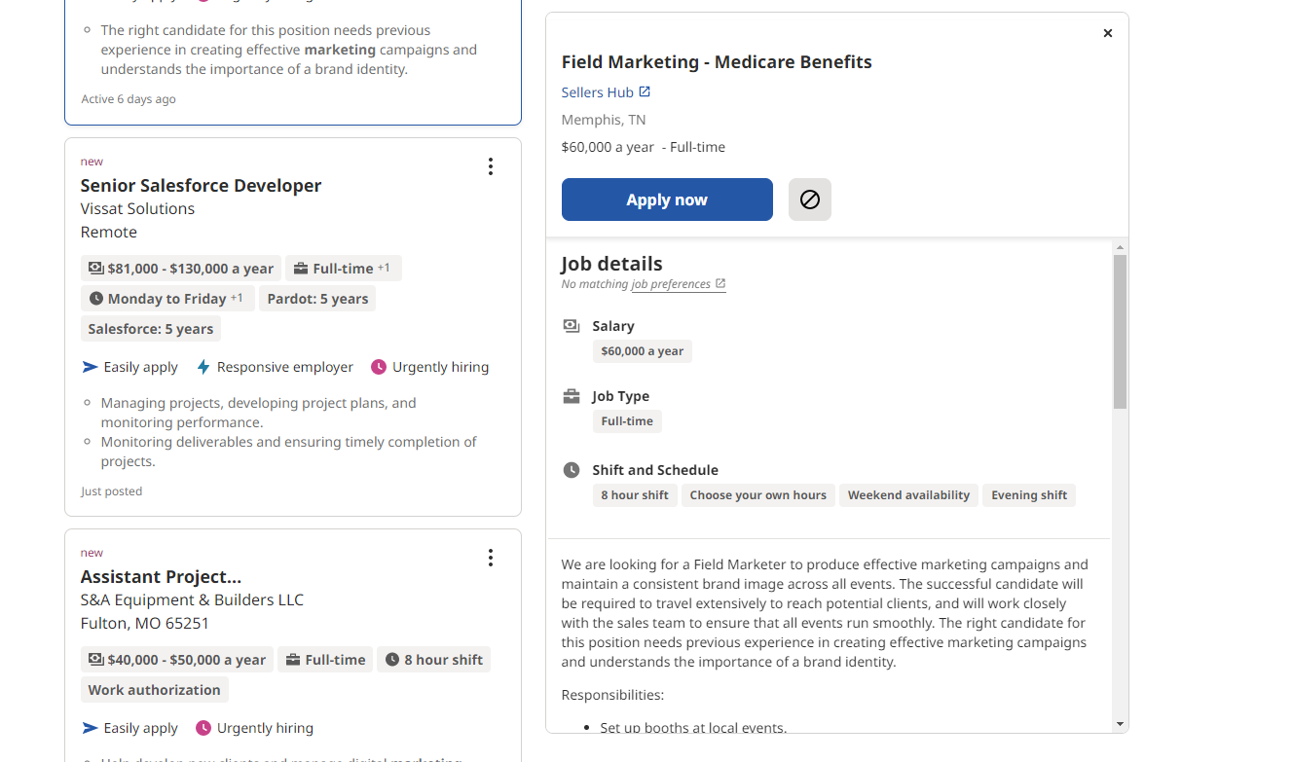



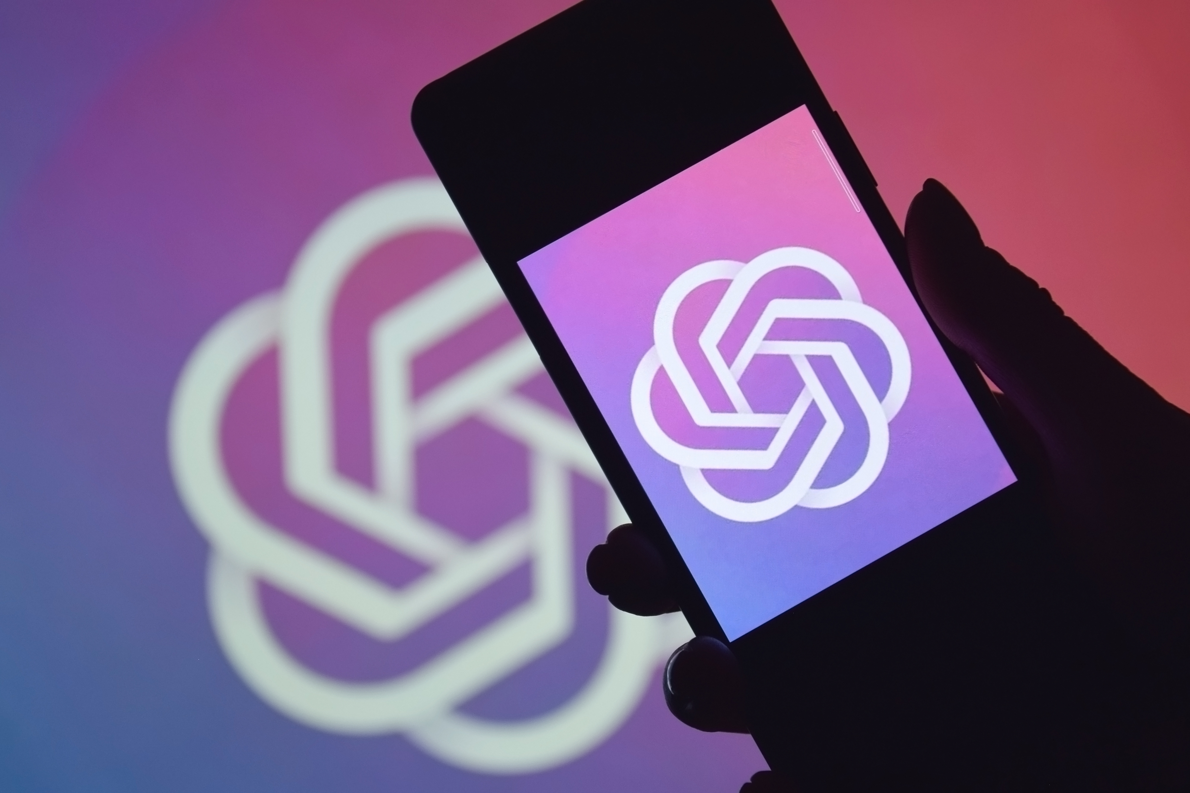
Evolution of Talent Acquisition Technologies
Online Recruitment Sites
Job Distribution
Conversational AI
1700
1960
2007
2023
Newspaper
Yellow Pages
Aggregators
Programmatic Job Advertising
Chat GPT
Manual
Automation
AI-enabled

Slide 4
AI for Talent Acquisition
HIRE
Assessment
Personalized
Rejection
Content
Creation
Candidate
Insights
AI-Assisted
Evaluation
Job
Advertising
ATTRACT
ENGAGE
ENGAGE
Conversational
AI
Personalized
Communication
Interview
Design
Resume
Review
Intelligent
Workflows
Notes:
Focus is on engagement

Slide 5


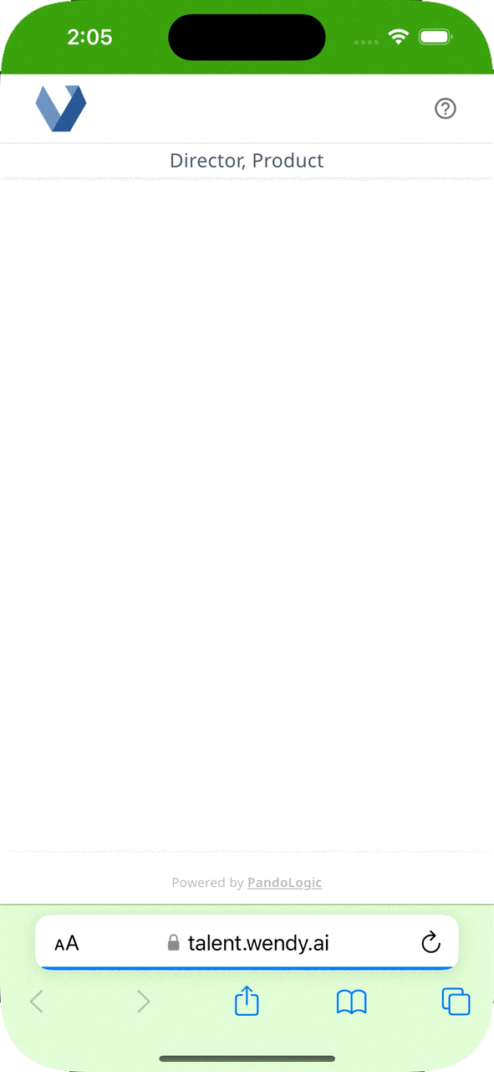



AI for Talent Engagement
40%
of chats occur off-hours, allowing job seekers to engage when most convenient
88%
chat completion rate from chat engagement
3.5 hours
average time from candidate application to the start of the chat
6.8
average unique data points per conversation, allowing for more informed decision-making

Slide 6






Candidate Chat
DSLLM
Job
Description
Generation
Execution
Evaluation

Slide 7


Case Study: Veritone
14
roles opened
"We were overwhelmed with candidates coming in for a Marketing Director role, but we narrowed them down to 30 candidates in a matter of days.
We started using conversational AI to show that we are drinking our own champagne, now I don't ever want to go back to the old way."
-- Seth Greenberg, CMO
87.5%
chat completed
876
applications processed
~300hours
saved

Slide 8
Demo
Notes:
Keisuke to record and talk over demo
Extend demo out to include copilot here

Slide 9
Key Takeaways
Question Answering: Providing guidance and empowerment to those who hire
Engagement: Timely communication to candidates, streamlining the process
Evaluation: Summarizing the pool of candidates allowing recruiters to assess and hire

Slide 10
THANK YOU

