Slide 1

Human-Agent Teaming for Improved
Job Satisfaction and Productivity
Jonathan Wiggs
Co-Founder and Chief Technology Officer

Slide 2
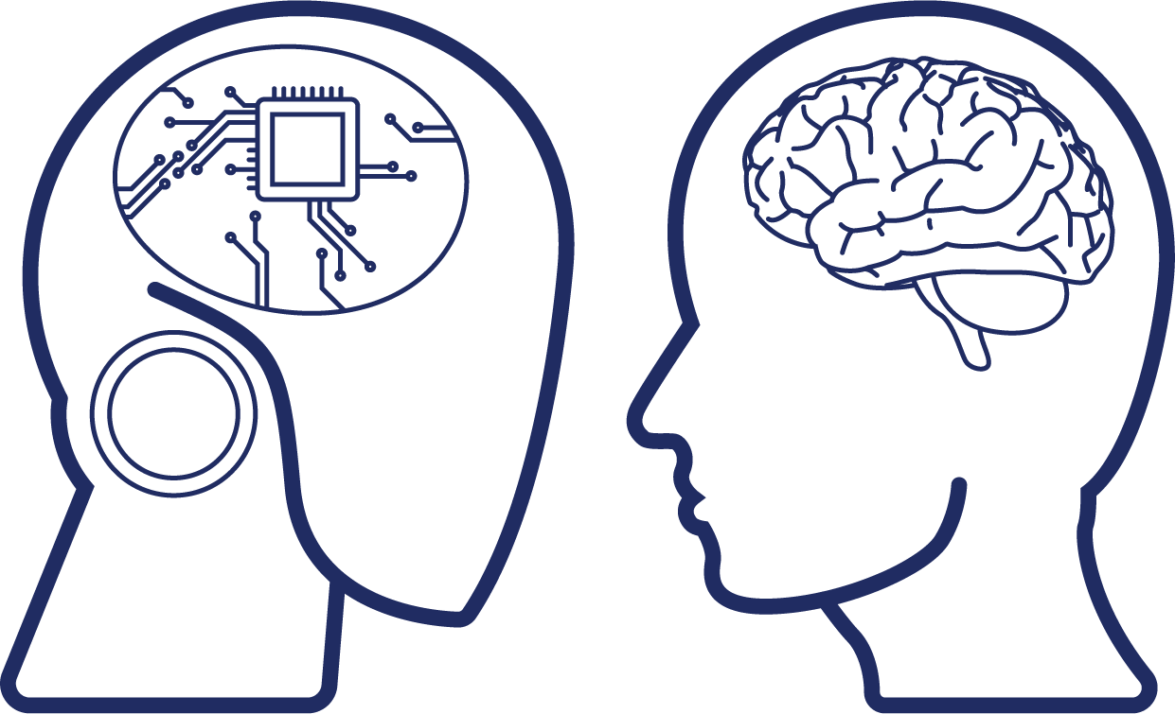
The Concept of Human-Agent Teaming
Pairing Human Intelligence with Artificial Intelligence, Leveraging Unique Strengths of Each
First Known Example is
US AirForce UAV in 1918
Intended to Augment Talent, NOT Replace

Slide 3
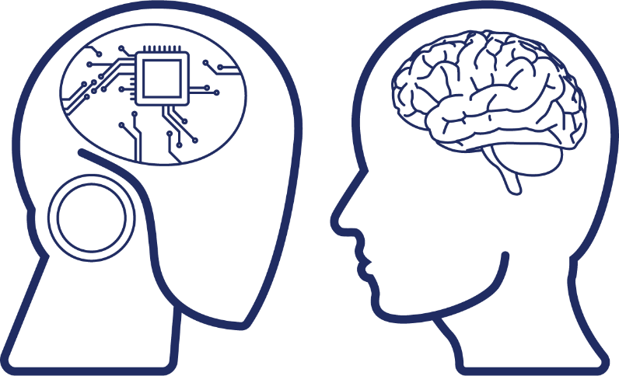

Not The Same as Human-Corrected Computing
Human-Agent Teaming is a Partnership, Not a Remediation
Human-Corrected Computing
Human-Agent Teaming
Step 1
Step 2
Any Manner of Task Sharing

Slide 4
Akin to Military Concept of “Force Multipliers”
Tangible or Intangible Variables That Increase or Enhance Combat Value and Capabilities
One Becomes Many

Slide 5




Same Principles Can (and Should) Apply to Business
AI Agents Serve as “Workforce Multipliers” for Greater Effectiveness and Productivity
2X More Effective
3X More Effective
4X More Effective

Slide 6
Division of Labor Between Humans and Agents
When AI Agents Perform Rote, Routine and Repetitive Tasks, Human Workers are Elevated
More Use of Critical Thinking
Less Tedium and Drudgery
Able to Prioritize Higher-Value Tasks
Greater Sense of Fulfillment and Satisfaction
Lower Probability of Burnout or Quiet Quitting

Slide 7
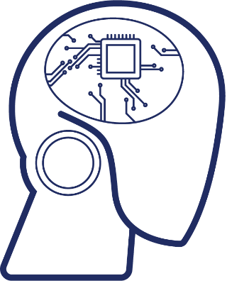
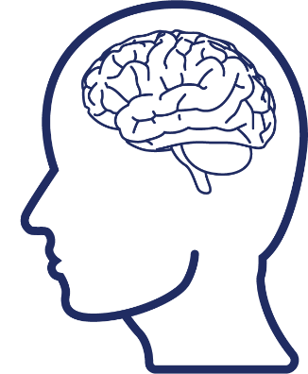
This Leads to Happier Workers, Healthier Bottom Line
Employers Benefit from Improved Productivity, Efficiency, Retention and Morale

Slide 8
Virtually Every Industry Can Benefit
AI Agents Proving Useful for Many Roles, Tasks and Environments
Construction
Publishing
Banking
Architectural Design
Project Management
Site Monitoring
Manufacturing
Background Research
Content Creation
Proofreading/Editing
Healthcare
Fraud Detection
Identity Verification
Lending Analysis
Quality Control
Maintenance Planning
Assembly Line
Clinical Diagnosis
Patient Monitoring
Medical Billing

Slide 9

Conversational AI Agents vs Chatbots
Despite Often Being Conflated, They’re Not The Same!
Interact primarily through spoken language
Understand and generate speech like a human
Able to interpret context, inference and intent
Not scripted
Not reliant on pattern matching to knowledgebase
Interact primarily through
text-based communication
Do not understand nor generate speech like a human
Unable to interpret context, inference and intent
Heavily scripted
Reliant on pattern matching
to knowledgebase

Slide 10
Conversational AI Agents vs Chatbots
Use Cases and Nature of Engagement With Humans Differ
Typically function within SaaS/enterprise applications and smart devices
Commonly used for
complex, data-driven
tasks and transactions
Respond naturally to spoken language and engage in human-like conversations
VOICE DRIVEN
Typically function within messaging platforms
and websites
Commonly used for
FAQs, customer support
and information retrieval
Respond to simple, flat queries by recognizing established keywords and phrases
TEXT DRIVEN

Slide 11


The Role of Conversational Implicature
Why Context, Inference and Intent is Vital to the Efficacy of Conversational AI Agents
concept in pragmatics branch of linguistics dealing with study of language
occurs when a person speaking implies something without explicitly stating it
and a person listening makes inferences based on context and conversational norms

Slide 12
The Role of Conversational Implicature
Some Illustrative Examples
Will you be joining us for dinner tonight?
What do
you think of my new haircut?
How did
you like my presentation?
I have
some work
to finish.
It’s a lot shorter than before.
You covered a lot of information.

Slide 13
RPA vs AI for Human-Agent Teaming
Pros, Cons and Considerations
Robotic Process Automation | Artificial Intelligence
Rules-Based, Not Very Flexible | Dynamic, Extremely Flexible
Able to Handle Simple, Straightforward Tasks | Able to Handle Complex, Multi-Faceted Tasks
Not Good for Language-Based Tasks | Excellent for Language-Based Tasks
Often Requires Up-Front Customization/Tailoring | More Often Available Out-of-the-Box
Must Be Re-Tooled If/When Processes Change | Easily Adapts If/When Processes Change
Heavy Ongoing Maintenance and Support | Simple, Streamlined Maintenance and Support
Often Requires Dedicated In-House Experts | Does Not Require Dedicated In-House Experts

Slide 14
Adoption of Human-Agent Teaming
Evaluating Vendor Solutions
TECHNOLOGY
REQUIREMENTS
GOALSETTING
How robust
(“real”) is
the tech?
What data (and
how much) does the
vendor require?
What are the goals (promises) and how will
they be achieved?
How scalable
(on demand)
is the solution?
Can you easily
operationalize
the solution?
SCALABILITY
OPERATIONALIZATION

Slide 15
Adoption of Human-Agent Teaming
Overcoming Skepticism and Securing Buy-In
BUSINESS NEED
VALUE PROPOSITION
Understand and Define Business Need(s), Ascertain Specific Roles and Tasks
Demonstrate Value, Perform Cost/Benefit Analysis and
ROI Proforma
STAKEHOLDER ENGAGEMENT
RISK MITIGATION
Identify and Educate Key Stakeholders, Solicit Input, Address Questions/Concerns
Conduct Comprehensive Risk Assessment, Prepare Focused Mitigation Plan

Slide 16

Adoption of Human-Agent Teaming
Effecting Positive Change and Achieving Successful Outcomes
PILOT
FEEDBACK
Pilot Solution (Limited Scope)
Collect Feedback, Make Changes
COMMUNICATION
KPIs
Communicate Benefits, Allay Fears
Continuously Monitor KPIs
TRAINING
RESULTS
Provide Training and Support
Share Unfiltered Results

Slide 17
Thank You!
Jonathan Wiggs
Co-Founder and Chief Technology Officer

