Slide 1

Welcome to our classroom session
Introduction to
bot management,
a data-driven approach to building a great bot

Slide 2

Agenda
Presenter
Meet Wysdom
Bot team challenges
Bot management framework
Chatbot analytics in action
Jay Athia
Sr. Director, Customer Success
jay.athia@wysdom.ai
Notes:
Credibility
Jay personal - 5+ years managing and analyzing bots. Lots of platforms, voice, mobile. Finding and fixing the most trivial problems and the most complex, learning along the way to refine a process to help find the most impactful issues, forecast them, release and measure.

Slide 3
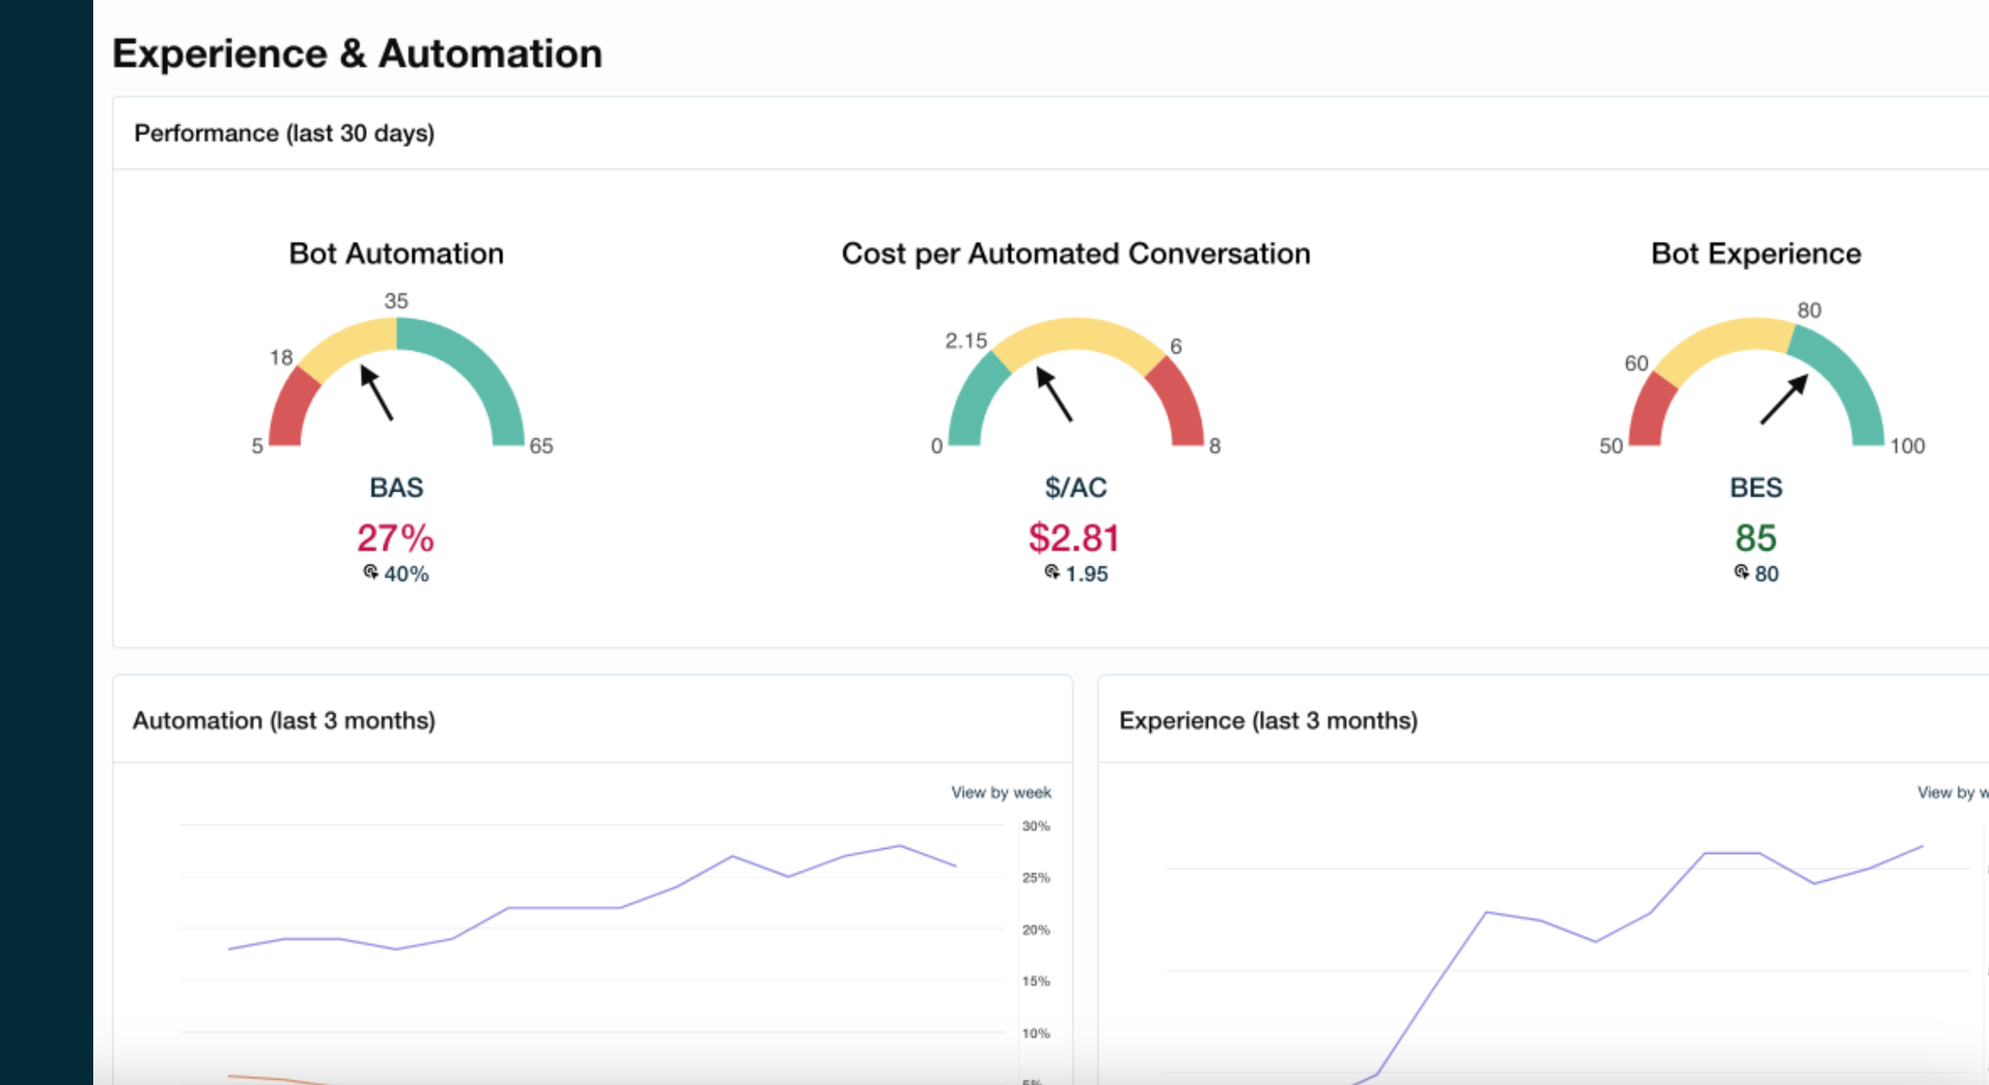







Fast track bot improvement with Wysdom
Chatbot
Analytics software
Chatbot
services
Dozens of
happy customers
Notes:
Talking points
Thanks for joining me today.
First a bit about us.

Slide 4

The bot isn’t
living up to expectations
Not meeting containment goals
Contact center volume still growing
I can’t get resources
It’s the wrong platform for our needs
Notes:
Rephrase problem
You probably got a bot platform, expected the latest tech to automate and it’s not living up. Task completion or containment isn’t there. Contact center volume isn’t letting up -- and the platform gets blamed on being too difficult or lacking features. You find new use cases to add to it,and that gets a bit more ROI, but that too stagnates as there are no resources for additional integrations or new channels like voice.
Emotional impact
Execs aren’t thrilled, they start getting distracted by a new technology that might solve the problem. You are trying to keep the bot running well and proving your worth.

Slide 5
Introducing the
bot management framework

Slide 6
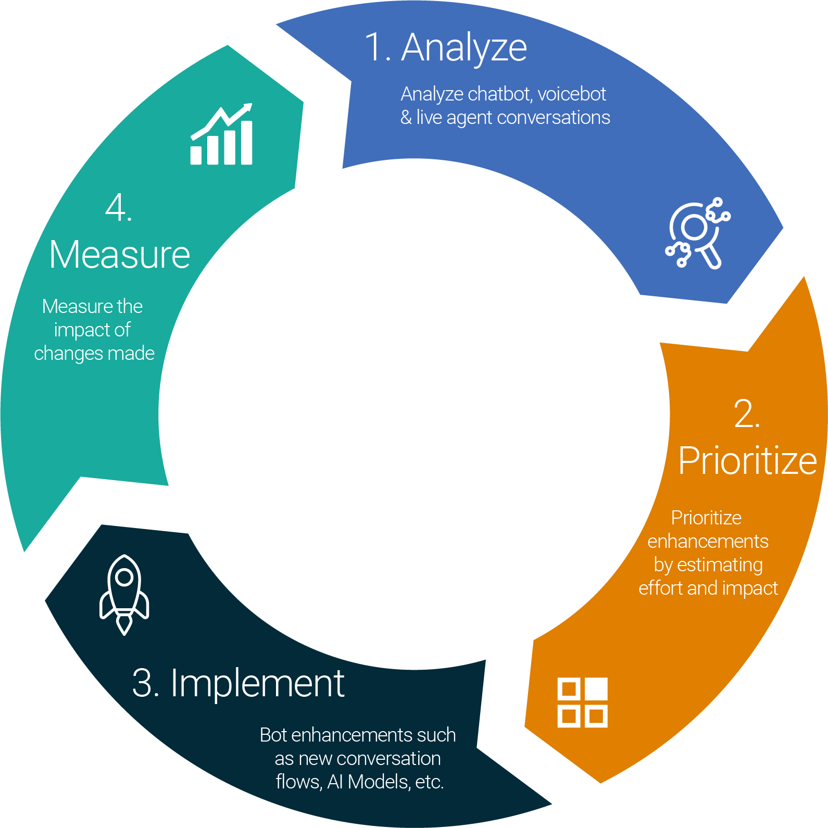
Bot management framework
Notes:
Credibility
Jay personal - 5+ years managing and analyzing bots. Lots of platforms, voice, mobile. Finding and fixing the most trivial problems and the most complex, learning along the way to refine a process to help find the most impactful issues, forecast them, release and measure.

Slide 7

Analyze
01
Consider the entire user journey - bot to live agent
02
Start with Conversation Topics
03
Don’t focus solely on intents - what queries was the bot unable to handle?
04
Find problem areas; avoid tunnel vision

Slide 8


How do I know what customers are asking about?
≠
Intents
Disposition Codes

Slide 9
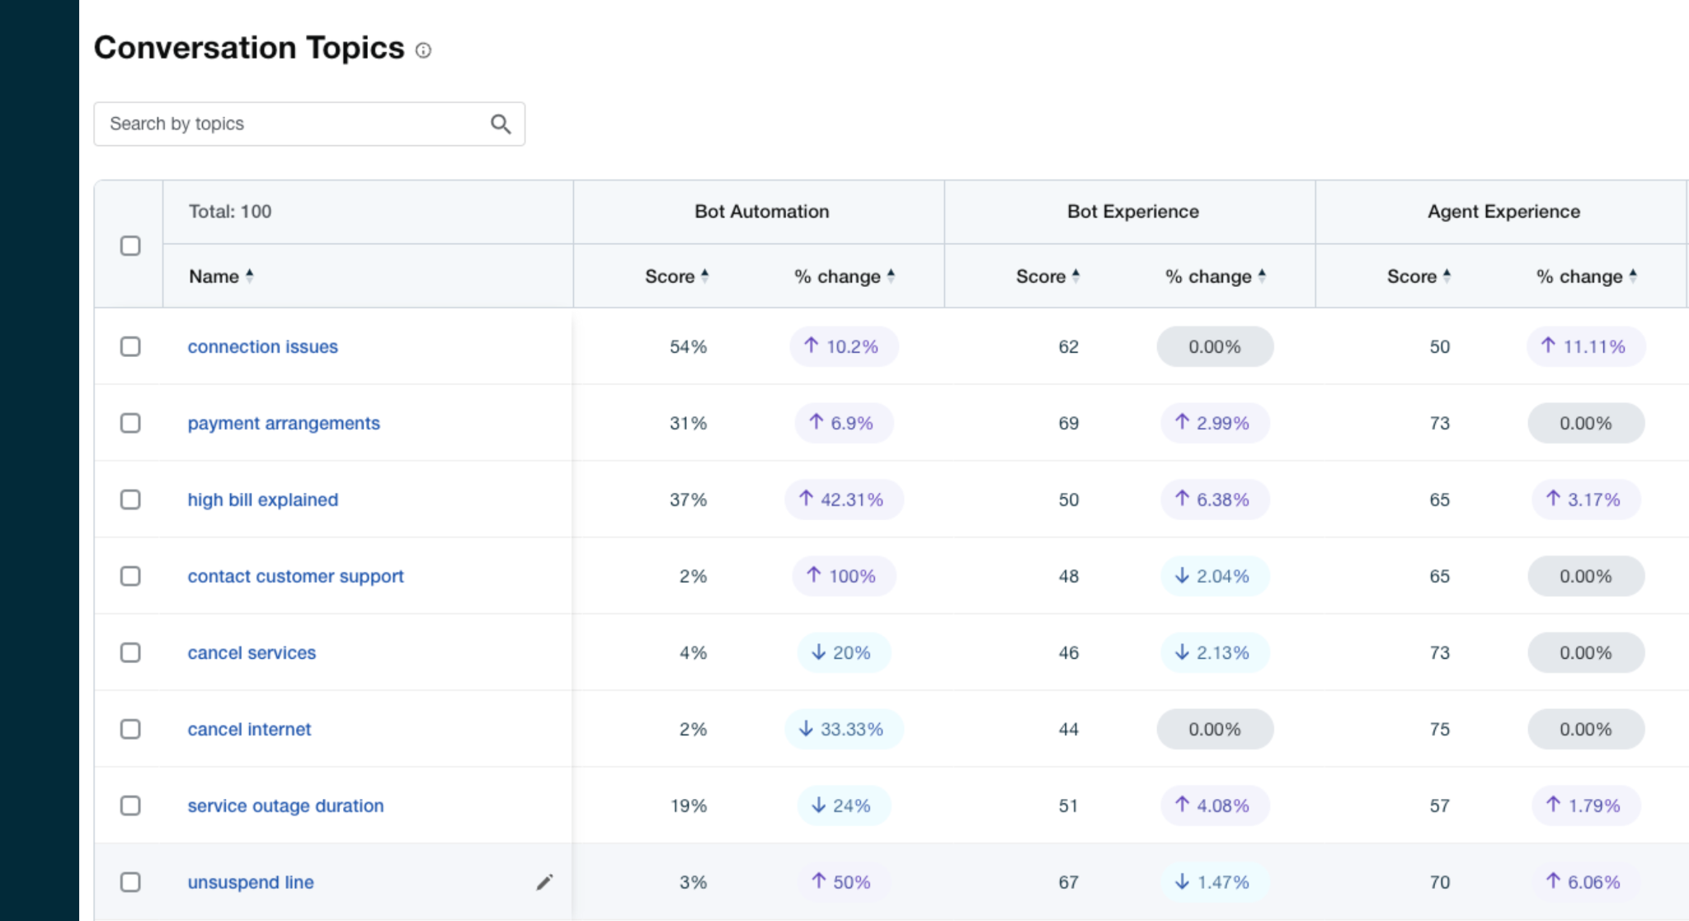
AI-classifier organizes conversations into topics
Notes:
Slide 3 - Introduce topics: 4 minutes
Top level/bottom level - (disposition codes, intents) Metrics weren’t actionable at either level
Topics is the goldilocks place in the middle, 100-150
AI can solve this problem
Slide 4 - Metrics by topic - 3 mins
When we focus on the right metrics, by topic, it makes things clear
Another AI technique - conversation analysis, allows us to show the key metrics by topic
Human agents are managed by disposition codes, virtual agents by intents, no intersection - you need one - topics
Windstream - now they can see real progress

Slide 10
Prioritize
01
What changes will have the biggest impact on automation & experience?
02
Volume by topic | High-handoff topics | Gap to bot average | Use transcripts to validate
03
If the impact is lower, move it to a later sprint

Slide 11

Implement
01
Make sure you are designing with analytics in mind - enable cloud logging (Dialogflow example); tagging
02
Roll out changes in low volume channels or small user groups
03
Measure performance changes to see if it’s having the right effect

Slide 12

Measure
01
Are you seeing the expected impact on automation & experience?
02
How do users feel about the changes?
03
Look at secondary metrics: Handle time, abandonment, paraphrasing, related topics, etc.

Slide 13

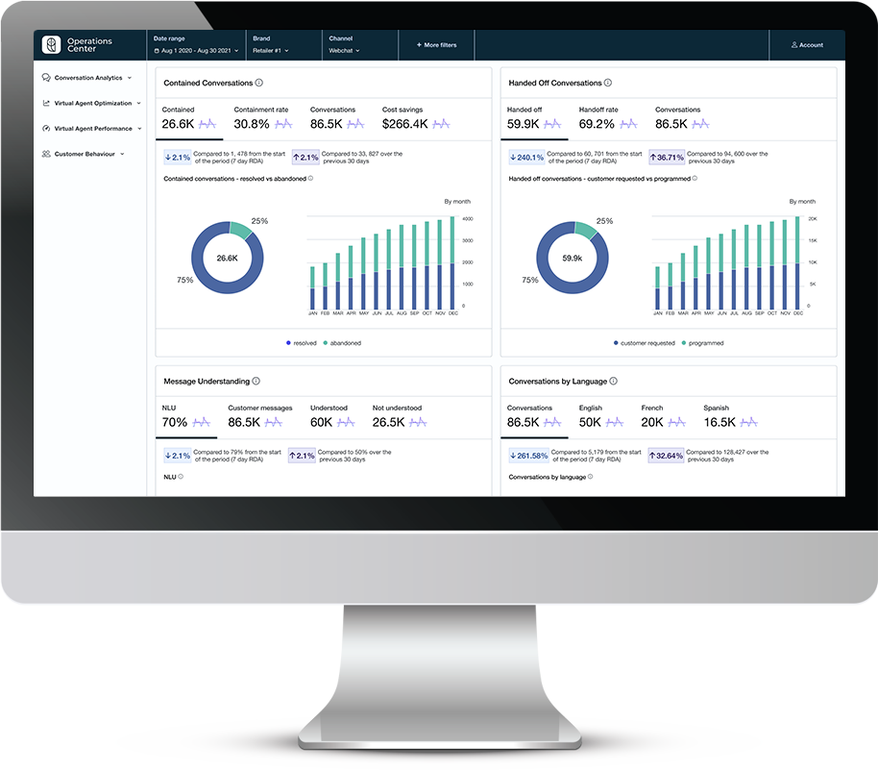
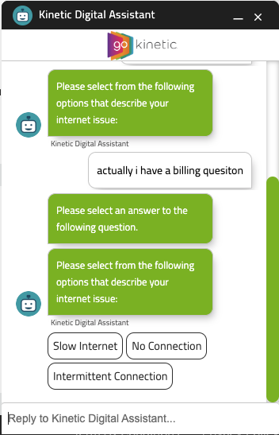
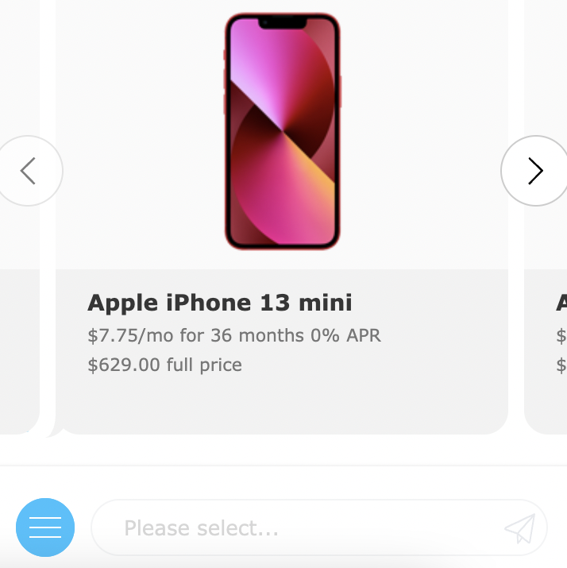
Customer success example
Challenge
Results
Client had an underperforming bot with no analytics or reporting, performance was subjectively poor
Increase in automation from 5% to 40%
Increase in CSAT from 45 to 73
Cost per automated conversation from over $16.50 to $1.70
Additional savings of $800k
Bot conversations up by 30%
Additional
Solution
$800k
OC was connected to bot & live agent conversation data
Improved conversational designs
Added auto-routing for new use cases
Improved classifier performance with corpus training
Added “smalltalk” module
Identified API failures leading to lower automation rates
Reduced number of auto-escalations
Content updates to late payment & autopay issues
annual savings
 | Before | After
Bot Automation Rate | 5% | 40%
Bot Experience Score | 45 | 73
Volume (monthly) | 55K | 70K
Cost ($/AC) | $16.50 | $1.70
Notes:
Here we have a real-life example, one of our customers in Telco.
They had no systematic process for managing bot performance. In fact, they had little in place for measuring performance or any organized way to upgrade the performance.

Slide 14
See the framework in action - Demo

Slide 15
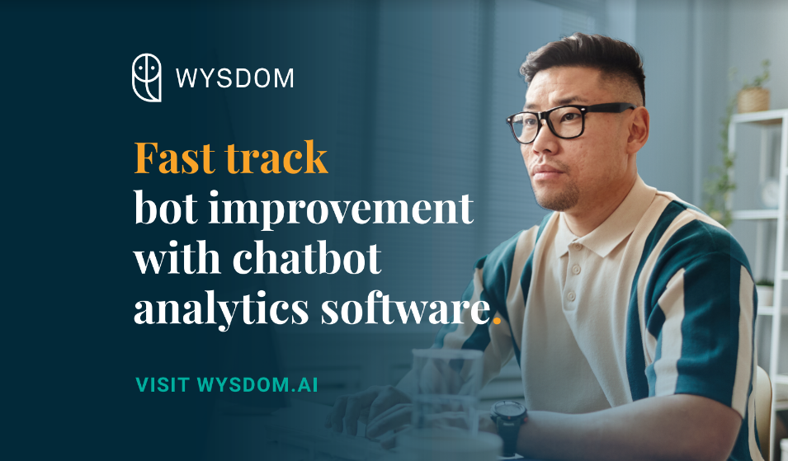

Find us at the show … and after!
Booth visit
# 416
Demo stage
Today @ 2:45
Webinar
Sep 13 @ 2:00 ET
wysdom.ai

Slide 16



www.wysdom.ai
sales@wysdom.ai
linkedin.com/company/wysdomai
Notes:
talking points:
so, that’s a wrap for me, hope you learned something today.
I wanted to invite you to check out our website, but more importantly, find us on LinkedIn search for Wysdom AI (Wysdom with a Y), and follow us.
The Team has been putting out a lot of content about bot analytics that you might find quite interesting. We’ve recently started a topic around LLMs talking about how ChatGPT, Bing and so on, about these latest trends.

