Slide 1

Welcome to our presentation
From chaos to clarity:
The 3 metrics you need
to prove chatbot performance

Slide 2

Agenda
Presenter
Meet Wysdom
Bot team challenges
3 cornerstone KPIs
Conversation topics
Case study example
Ian Collins
CEO, Founder @ Wysdom AI
ian.collins@wysdom.ai

Slide 3
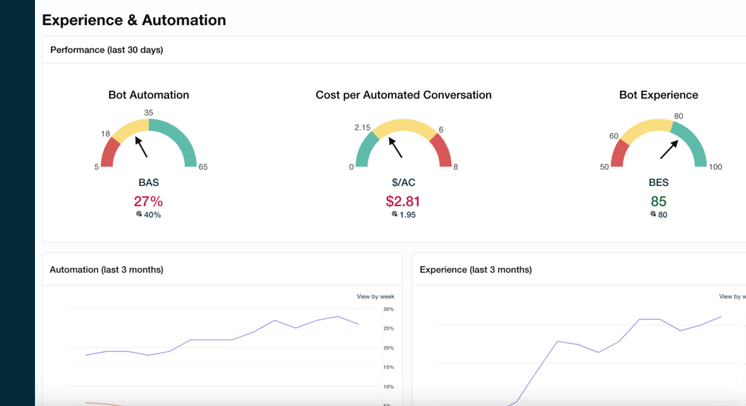







Fast track bot improvement with Wysdom
Chatbot
Analytics software
Chatbot
services
Dozens of
happy customers
Notes:
Talking points
Thanks for joining me today.
First a bit about us.

Slide 4
You launched your bot, now what?

Slide 5
The wrong focus
99%
1%
Pre-launch
preparation
Post-launch
operations
platform selection
use cases
conversation design
model training
monitoring
tuning
KPI reporting

Slide 6

After launch,
a bot needs ongoing care
Why is my bot making mistakes?
The topics keep changing!
What is the impact of my work?
Is the bot meeting our business goals?
Notes:
Once it’s launched - the challenge
It’s making mistakes, not solving customer problems, but where & why?
It’s not static, always changing, customers and products
Topics trend up and down - what can be automated - move to the bot; what should not be automated, push it right away to the agent
Random, unsynchronized Bot Management efforts
What is the impact? To what end
The end goal is unclear
Efforts are focussed on the technology

Slide 7
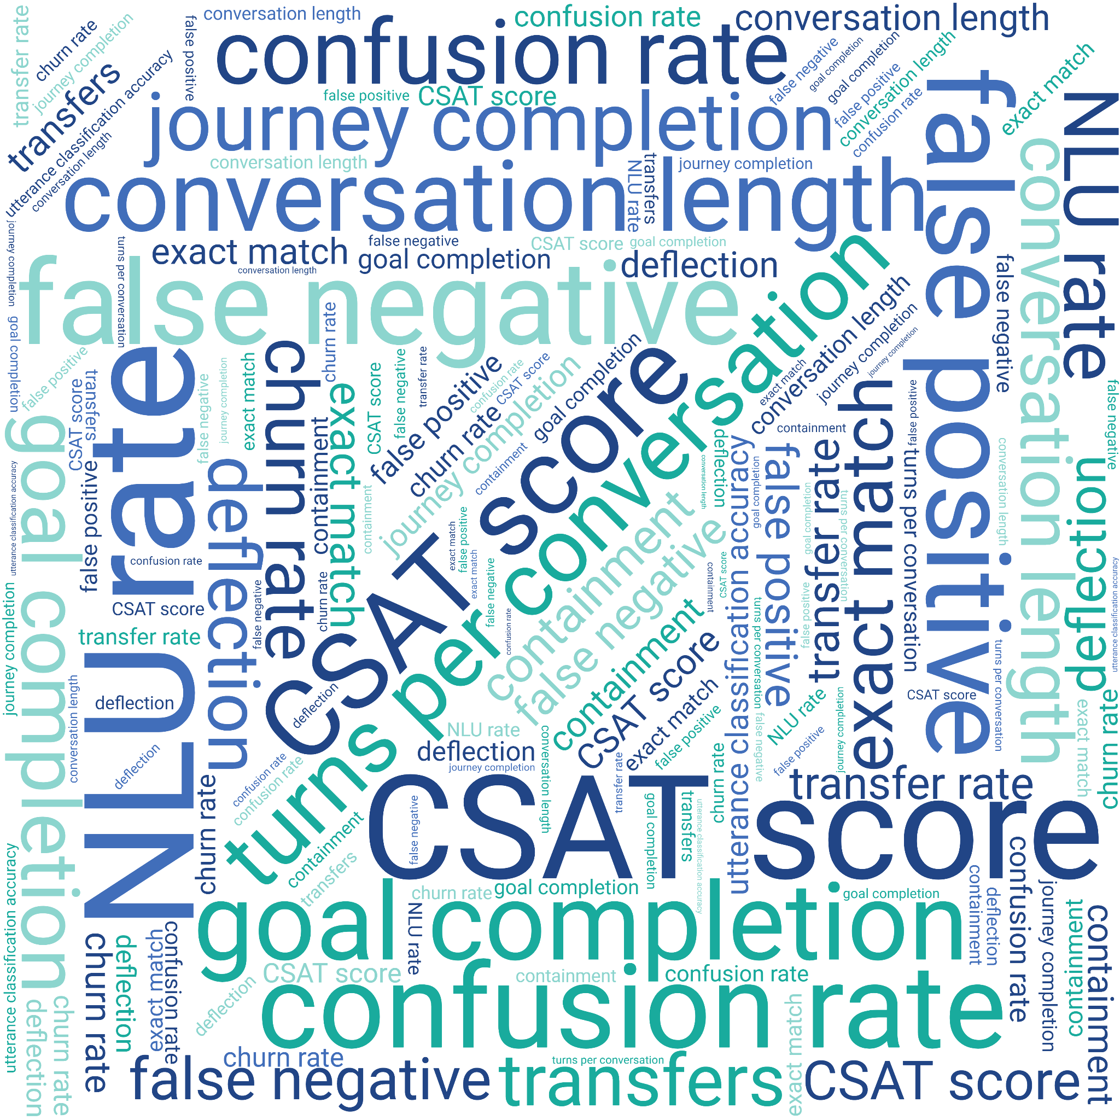
Don’t be
distracted by
technical
metrics

Slide 8
3 cornerstone KPIs
Bot automation
How often did the bot solve the customer problem
Notes:
At Wysdom, we believe that the key performance indicators that will show you how well your conversational bot is meeting business goals can be narrowed down to three cornerstone KPIs.
When we focus on these three business metrics, it makes it clear what needs to be done

Slide 9
3 cornerstone KPIs
Bot experience
Bot automation
What does the customer think about the interaction
How often did the bot solve the customer problem
Notes:
At Wysdom, we believe that the key performance indicators that will show you how well your conversational bot is meeting business goals can be narrowed down to three cornerstone KPIs.
When we focus on these three business metrics, it makes it clear what needs to be done

Slide 10
3 cornerstone KPIs
Cost per conversation
Bot experience
How much am I paying for each automated conversation
Bot automation
What does the customer think about the interaction
How often did the bot solve the customer problem
Notes:
At Wysdom, we believe that the key performance indicators that will show you how well your conversational bot is meeting business goals can be narrowed down to three cornerstone KPIs.
When we focus on these three business metrics, it makes it clear what needs to be done

Slide 11


How do I know what are my customers asking about?
≠
Intents
Disposition Codes

Slide 12
Conversation topics is the glue

Slide 13
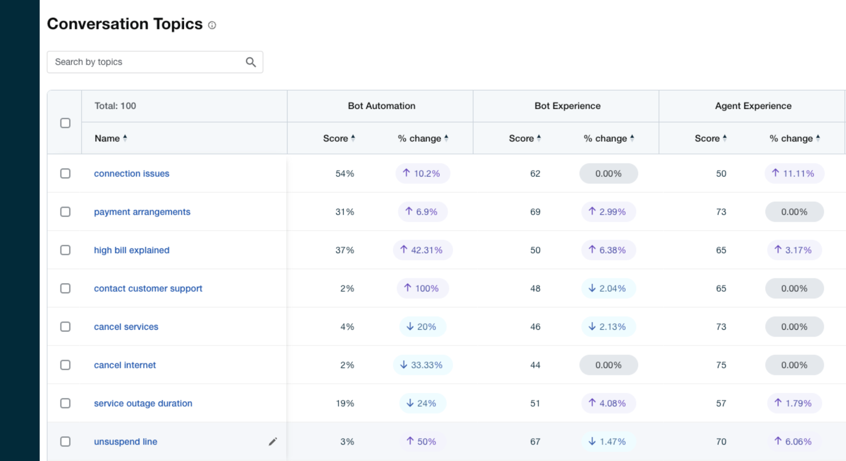
AI-classifier organizes conversations into topics
Notes:
Slide 3 - Introduce topics: 4 minutes
Top level/bottom level - (disposition codes, intents) Metrics weren’t actionable at either level
Topics is the goldilocks place in the middle, 100-150
AI can solve this problem
Slide 4 - Metrics by topic - 3 mins
When we focus on the right metrics, by topic, it makes things clear
Another AI technique - conversation analysis, allows us to show the key metrics by topic
Human agents are managed by disposition codes, virtual agents by intents, no intersection - you need one - topics
Windstream - now they can see real progress

Slide 14

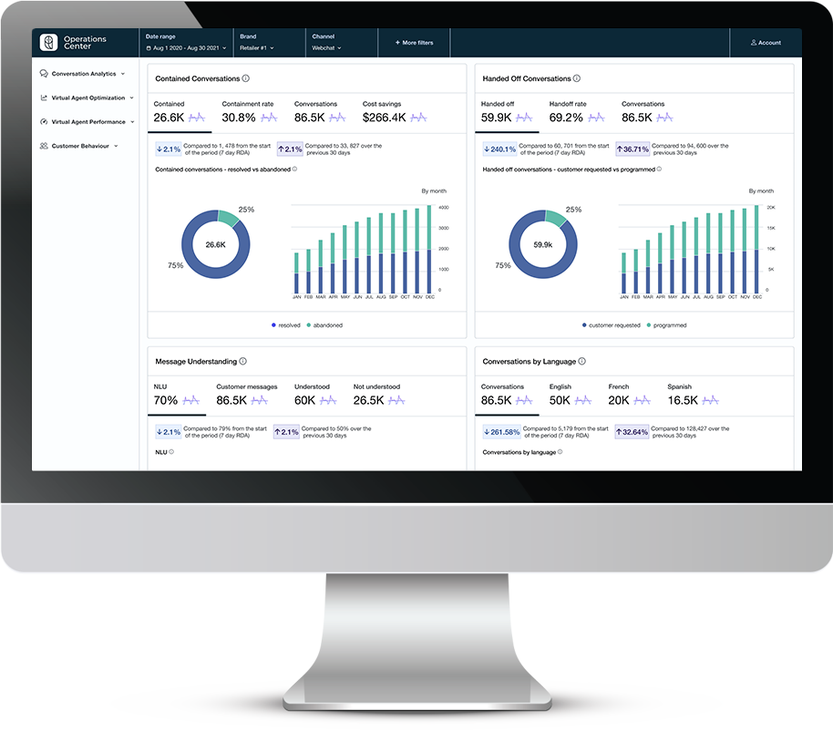
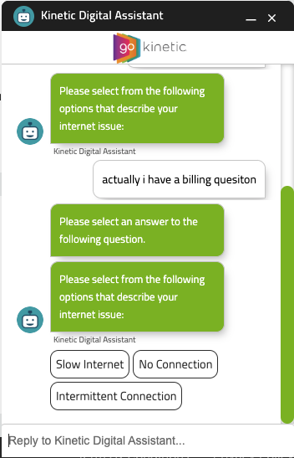
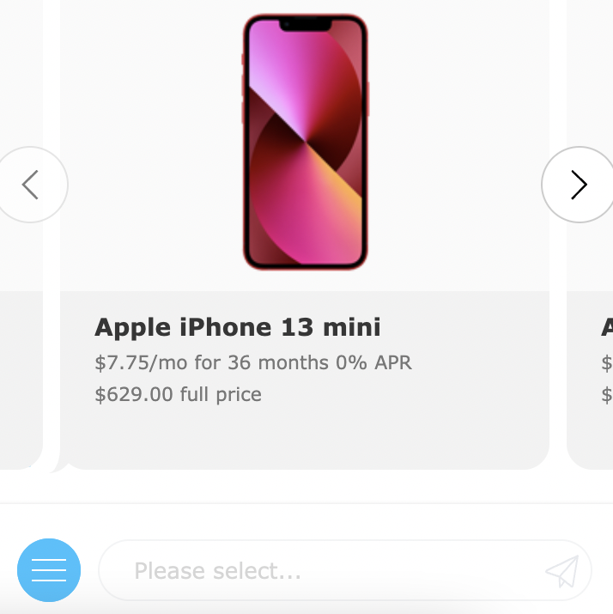
Customer success example
Challenge
Results
Client had an underperforming bot with no analytics or reporting, performance was subjectively poor
Increase in automation from 5% to 40%
Increase in CSAT from 45 to 73
Cost per automated conversation from over $16.50 to $1.70
Additional savings of $800k
Bot conversations up by 30%
Additional
Solution
$800k
OC was connected to bot & live agent conversation data
Improved conversational designs
Added auto-routing for new use cases
Improved classifier performance with corpus training
Added “smalltalk” module
Identified API failures leading to lower automation rates
Reduced number of auto-escalations
Content updates to late payment & autopay issues
annual savings
 | Before | After
Bot Automation Rate | 5% | 40%
Bot Experience Score | 45 | 73
Volume (monthly) | 55K | 70K
Cost ($/AC) | $16.50 | $1.70

Slide 15
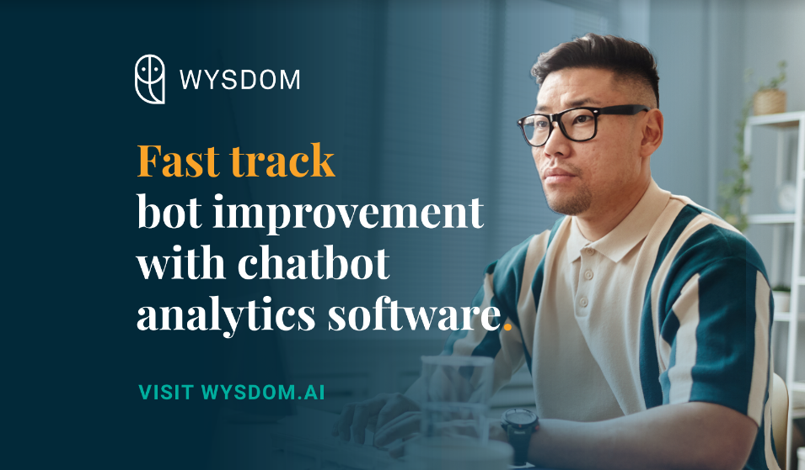
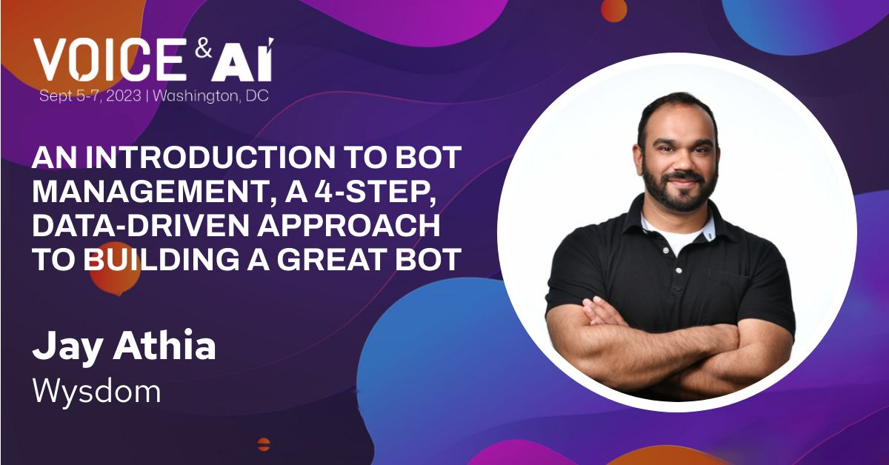

Find us at the show … and after!
Booth visit
# 416
Demo stage
Today @ 2:45
Classroom session
Today @ 4:00
Embassy Room
Webinar
Sep 13 @ 2:00 ET
wysdom.ai

Slide 16



www.wysdom.ai
sales@wysdom.ai
linkedin.com/company/wysdomai
Notes:
talking points:
so, that’s a wrap for me, hope you learned something today.
I wanted to invite you to check out our website, but more importantly, find us on LinkedIn search for Wysdom AI (Wysdom with a Y), and follow us.
The Team has been putting out a lot of content about bot analytics that you might find quite interesting. We’ve recently started a topic around LLMs talking about how ChatGPT, Bing and so on, about these latest trends.

Slide 17
https://www.gartner.com/en/newsroom/press-releases/2023-06-15-gartner-survey-reveals-only-8-percent-of-customers-used-a-chatbot-during-their-most-recent-customer-service-interaction
Slide 1 - Intro: 3 minutes
We work with hundreds of bot teams
  Their problem - focus is 99% building, 1% after launch - opposite of what’s needed
    They didn’t think about bot management until the problem was on top of them
    The metrics they’re using aren’t working
    They realized
      A virtual agent needs attention like a human agent, needs to be managed, coached, measured, reported on
      To show SLT and ROI - deliver regular reports
      To make it smarter
  Once it’s launched - the challenge
    It’s making mistakes, not solving customer problems, but where & why?
    It’s not static, always changing, customers and products
    Topics trend up and down - what can be automated - move to the bot; what should not be automated, push it right away to the agent
  Random, unsynchronized Bot Management efforts
    What is the impact? To what end
    The end goal is unclear
    Efforts are focussed on the technology
Too much emphasis on technical results, need to shift the focus to business results - afterall, that’s why you invested in Conversational AI to begin with: keep your customers happy, use automation to get them information they are looking for, and keep costs down
Slide 2 (animation) - the metrics: 2 minutes each (6 minutes)
When we focus on business metrics, it makes it clear what needs to be done
Slide 3 - Introduce topics: 4 minutes
Top level/bottom level - (disposition codes, intents) Metrics weren’t actionable at either level
Topics is the goldilocks place in the middle, 100-150
AI can solve this problem
Slide 4 - Metrics by topic - 3 mins
When we focus on the right metrics, by topic, it makes things clear
Another AI technique - conversation analysis, allows us to show the key metrics by topic
Human agents are managed by disposition codes, virtual agents by intents, no intersection - you need one - topics
Windstream - now they can see real progress
Slide 5 - closer - 3 mins - The future is a single contact centre with a combination of human and virtual agents
They will all be managed by a single dashboard joined by topics
See our classroom session - we show you how we go about it - the bot management playbook we’ve perfected over the years - See our demo - in action
Come to the booth 1:1
Abstract
All too often, companies launch a chatbot without any plan in place to manage and grow its performance. Shortly after going live however, they realize they lack the data, insights, and plan, that they need to improve the quality and demonstrate the true value the bot brings to the business.
In this session we help you cut through the noise of false metrics, like containment, NLU rate, CSAT and more, and share the true KPIs that you need to improve performance, and show the business impact of Conversational AI.

