Slide 1
Impacts of Digital Humans on Voice and Chat Interactions
Gillian Eiserman
Conversation Designer @ General Motors

Slide 2
Table of Contents
01
Introduction
03
Considerations
02
Impacts
Saying hi and laying some groundwork.
Learn from my mistakes. Please.
How Digital Humans can impact experiences.

Slide 3
01
Introduction

Slide 4
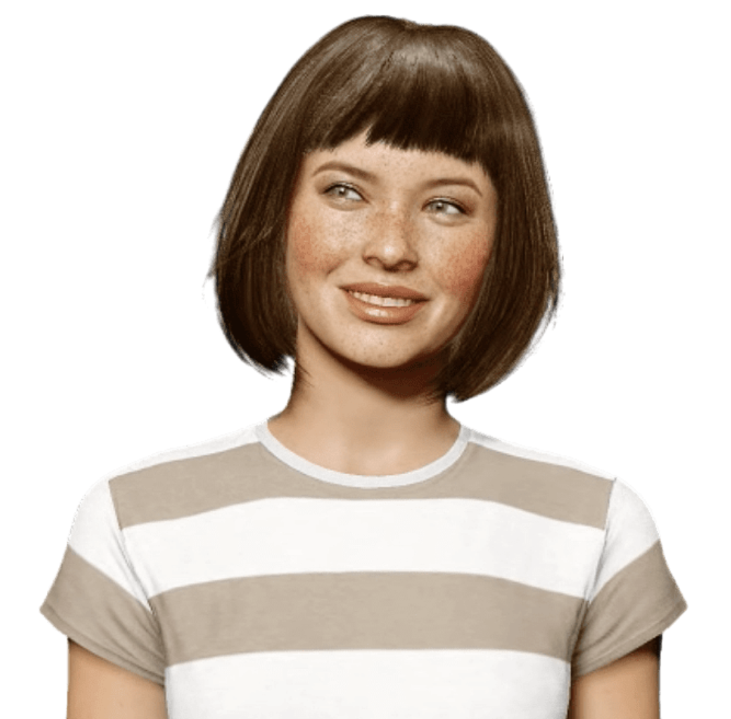
Digital Humans: An Overview
Digital Humans are human-like digital avatars that can interact using life-like expressions and gestures, capitalizing on verbal and non-verbal communication.
They humanize virtual interactions and can often give users a more comfortable, personalized experience.

Slide 5
By the Numbers
$29.51
$561.16
34.2%¹
billion¹
billion¹
Market size in 2022
Revenue forecast 2032
Compound annual growth rate
¹https://www.emergenresearch.com/industry-report/digital-human-avatar-market

Slide 6

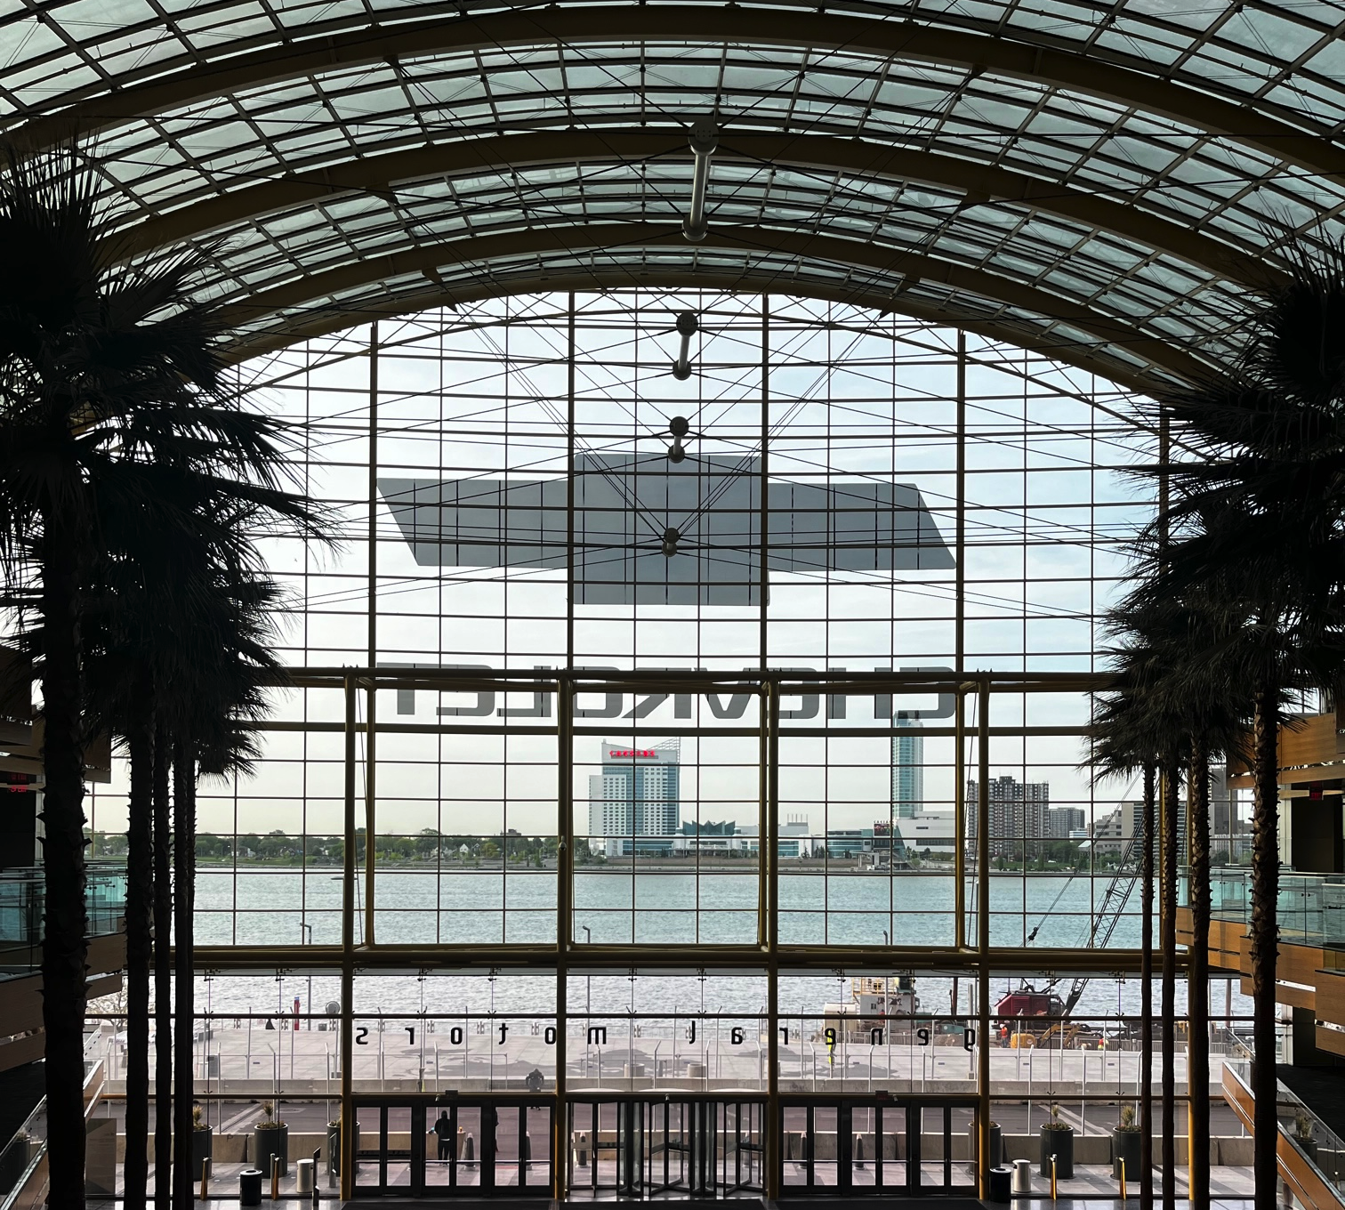
Hi, hello, how are you?
Currently a Conversation Designer at General Motors leading chat experiences and Digital Human explorations.
Background in Software Engineering and QA before transitioning to UX and finding Conversation Design.

Slide 7
02
Impacts

Slide 8

Bringing a Brand to Life
Digital Humans are a much more visual embodiment than voice and chat channels usually have and can bring the brand to life.

Slide 9
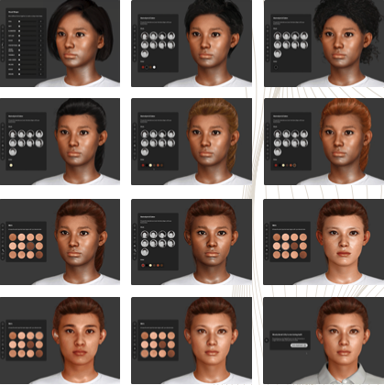
Bringing a Brand to Life
You can control everything from their outfit to the amount of freckles to prosody in certain phrases - so you can truly embody your brand.
The impact of Digital Humans on branding cannot be understated and needs to be done with care so it strengthens the experience instead of being at odds with it.

Slide 10
Engaging the User
Research shows that as humans, we find conversations with another person’s face more engaging than without¹. This means that digital humans can help drive user engagement and make the experience more impactful.
¹http://up.csail.mit.edu/other-pubs/las2014-pguo-engagement.pdf

Slide 11
Engaging the User
Having a digital human can make the conversation seem more personal, especially if they are able to respond to visual and verbal cues from the user.
This helps to build trust with the experience and the brand.

Slide 12
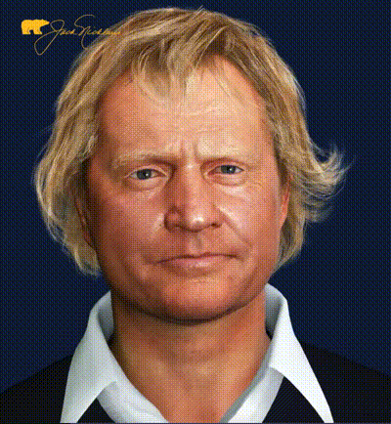
Lag and Processing
Agent is typing…
*crickets*
In chat and voice, small amount of lag is normal and users are often used to it
But when face-to-face with a digital human, it’s more apparent and unnerving

Slide 13
03
Considerations

Slide 14
Digital Human Considerations
Multiple Digital Humans
Persona
Create or audit your persona before you create your digital human to save yourself time.
Consider multiple embodiments to give users more choice and diversity.

Slide 15
Usage Considerations
Urgency
Modality
Consider low-stakes use cases such as looking up product info or introducing a product instead of.
Keep in mind the space you’ll need for your digital human as well as any buttons, transcripts, etc.

Slide 16
User Considerations
Make sure to take into account how receptive your users are to new technology - you want user who will be primed to accept and respond to digital humans.

Slide 17

Thanks
Let’s connect!
gmeiserman@gmail.com
www.linkedin.com/in/gillian-eiserman
gm.com
Please keep this slide for attribution

