Slide 1
Detection and Prevention
Watermark
A watermarker is a tool that adds a digital watermark to an audio clip which can be used to identify the source of the clip.
Liveness component in voice biometric detection software. Synthetic voices are not real so need to be played back.
Implementing on-device solutions where voice is captured at a 16kHz sampling rate
Transmitting the voice to servers in a lossless 16kHz format
2
Notes:
Manipulation and Coercion, erosion of trust

Slide 2

Shallow Dive into Deepfakes
An Intro to Addressing New Security Threats to Voice Biometrics
September 6, 2023
Voice&AI Sponsor

Slide 3
Table of contents
Introduction
What Are Voice Deep Fakes?
Real-World Applications
Ethical and Legal Concerns
Detection and Prevention
Q&A
2

Slide 4
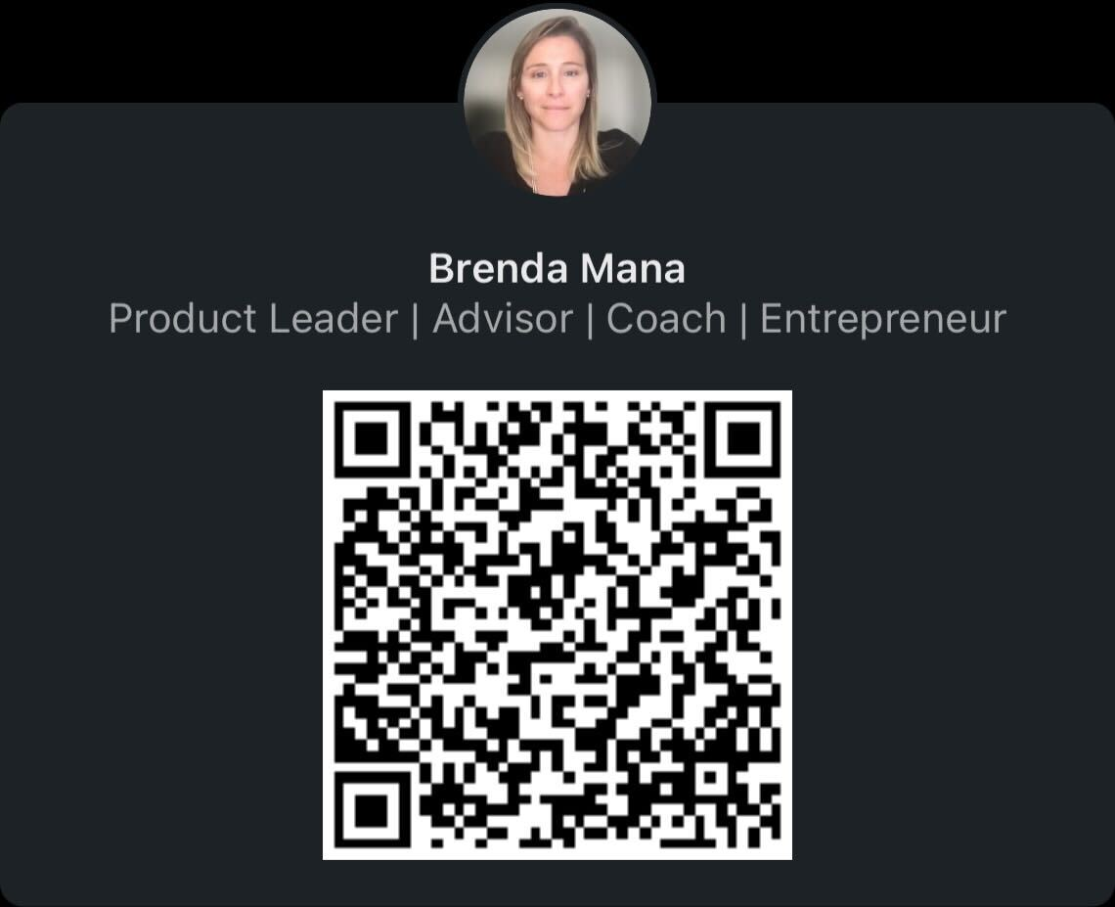
Introduction
Brenda Mana
Product Management Director, Voice Biometrics
bmana@idrnd.net
Connect, let me know you were here ————>
Topic Relevance
Voice deepfakes have the potential to disrupt society:
Mis & Disinformation
Identity Theft
Privacy Concerns
Manipulation, Coercion
Security & Ethical Threats
Legal Issues
2

Slide 5
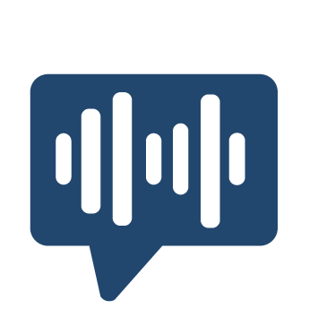

What Are Voice Deep Fakes?
Voice cloning, voice mimicry or voice deepfake is the creation of an artificial simulation of a person's voice. A synthetic fabrication of someone’s voice.
Video or image deepfake is the creation of alter existing footage or create entirely synthetic one that mimic the appearance and movements of real people.
2
Notes:
Voice deepfakes typically employ techniques like text-to-speech (TTS) synthesis and voice cloning to replicate a person's voice patterns and intonation
Video deepfakes are often associated with creating misleading or deceptive content, such as fake news, malicious impersonation, or altering historical footage.

Slide 6
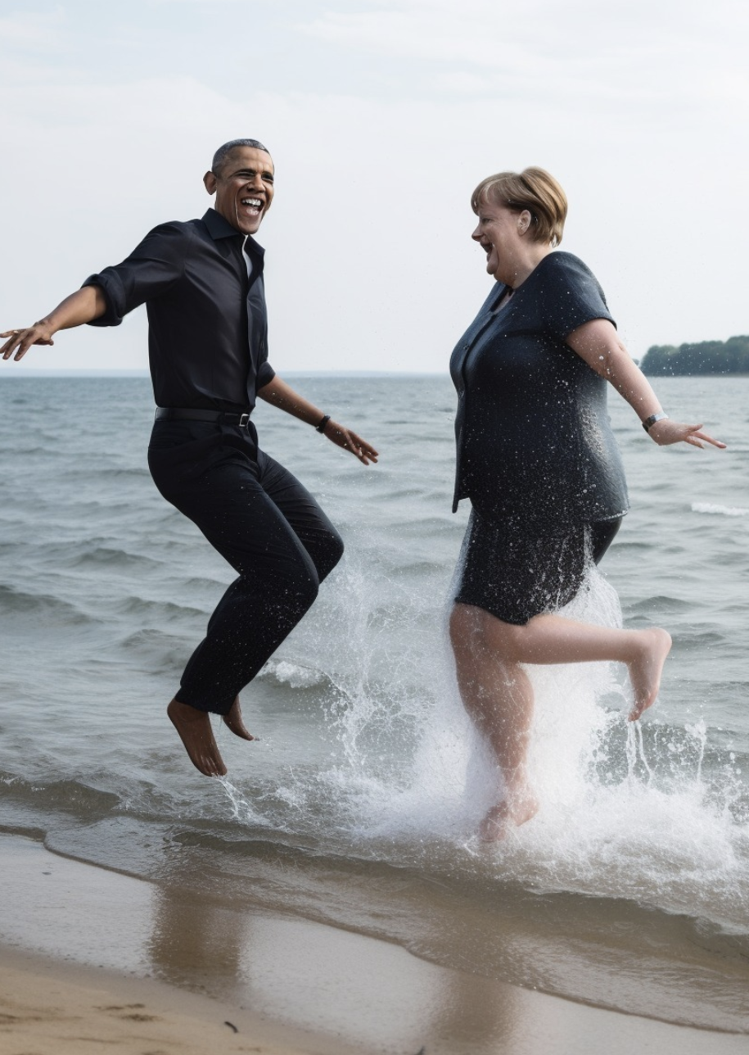
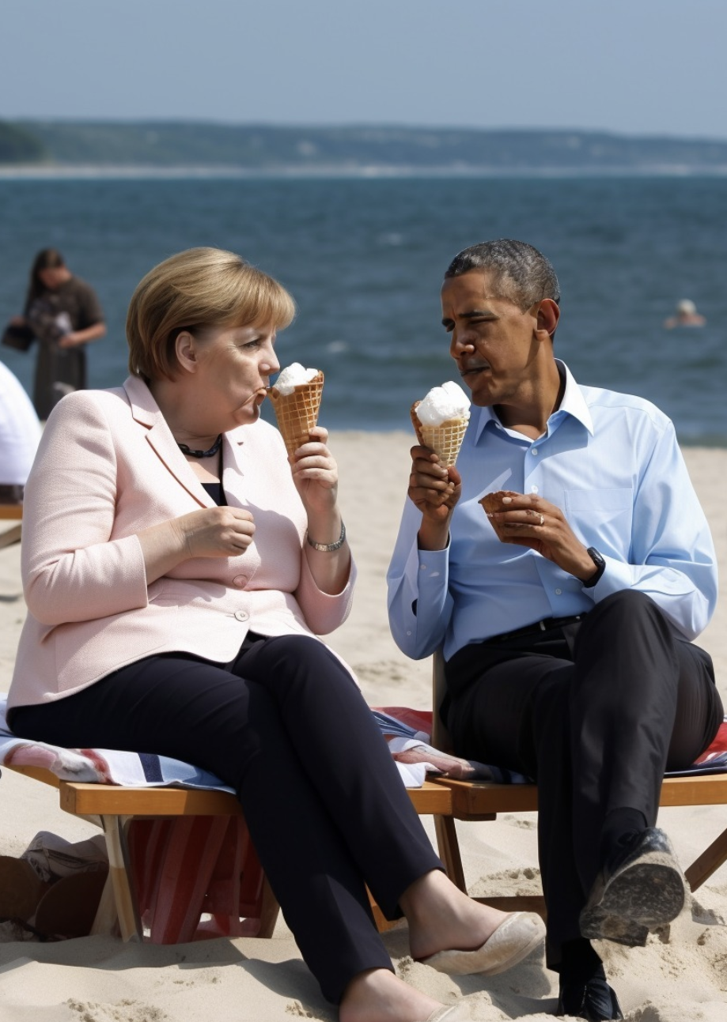
Real-World Applications
2

Slide 7
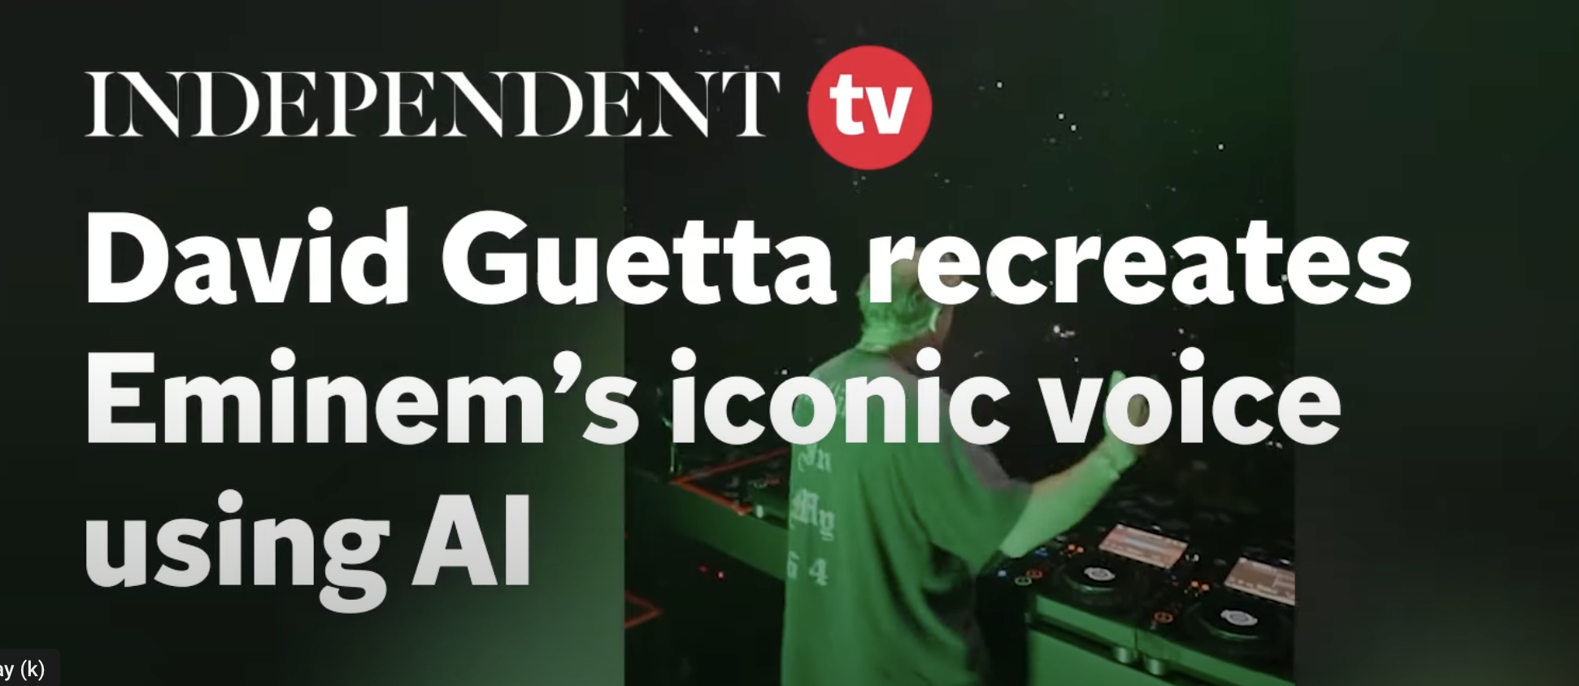
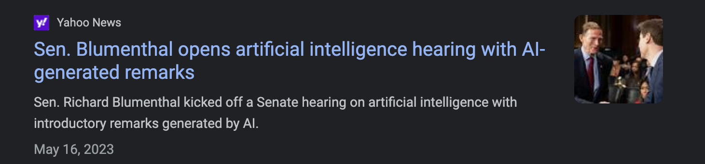
Real-World Applications
2

Slide 8

Real-World Applications
Which one is cloned vs real?
Can you tell them apart?
2

Slide 9
Ethical and Legal Concerns
Privacy Concerns: Individuals' voices can be cloned without their consent, leading to potential breaches of personal privacy and security.
Identity Theft: Fraudsters can impersonate someone's voice to gain access to sensitive information, commit financial crimes, or manipulate others into taking certain actions.
Security Threat: By getting access to secure systems or facilities, national security and cybersecurity.
Legal Issues: Copyright infringement, usage type and time related consent.
2
Notes:
Manipulation and Coercion, erosion of trust

Slide 10
Detection and Prevention
Fast evolving ecosystem, multiple cloning engines launched just in 2023
Examples of Platforms requiring voice consent
Professional Voice Cloning from ElevenLabs
Resemble.ai
Speech Classifier tools available to identified cloned audio free and paid
2
Notes:
Manipulation and Coercion, erosion of trust

Slide 11
Detection and Prevention
Watermark
A watermarker is a tool that adds a digital watermark to an audio clip which can be used to identify the source of the clip.
Liveness component in voice biometric detection software. Synthetic voices are not real so need to be played back.
Implementing on-device solutions where voice is captured at a 16kHz sampling rate
Transmitting the voice to servers in a lossless 16kHz format
2
Notes:
Manipulation and Coercion, erosion of trust

Slide 12
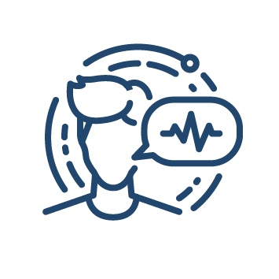


Q&A
12

Slide 13
Thank you for coming!
Let’s connect!
Brenda Mana
Product Management Director, Voice Biometrics
ID R&D
bmana@idrnd.net
2

