Slide 1

Harnessing Your Organization's Productivity From Day One With Enterprise-Ready Tools
Andrew Weiss
Field CTO, Public Sector | GitHub
Notes:
Hello! And welcome to GitHub Enterprise Platform: the AI-powered developer platform, globally available, secure by default.

Slide 2




The GitHub experience
A single integrated enterprise-ready platform
Security at
every step of
the workflow
Industry-best collaborative tools for developers
Powered
By AI
Notes:
How do we help you unlock these benefits? By offering a single integrated, enterprise-ready platform with industry best collaborative tools, security features wrapped in every step of the development process, and the power of AI supercharging every interaction so your developers can move quickly, efficiently, and confidently.

Slide 3


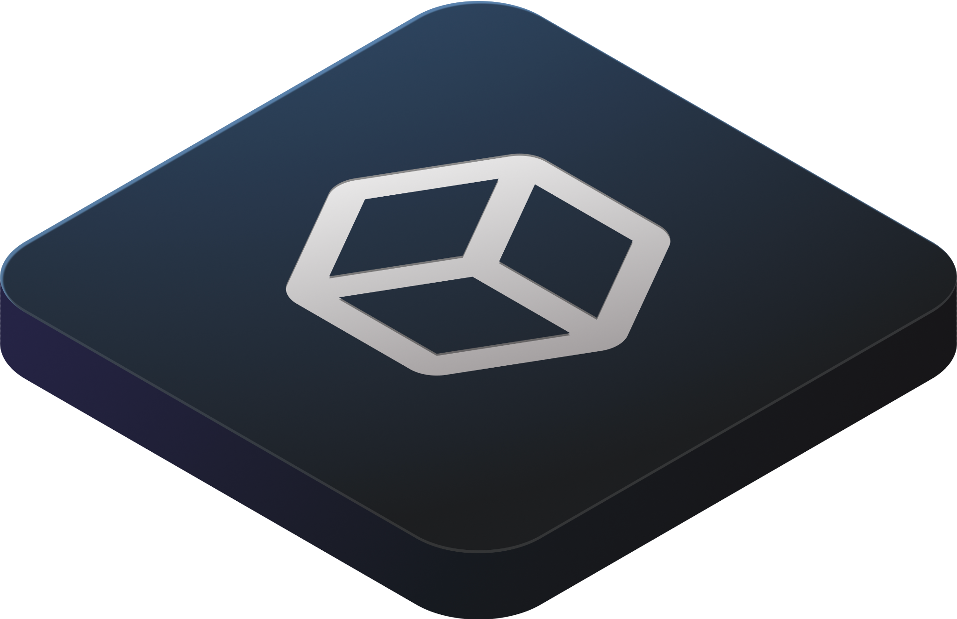

Powered by AI
Collaboration
The AI Powered Developer Platform to Build, Scale, and Deliver Secure Software
Productivity
Security
Integrations & APIs
Scale
Notes:
Meet the GitHub Enterprise Platform. The GHE platform is comprised of four layers–scale, collaboration, productivity, and security–with every layer powered by AI. This streamlined, time-tested platform is purpose-built to provide a seamless experience for your developers. WIth built-in integrations and APIs, GHE is ready to meet your business where you’re at, and prepare you for the future.
Let’s walk through each layer of the platform.

Slide 4




75% of developers are more fulfilled
Copilot enables faster coding by 55%
20,000+ businesses have used it
46% of code
is written with the help of Copilot
More than
1M developers
Notes:
Generative AI is dramatically transforming software development as we speak. And we’re excited to lead the way for developers and organizations around the world.
AI will be upleveling collaboration through AI-powered pull requests and issues, productivity through Copilot, and security by automating security checks faster.

Slide 5

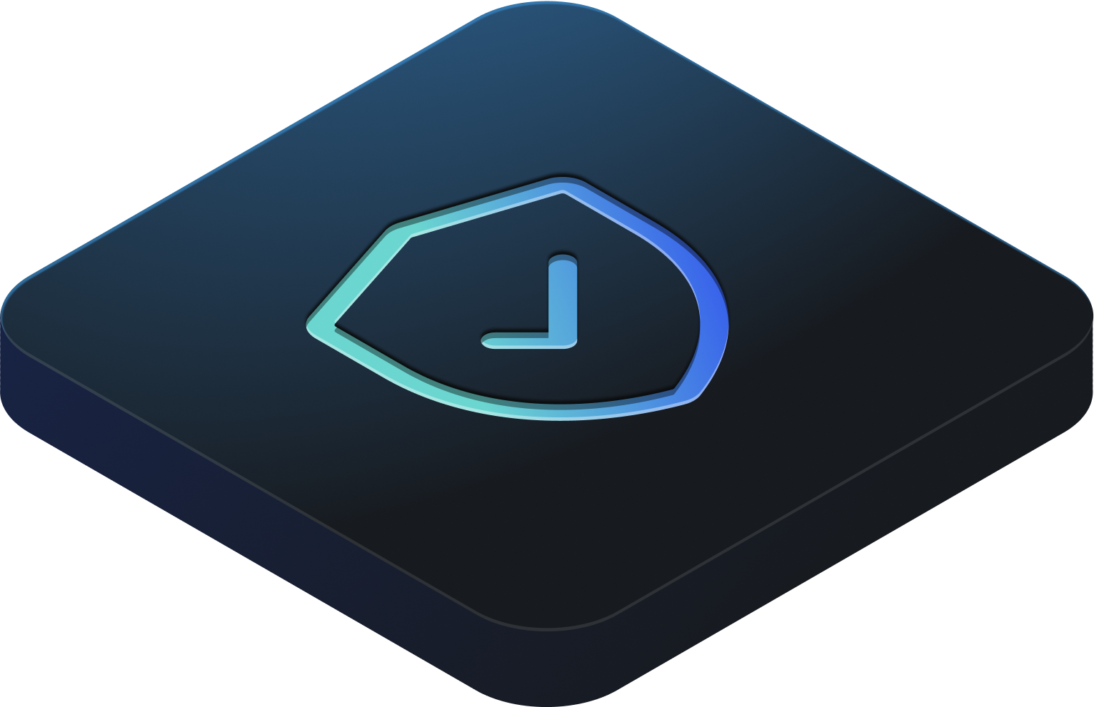
Security
Native, first party security by design to fix issues in minutes, not months.
Reduce risks
Seamless management
Security policy creation and enforcement
Secure your development environments
Reduce time spent on remediation, resulting in savings of USD 5.2 million
Admin controls
and management
Embed security
in your developer workflow
Prevent code vulnerabilities in production
Native Application Security Capabilities
Notes:
GitHub Enterprise focuses on integrating security directly into the development process from the start. With increased need to protect the entire software lifecycle by building enterprise-grade compliance and governance standards into your process from code to cloud, developers need to keep security top of mind. GitHub Enterprise includes native, first-party security features that minimize security risk with a built-in security solution. You have traceability with rich data visibility and identity control with Enterprise Managed Users. Plus, your code remains private within your organization, and at the same time you are able to take advantage of security overview and Dependabot.
Furthermore, GitHub has continued to make investments to ensure that our features are enterprise-ready. We’re backed by Microsoft, trusted by highly regulated industrues, and meet compliance requirements globally. We provide a secure, compliant platform without sacrificing speed and that’s why we say: GitHub Enterprise is secure by design.

Slide 6




AI-powered development journey
Challenges
Strategies
Success criteria
Implementation
Organizational challenges GitHub Copilot can help address
GitHub Copilot use cases and strategies for adoption
Potential productivity gains
GitHub as a strategic partner

Slide 7



Software is hard
Technical debt
Burden imposed to manage application code continues to accumulate
Knowledge management gaps
Existing codebases not as well understood
App and data silos
Complex system integrations that are difficult to dissect

Slide 8



Benefits of AI in software development
Reduce monotonous tasks
Project scaffolding, unit testing, code duplication
Employ idiomatic techniques
Write idiomatic code from the outset
Understand existing code
Gain a better understanding of existing codebases and documentation

Slide 9
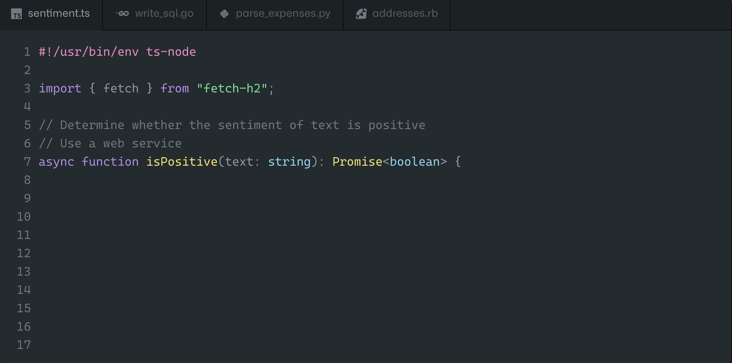
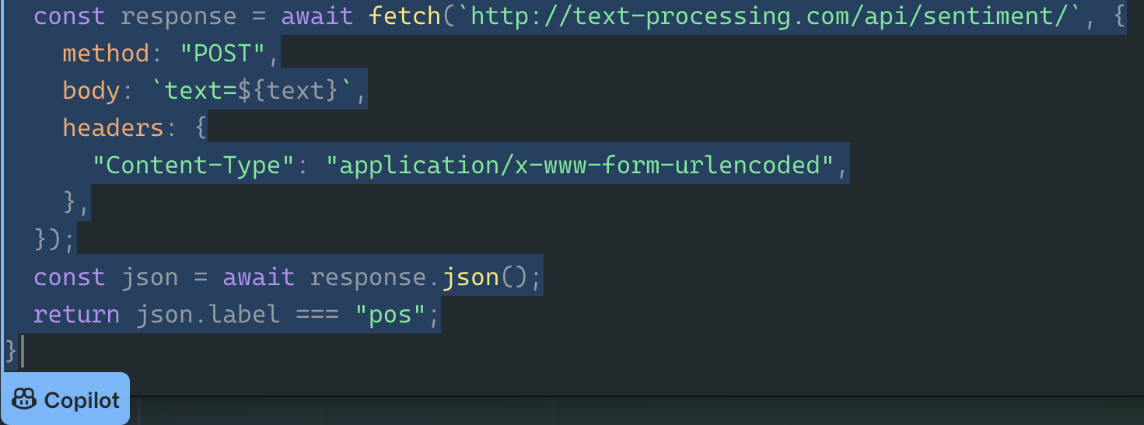
Appendix / Products & Features
Copilot
Your AI pair programmer.
Uses the context you’ve provided and synthesizes code to match.
Convert comments to code
Autofill for repetitive code
Autosuggest tests
Show alternatives
Notes:
Copilot slide deck
Uses the context you’ve provided and synthesizes code to match
Convert comments to code: describe the logic you want, and let Copilot assemble the code for you
Autofill for repetitive code: quickly produces boilerplate and fills in repetitive code patterns
Autosuggest tests: import a unit test package and Copilot will suggest tests that match your implementation code
Show alternatives: show a list of solutions to use as provided, or edit to meet your needs

Slide 10


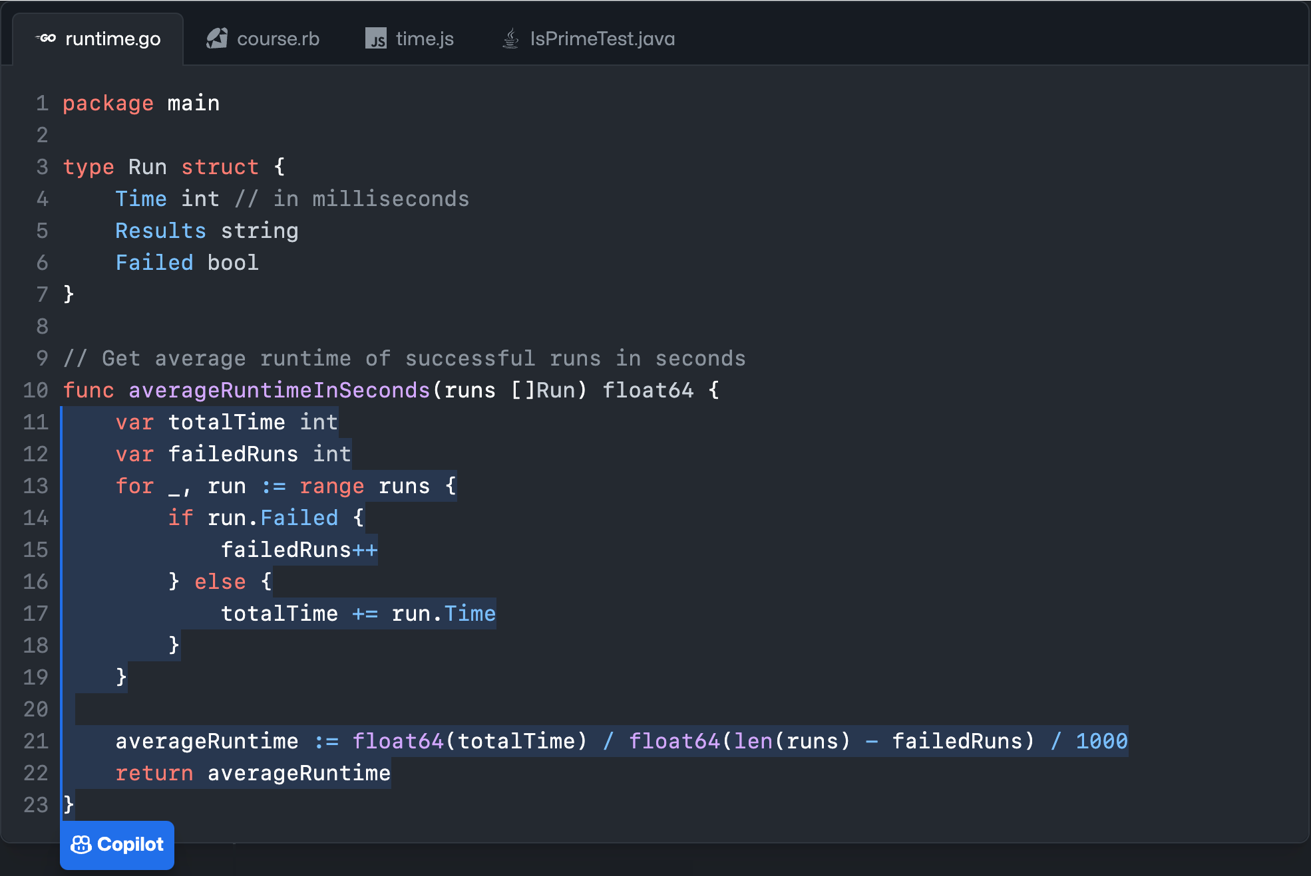



Once enabled…
Context
Suggestions
OpenAI GPT-3.5 Turbo Derivative
Notes:
The Copilot extension requests a completion (sending some context code from the file the user is editing and potentially other related files). This request goes to the Copilot Proxy.
The Copilot Proxy does some post-processing on the request/response, retaining them in memory only while the request is ongoing.
The Copilot Proxy calls out to the model running in the Azure Intelligence Platform, which streams the generated completions back.
The Copilot Proxy computes hashes of the code completions and checks if those hashes exist in the Snippy database (which contains hashes of publicly visible code snippets). Completions whose hashes are in the Snippy database can be filtered out to not be shown to users.
Completions are sent back in the response to the Client.

Slide 11
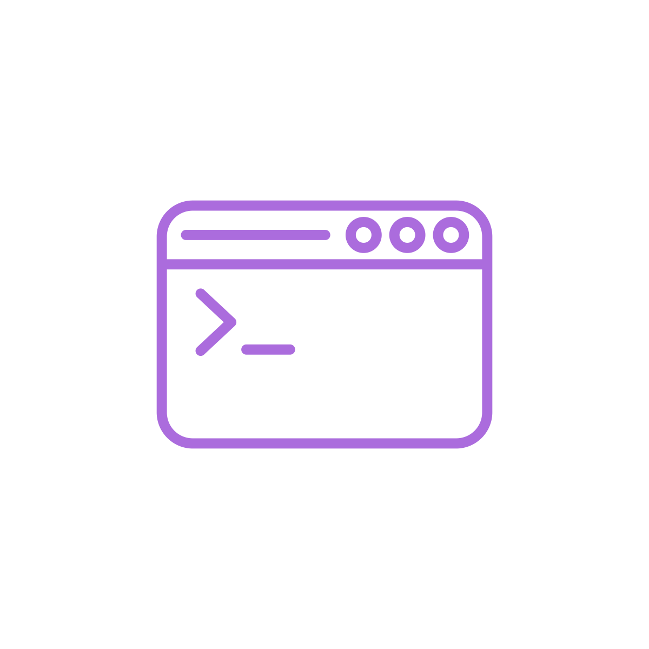



CODE EDITOR
PROXY
MODEL
Toxicity
Code classifier
Notes:
Read the talk track here.

Slide 12
CODE EDITOR
PROXY
MODEL
PII
Toxicity
Code classifier
Code quality
Duplicate detection

Slide 13
Ubiquitous
Personalized
Conversational
Trusted
Notes:
Ubiquitous: we started in the code editor, now bring it to the SDLC
Personalized: bring the full context of your organization’s code to every suggestion
Conversational: we’re placing a big bet on chat
Trusted: you can

Slide 14
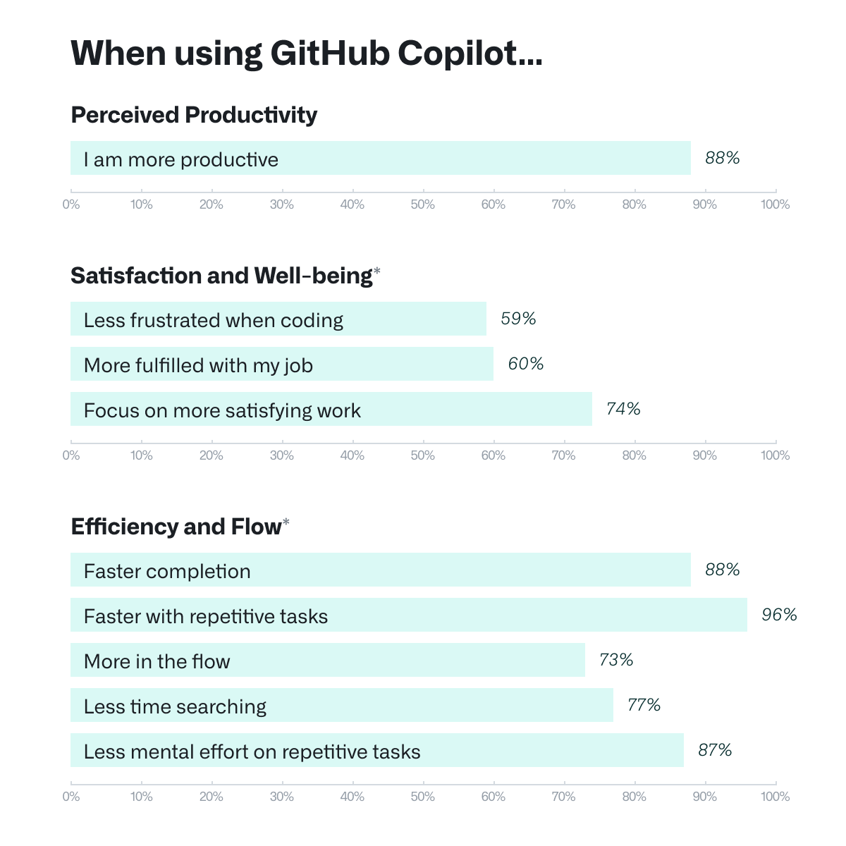
Proof Points
More than 2,000 developers surveyed
What value does it represent?
Notes:
The >2,000 responses we received came from developers that were signed up in the Technical Preview. They were primarily professional developers (~60%), though we also received responses from students (~30%), and developers who identified as hobbyists (~7%).
Finding 1: Developer productivity goes beyond speed
Through a large-scale survey, we wanted to see if developers using GitHub Copilot see benefits in other areas beyond speeding up tasks. Here’s what stood out:
Improving developer satisfaction. Between 60–75% of users reported they feel more fulfilled with their job, feel less frustrated when coding, and are able to focus on more satisfying work when using GitHub Copilot. That’s a win for developers feeling good about what they do!
Conserving mental energy. Developers reported that GitHub Copilot helped them stay in the flow (73%) and preserve mental effort during repetitive tasks (87%). That’s developer happiness right there, since we know from previous research that context switches and interruptions can ruin a developer’s day, and that certain types of work are draining
The takeaway from our qualitative investigation was that letting GitHub Copilot shoulder the boring and repetitive work of development reduced cognitive load. This makes room for developers to enjoy the more meaningful work that requires complex, critical thinking and problem solving, leading to greater happiness and satisfaction.

Slide 15
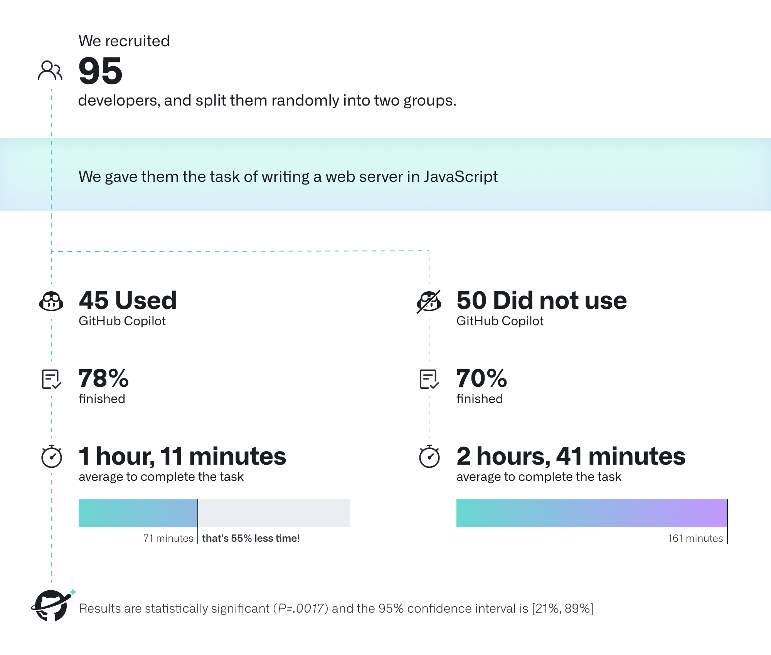
Proof Points
More than 2,000 developers surveyed
What value does it represent?
Notes:
Finding 2: … but speed is important, too
In the survey, we saw that developers reported they complete tasks faster when using GitHub Copilot, especially repetitive ones. That was an expected finding (GitHub Copilot writes faster than a human, after all), but >90% agreement was still a pleasant surprise. Developers overwhelmingly perceive that GitHub Copilot is helping them complete tasks faster—can we observe and measure that effect in practice? For that we conducted a controlled experiment.
The group that used GitHub Copilot had a higher rate of completing the task (78%, compared to 70% in the group without Copilot).
The striking difference was that developers who used GitHub Copilot completed the task significantly faster–55% faster than the developers who didn’t use GitHub Copilot. Specifically, the developers using GitHub Copilot took on average 1 hour and 11 minutes to complete the task, while the developers who didn’t use GitHub Copilot took on average 2 hours and 41 minutes. These results are statistically significant (P=.0017)
In our research, we saw that GitHub Copilot supports faster completion times, conserves developers’ mental energy, helps them focus on more satisfying work, and ultimately find more fun in the coding they do.
Read more in this blog post: https://github.blog/2022-07-14-research-how-github-copilot-helps-improve-developer-productivity/

Slide 16
Let’s demo!

Slide 17
GitHub Copilot brings value to any coding scenario …

Slide 18
GitHub Copilot use cases
Tackle legacy code
Automate infrastructure
DevSecOps foundation
Take advantage of modern, cloud-native programming languages
Automate provisioning of infrastructure and cloud resources
Establish a secure pipeline for testing and deployment

Slide 19

Write safer code with GitHub Copilot*
CodeQL
Provide context to address vulnerable code paths
*Always follow sound code review practices when using Copilot as one would for any other code

Slide 20



Make DevSecOps the default
Quickly craft CI/CD pipelines
Leverage GitHub Copilot for recommending CI/CD pipeline configurations for a given codebase
Migrate from legacy tools
Use GitHub Copilot to migrate from legacy CI/CD systems to GitHub Actions
Write more secure code
Secure your code by combining GitHub Copilot with GitHub Advanced Security

Slide 21
Reimagine knowledge management
Accelerate onboarding
Boost morale
Gain an understanding of existing codebases and docsets with Copilot for Docs
Improve developer satisfaction and conserve mental energy
Improve discoverability and reuse
Standardize information management
Make “innersource” more tangible within the organization
Enhance documentation and bridge knowledge gaps

Slide 22
And works regardless of where your code resides

Slide 23
But it remains important to always follow sound code review practices

Slide 24


Our vision for the future of AI-powered software development.

Slide 25
Pillars for the vision
Ubiquitous across every tool developers use and integrated into every task that developers perform. Offering suggestions wherever you write and providing insights wherever you read. All with a radically-usable experience.
Conversational by default, so natural language can be used to achieve anything. Offering an informal and iterative interface that empowers developers to create more fluidly by thinking out loud and then reacting to emergent insights.
Personalized to the context and knowledge of the individual, project, team, organization, and community. Offering a "second brain" to developers, which understands your intent, history, and helps translate information into meaning (code, docs, etc.)
Safe, Trustworthy, and Reliable so our customers can take a bet not only on the technology and product but on GitHub as a partner and a contributor to responsible AI practices and goals.

Slide 26
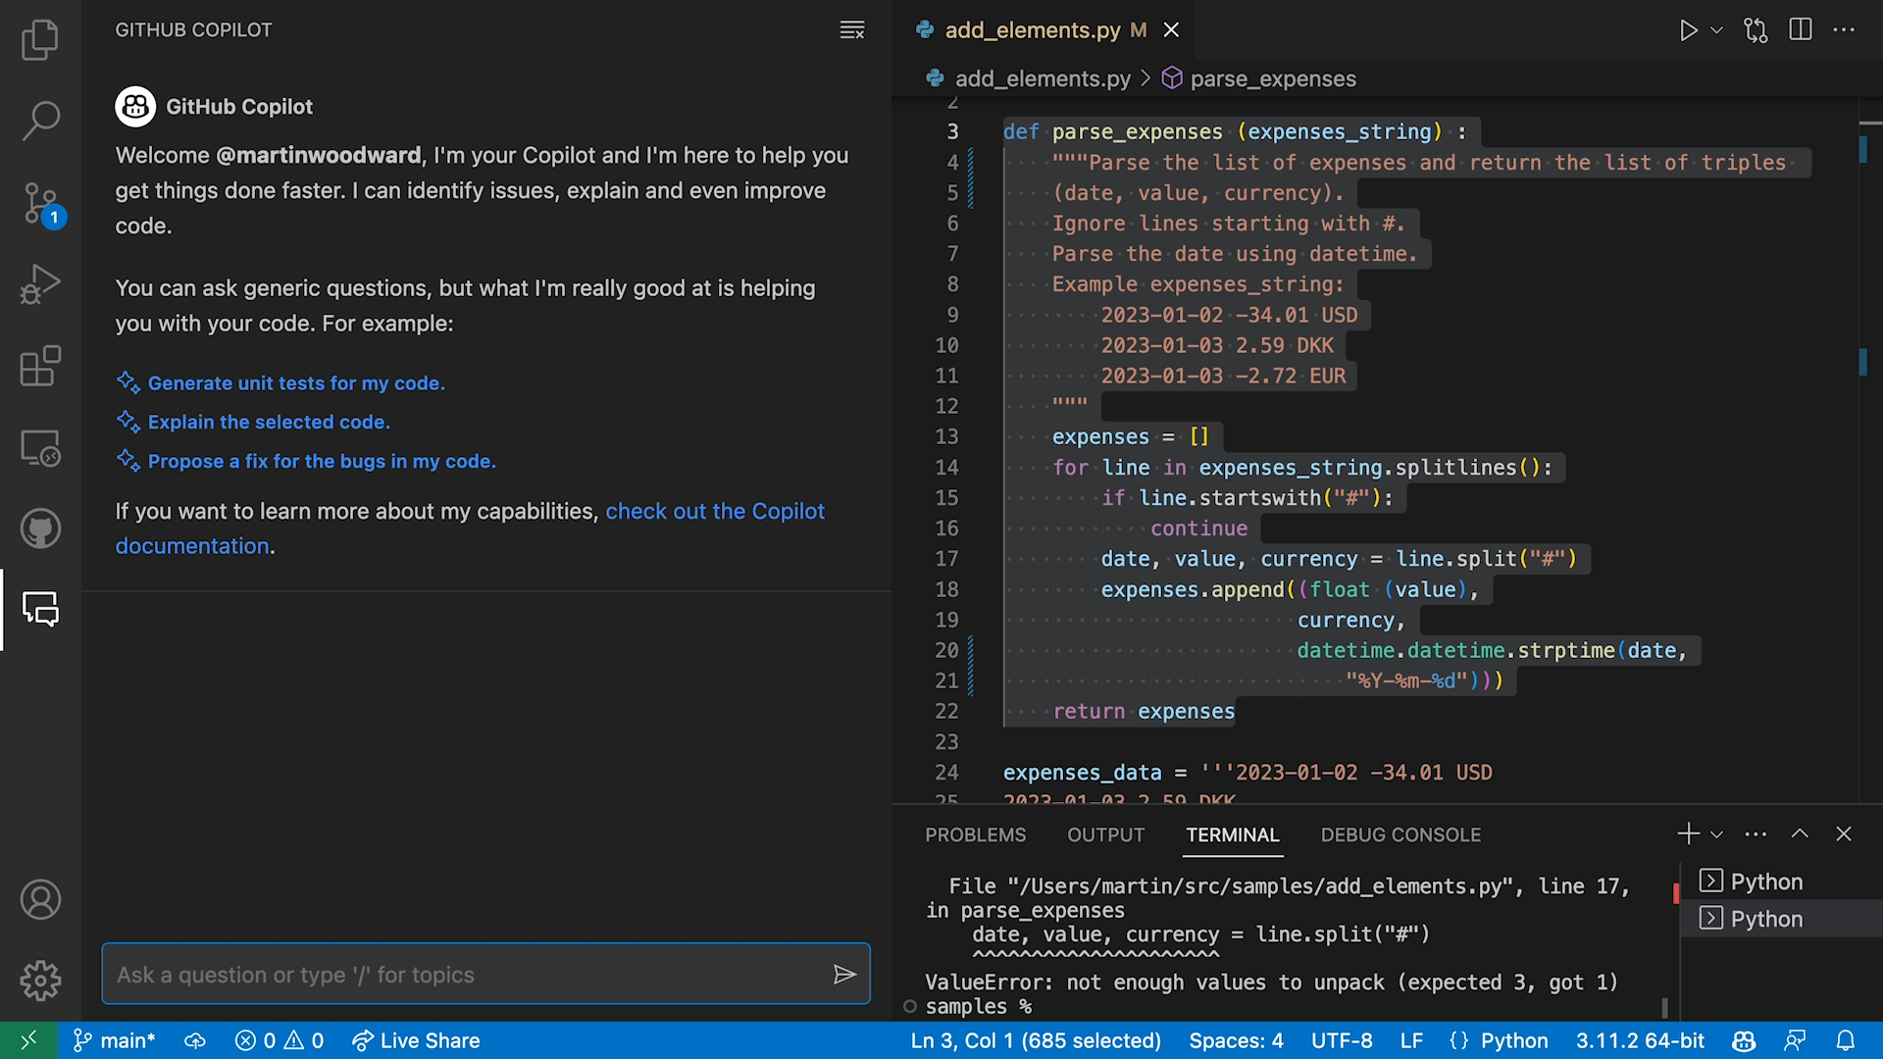
GitHub Copilot Chat
Chat experience in the IDE
ChatGPT-like experience in editor
Generic questions
Generate unit tests
Explain the code
Propose a fix for bug
Make code robust / secure
Support VS Code and Visual Studio

Slide 27
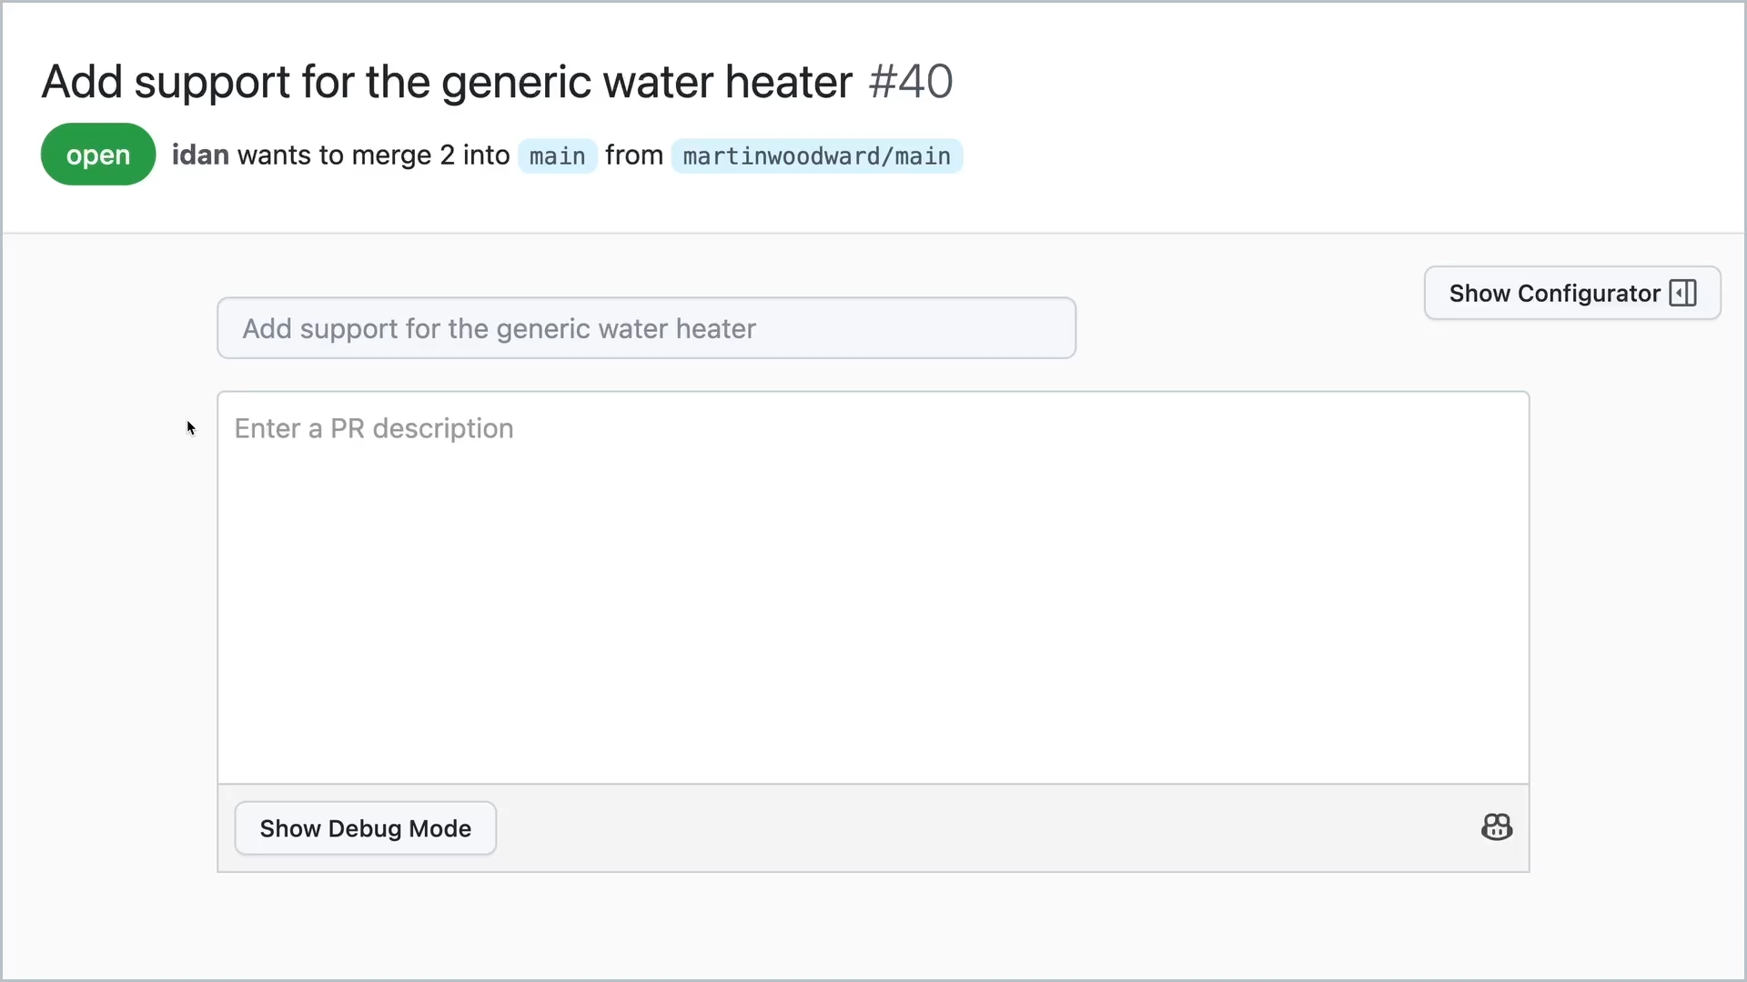
GitHub Copilot for Pull Requests
the future of AI-powered software development
AI powered tags in Pull Requests
Automatically suggest sentences and paragraphs as developers type based on PR code changes
Automatically warn and suggest tests where needed

Slide 28
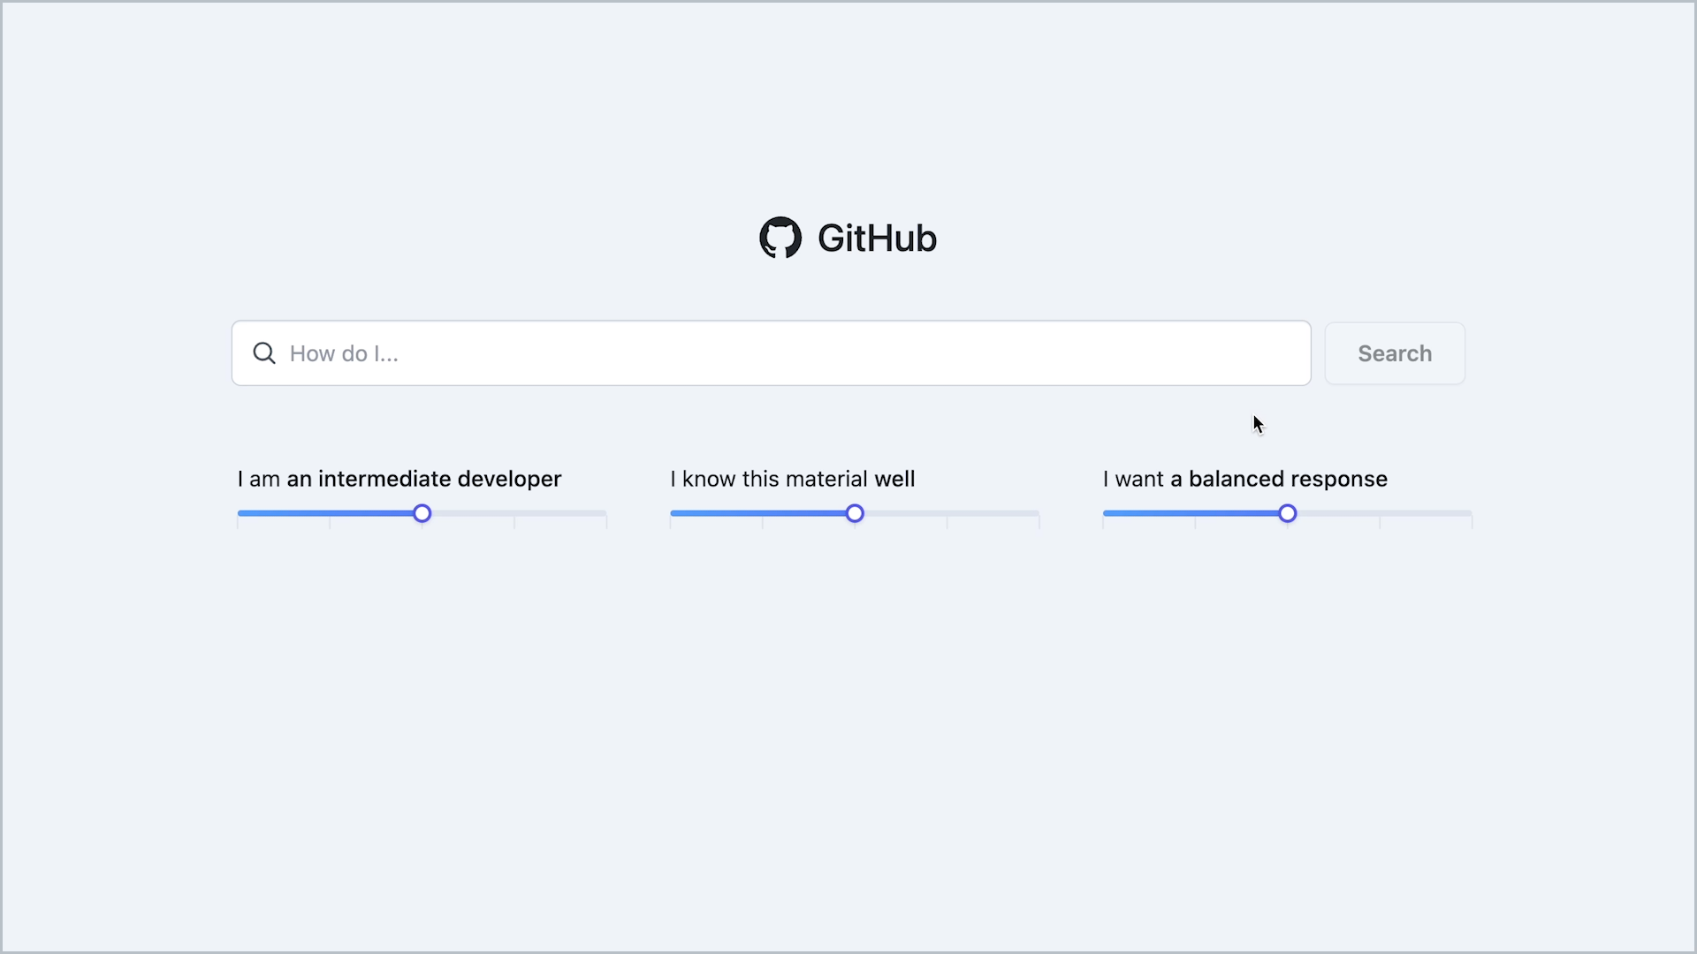
GitHub Copilot for Docs
the future of AI-powered software development
AI-generated responses to questions based on documentation
Starting with docs for:
GitHub
React
Azure
MDN
In future, your in-house docs and codebases

Slide 29
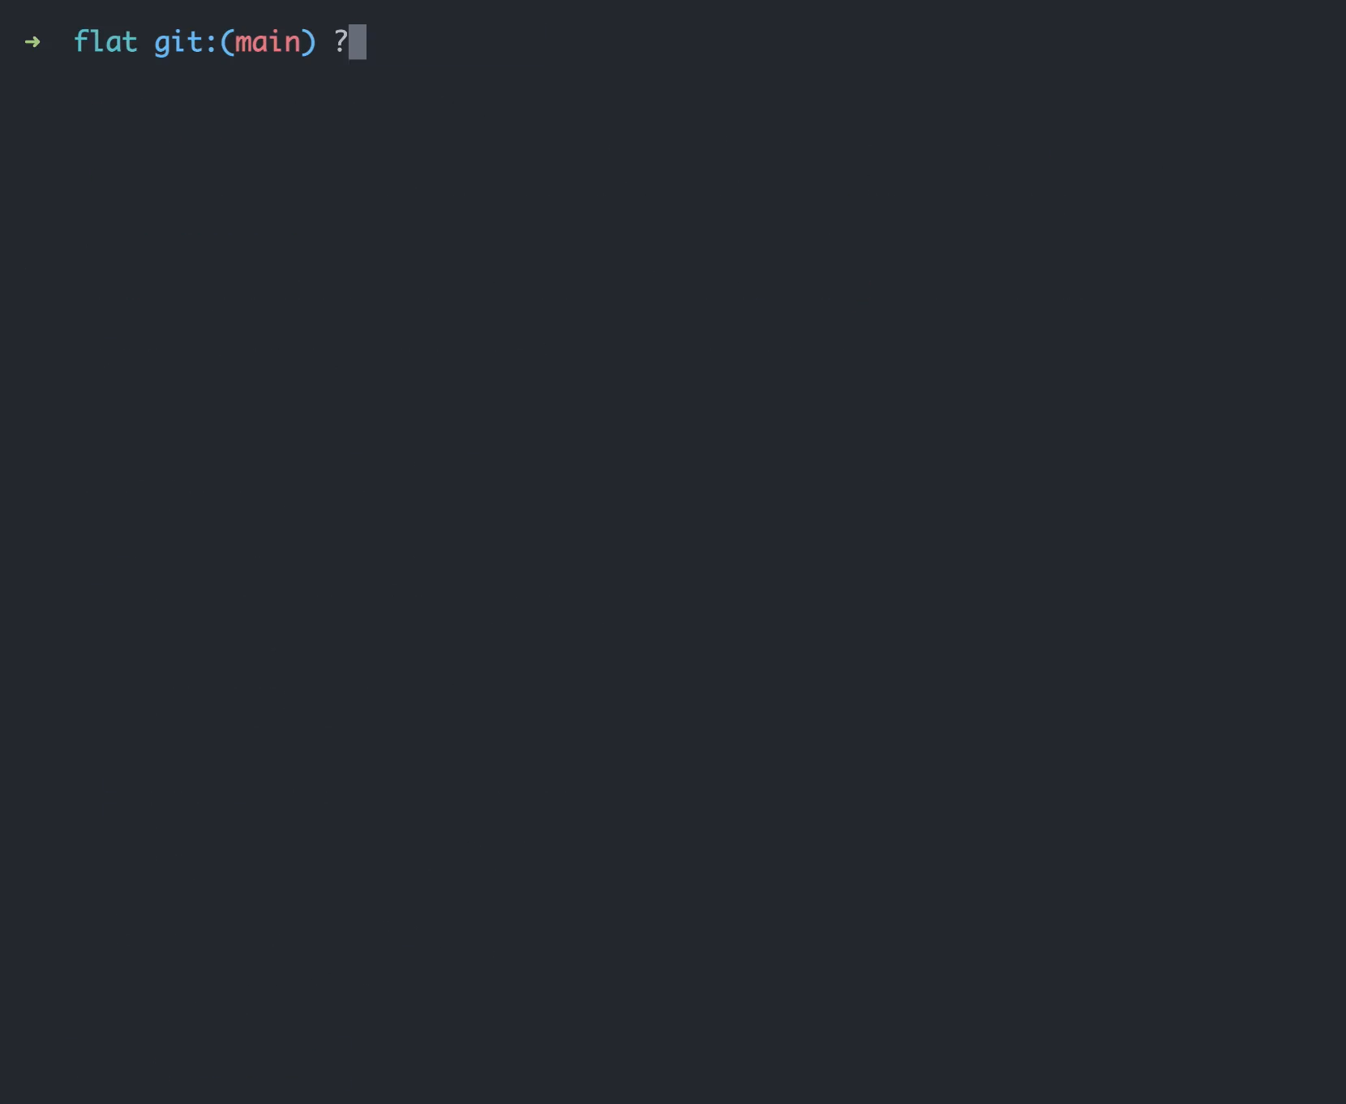
GitHub Copilot for the CLI
the power of Copilot in the terminal
Suggest CLI commands in the terminal window
Three shell commands:
?? – General CLI
git? – git specific CLI
gh? – GitHub specific CLI
Revise & Execute

