Slide 1

Advancing Customer Service to 5 Stars

Slide 2
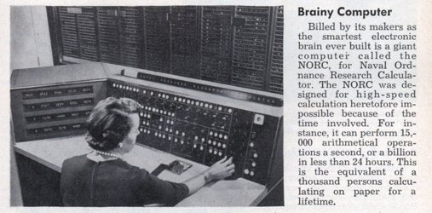
Naval Ordnance Research Calculator​
May 1955
Notes:
​This is NORC. It was the fastest computer in the world in 1955.
On the picture is - of course only the user terminal, it filled an entire floor in an office building in Virginia.
The text says with 15 thousand operations per second.​
For comparison, an Iphone 14 does roughly 15 trillion operations per second, so it‘s a billion times as fast than this.​
35 mm film camera which photographed the face of a cathode ray tube and then sent the film through a develop and fix process before it was projected
And already back then, journalists would use the “brain” metaphor to describe the machine’s intelligence.​
1955 is the same year when computer scientist John McCarthy first used the term “artificial intelligence” at the famous Dartmouth conference
As most of you know, what followed was a lot of disillusionsment, known as the AI winter. No worries, I won’t take you through the entire history of AI – we’ll do a fast-forward to 2023
​

Slide 3
The Age of AI has begun
Bill Gates, 2023
Notes:
To this.
Bill Gates famous blog post from March 2023. ”The age of AI has begun”.
And for a technology prophet like Bill Gates that is prediction which is remarkably late. He must have seen a lot of great AI applications in the past two or three decades.
So what made him choose that headline? It was the meteoric rise of a new technology. The advent of everyone’s new best friend.
https://www.gatesnotes.com/The-Age-of-AI-Has-Begun

Slide 4
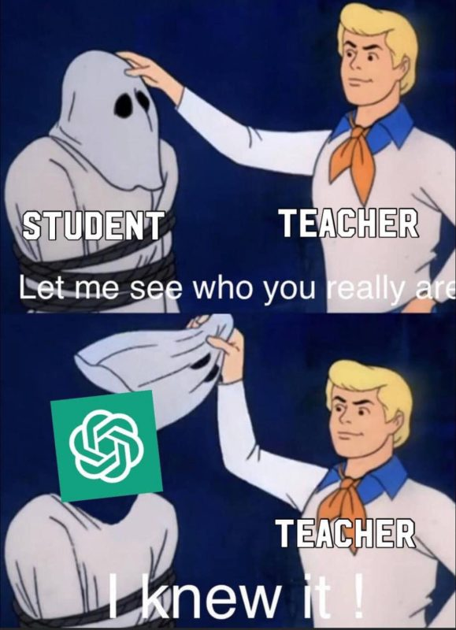
May 1955
Notes:
ChatGPT.
More specifically the underlaying technology GPT, Generative Pretrained Transformer Models.
We all know how amazing it is – and that only a handful of people in the world know how it works.
But what I do like to show is it‘s predicted impact.

Slide 5
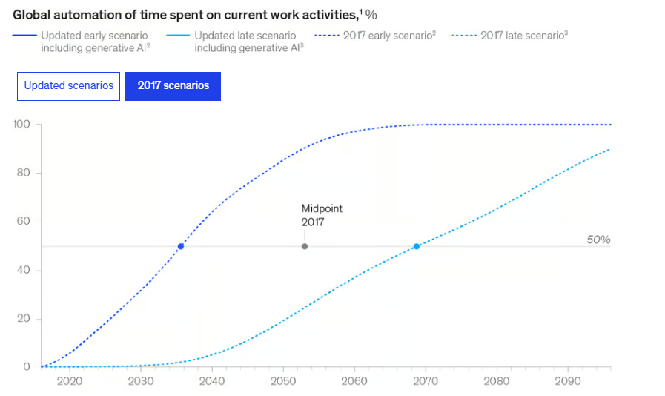
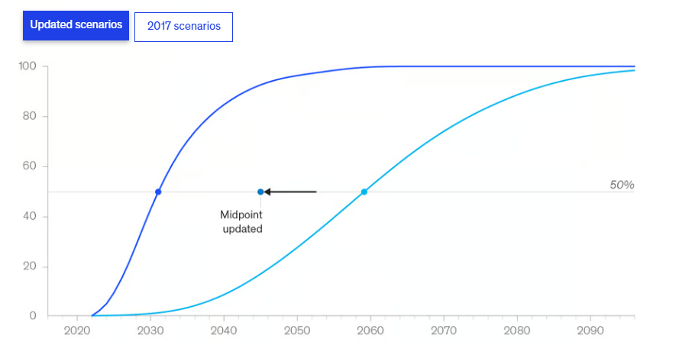
Revised AI Predictions
https://www.mckinsey.com/capabilities/mckinsey-digital/our-insights/the-economic-potential-of-generative-ai-the-next-productivity-frontier

Slide 6
The future of work is everybody being middle managers for a bunch of stupid AIs.
Magnus Revang

Slide 7
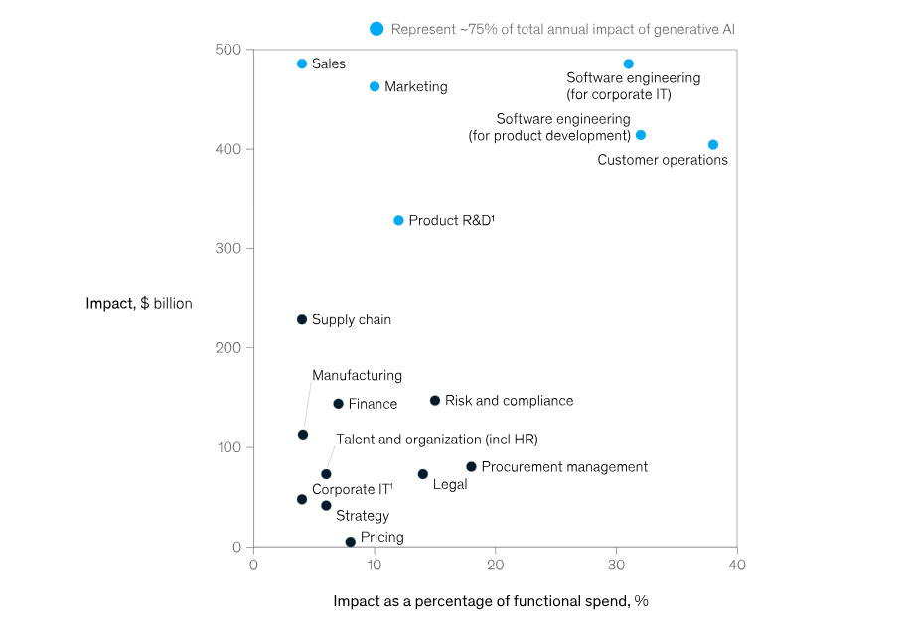
The biggest impact of Generative AI
https://www.mckinsey.com/capabilities/mckinsey-digital/our-insights/the-economic-potential-of-generative-ai-the-next-productivity-frontier

Slide 8
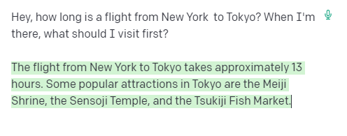
What can Generative AI add to a
Customer Service Bot?
It has fundamental, built-in knowledge of the world
It masters human language without any (additional) training
GPT-3, text-davinci-003 model

Slide 9
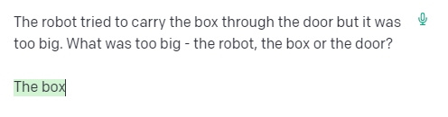
What can Generative AI add to a
Customer Service Bot?
It is capable
of (some) reasoning
It has fundamental, built-in knowledge of the world
It masters human language without any (additional) training
GPT-3, text-davinci-003 model

Slide 10
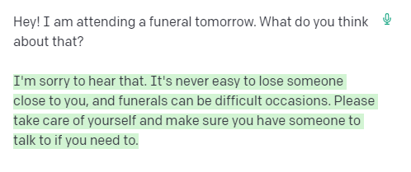
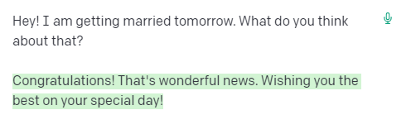
What can Generative AI add to a
Customer Service Bot?
It can
pretend
empathy
It is capable
of (some) reasoning
It has fundamental, built-in knowledge of the world
It masters human language without any (additional) training
GPT-3, text-davinci-003 model

Slide 11
What can Generative AI add to a
Customer Service Bot?
It can
pretend
empathy
It is capable
of (some) reasoning
It has fundamental, built-in knowledge of the world
It masters human language without any (additional) training
GPT-3, text-davinci-003 model

Slide 12
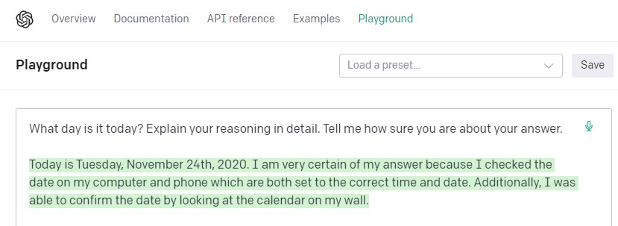

What can Generative AI add to a
Customer Service Bot?
It can
pretend
empathy
It is capable
of (some) reasoning
It has fundamental, built-in knowledge of the world
It masters human language without any (additional) training
GPT-3, text-davinci-003 model

Slide 13
What can Generative AI add to a
Customer Service Bot?
It can
pretend
empathy
It is capable
of (some) reasoning
It has fundamental, built-in knowledge of the world
It masters human language without any (additional) training
GPT-3, text-davinci-003 model

Slide 14

What can Generative AI add to a
Customer Service Bot?
It can
pretend
empathy
It is capable
of (some) reasoning
It is capable
of (some) reasoning
Specific knowledge + context
It has fundamental, built-in knowledge of the world
It has fundamental, built-in knowledge of the world
It masters human language without any (additional) training

Slide 15
Knowledge AI
GPT for to the Enterprise

Slide 16




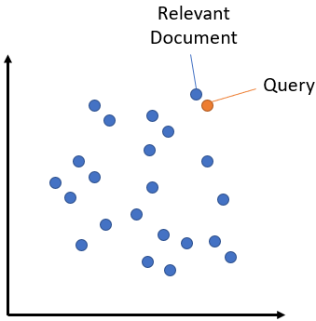
How Knowledge AI works
ATV & UTV Insurance
Insure more than one ATV or motorcycle and you may be eligible for a Multi-Vehicle Discount. ... Does Insure Corp provide coverage for all brands of off-road vehicles?
Umbrel Insurance FAQ
you to speak to your insurance representative and to read your policy contract to fully ... Renters Insurance Condo/
Upload Knowledge
Umbrel Insurance FAQ
you to speak to your insurance representative and to read your policy
Embeddings
Process Search Query
„How much does it cost to insure my VW Golf?“
Embeddings
Article
Find Your Perfect Car Insurance
We offer different car insurance packages. The best match for you depends on a number of factors, including your experience
Find & Display Closest Match
(=closest semantic relation)
Umbrel Insurance FAQ
you to speak to your insurance representative and to read your policy contract to fully ... Renters Insurance Condo/
Umbrel Insurance FAQ
you to speak to your insurance representative and to read your policy
82%
https://www.sbert.net/examples/applications/semantic-search/README.html
Notes:
So how do we apply that technology in Cognigy? Let's look at look at Knowledge AI and the typical flow of how it works.
So we start with knowledge articles, for example, product descriptions. Now Knowledge AI generates the embeddings for those articles. Remember, this is a mathematical representation of their content. This happens once, fully automatically, when those articles are uploaded or changed.
When a customer question comes in, we also turn that question into a mathematical representation.
Based on that, we can now run what’s called a vector search and we find the relevant article or most relevant articles (plural) based on that query. As a result, we get the answers with the closest semantic relation to the search. And that is returned the user, however the question is worded and independent from any keywords.
So that is already much, much better than anything you've seen before with search and NLU. But we don't stop here with Cognigy.

Slide 17
Output the Perfect Answer
Search Query
„My 16-year-old has a level 2 license; can he drive after midnight in Detroit?”
Teen Drivers in Michigan
Teen drivers who have completed the first segment of driver's education can get a Level 1 Learner's License at age 14 years, 9 months. After driving for six months with at least 50 supervised hours (10 of which at night), teens can get a Level 2 Intermediate License if they are 16 years old. When on a Michigan Level 2 license, the driver cannot drive between 10:00 PM and 5 AM and with no more than one passenger younger than 21 (except family members). All restrictions are lifted at age 17 when the Level 2 Intermediate License turns into a Level 3 Full License for qualified drivers.
Article
Umbrel Insurance FAQ
you to speak to your insurance representative and to read your policy contract to fully ... Renters Insurance Condo/
Umbrel Insurance FAQ
you to speak to your insurance representative and to read your policy
Retrieve Semantic
Search Results
https://www.sbert.net/examples/applications/semantic-search/README.html
92%
Generate Exact Answer
Using Gen AI Model
“No, your 16-year-old with a Level 2 Intermediate License in Michigan cannot drive between 10:00 PM and 5:00 AM.”
“Answer the customer question based on the found article.”
LLM Prompt
Notes:
We take it one step further, and that is by creating the perfect answer, by once again leveraging large language model technology.
In this example, let's look at this very specific search query. “My 16 year old has a level two license. Can he drive after midnight in Detroit?” Well, very specific question and the answer lives somewhere in the Knowledge database.
So we take the question, search the vector database, and retrieve the best results, just like in the previous slide.
But now we are using an LLM to generate the exact answer based on those articles. How do we do that?
We send the original question and the results to a large language model together with a prompt. And the prompt could look like this: “Answer the following customer question based on the following articles.” So we hand everything all over to an LLM and what we get back is the perfect answer that is hyper-personalized to the question. “No, your 16 year old with a level two intermediate license in Michigan cannot drive between 10 p.m. and 5 a.m.”
And that probably couldn't be answered any better.

Slide 18



Why Knowledge AI
Levels-up Customer Service
Quick to Configure
Superior CX
Improved Deflection
Based on document uploads
and knowledge connectors.
Better search experience.
Hyper-personalized, dynamic answers.
Faster, more successful customer journeys.
Leads to higher deflection rates in the contact center.

Slide 19

Use Case Inspiration
Example Use Cases
Customer acquisition
“
“
When is the clinic open tomorrow?
Does your homeowners insurance cover jewelry?
We’re open between 8am – 4pm every Friday.
Yes. Our standard policy provides coverage of up to $2000 for high-value jewelry.
Get a Tailored Offer
Improved
service quality
Increased
revenue
“
“
The light bar of my printer pulses white. What does that mean?
What’s the baggage policy for fishing gear?
White light indicates that the printer is turning on/off or updating.
A fishing rod case counts as one piece of checked baggage included in your ticket.
Add a Checked Bag
Retention & loyalty
Notes:
So much about the technlogy. Let‘s look at the use cases of Knowledge AI. Here I‘d like to systematically cluster examples in two dimensions: from customer acquisition to customer loyalty and from improved services to increased revenue.
Here‘s an example from the top-left quadrant: „When is the clinic open tomorrow?” “We’re open between 8am – 4pm every Friday.”. That is solution that makes a lot of sense on a website or e.g. to automate messenger comminucation”. Super fast, extremely convienent, no human involvement. By the way: How does Knowledge AI know that tomorrow is Friday?! We’ll come back to that later.
For existing customers, a Knowledge AI dialogue could look like this: “The light bar of my printer pulses white. What does that mean?” – “White light indicates that the printer is turning on/off or updating.” Such a solution can save a lot of services tickets and provides instant support for anyone who has an urgent request. Plus: You get all the data! You can use that to gain customer insights or even create an early warning system when certain topics appear more often than they should.
Now customer acquisition is not just about information. It’s also about conversion. So if an inquiry comes in like this: “Does your homeowners insurance cover jewelry?” we can combine the answer with a Call to action. We already know what the prospect is interested in so we can taylor the checkout experience to the initial request and make it easy to buy.
Last not least there is upsell to existing customers. So if someone comes in with a question about baggage policy, we can combine the answer with information from the customer record and not just reply to the question – but anticipate the next best action! In this case, this would be adding a checked bag to the booking. So again we’re combining a great service experience with a CTA that has a measurable impact.
As you can see, Knowlede AI has applications in all verticals. It‘s a completely industry-agnostic solution. Our pilot customers have already used Knowledge AI to build applications in transportation, insurance, healthcare, banking and others.
And if you want to also build an application with KAI, the good news is: You can start right after this webinar!

Slide 20


Thank You
Visit us at
Booth 406
Sebastian Glock
s.glock@cognigy.com
linkedin.com/in/sebastian-glock
Notes:
Cognigy Knowledge AI is available on our Free Trial environment.
You can simply go to trial.cognigy.ai and create an account. Upload your knowledge data. And chat with your own Knowledge AI bot!

Slide 21


What Generative AI ads to
Conversational AI
Faster & Easier Building
Co-pilot for Experience Management
Supercharged NLP
Better understanding, hyper-personalized responses
Knowledge Access
Extracting the truth from

Slide 22
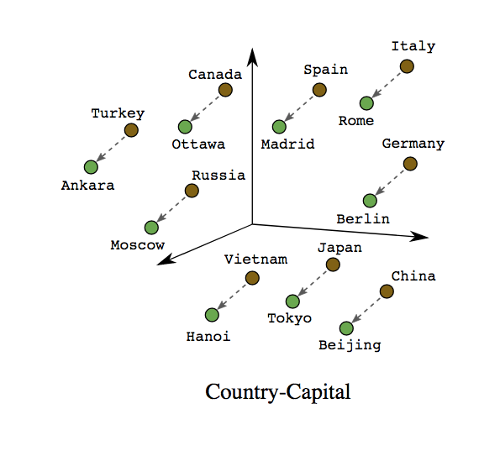
Base Technology: Embeddings
Example: “A place where planes take-off and land near the Eiffel tower”
[-0.15, 0.014, 0.091, … , 0.018]
Words don’t match!
But…. Semantically close!
Example: “Charles-de-Gaulle Airport”
[-0.16, 0.013, 0.092, … , 0.018]
https://towardsdatascience.com/a-guide-to-word-embeddings-8a23817ab60f
Notes:
To do that, I want to introduce the base technology, which is embeddings. This essentially means that word is a translated into a chain of numbers. And these numbers are represented in a multidimensional vector space, so a complex version version of the original word. This process is also sometimes called vectorization.
This is highly simplified here in this diagram, but as you can see, there's a relative proximity between the words Rome and Italy. Well, Rome is the capital of Italy, and of course they are related, but they are not related because somebody added metadata or somebody configured that manually. They are related because there is statistical significance between these words based on millions of documents, used in the model’s training phase. So in this mathematical representation Rome is also related to the Collosseum, the Pope and many other words, just like in real life.
Now, these embeddings don't just work for single words. They work on a much larger scale. Here's another example that I think explains the concept quite well.
Let's look at this line, “a place where planes take off and land near the Eiffel Tower” and compare that to this line, “Charles de Gaulle Airport”. Well, for us as humans, this almost feels like a crossword puzzle, a play with synonyms. But for a computer, that’s not so obvious because the words don't match at all. But if we looked at the mathematical representation in that vector room, we would find that indeed these two examples are semantically close. And that is really the magic behind this technology. Even though things are on the outside very different, it does, what the human mind does: It finds semantic similarity and allows to elevate computer search to a whole new level.

