Slide 1

Innovating Healthcare with CAI
The Future of Empowering Patients in Disease Management
Paulina Lewandowska
Product Owner, Conversation Designer
@Human Centered Design - Roche
07th September 2023

Slide 2


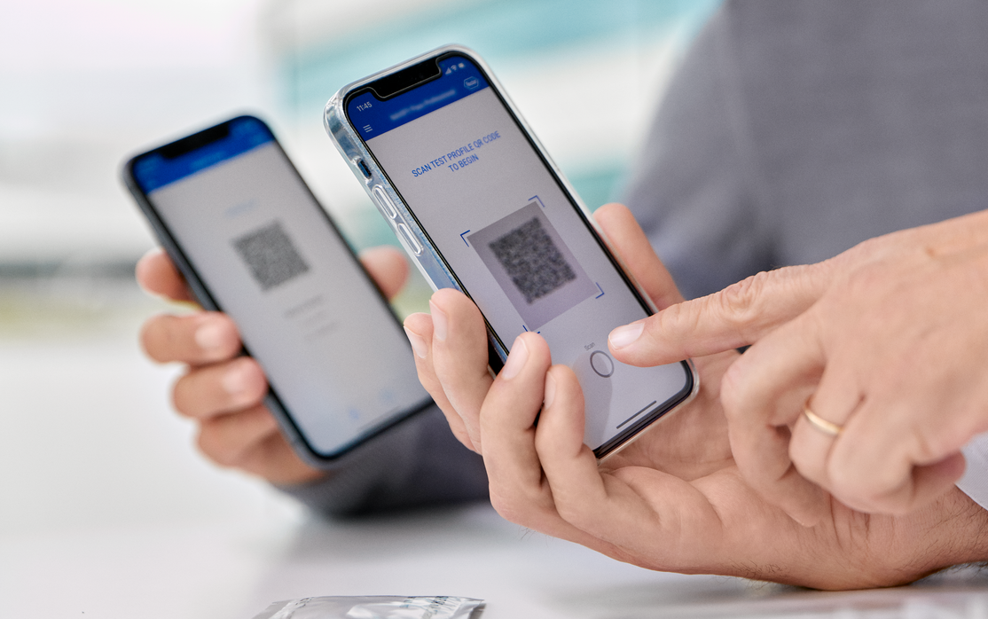



This is Roche
“Doing now what our patients need next”
125 years
of sustainable improvement of healthcare
Leader in Diagnostics
and Pharma
14.2 million
People treated with our medicines in 2022
CHF 14.1 billion
R&D investment in 2022
32 medicines
on the WHO List of Essential Medicines
Roche Informatics creates innovative solutions for the healthcare ecosystem
Sustainable
one of the most sustainable healthcare company in the Dow Jones Sustainability Indices
103,613
Employees worldwide

Slide 3


Healthcare systems challenges
Increased healthcare demand, aging population, global healthcare workers shortage…
22%
>50%
10 million
41 million
¹ World Health Organization - Ageing and health 4th October 2021;
² Joint Research Centre, Belmonte, Martina, et al. (2021), “Healthcare and long-term care workforce : demographic challenges and the potential contribution of migration and digital technology”, Luxembourg: Publications Office of the European Union;
³ World Health Organization - Health workforce
⁴ World Health Organization - Noncommunicable diseases

Slide 4

Let’s hire Baymax
…but only in a Disney world
Personal Healthcare Companion
Generative AI capabilities
Created to diagnose patients with a simple scan, provide medical advice, treatments, and even psychological comfort.
Inflatable, making him soft and non-threatening.
Huma traits & Conversational Interface
Able to evaluate and respond to emotional distress.
Can access vast databases to provide medical knowledge.
Showcases the ability to adapt and integrate new functions not originally programmed.
Walt Disney Animation Studio: Big Hero 6 movie (2014) inspired by Marvel Comics
CREDIT: Disney

Slide 5
Patient Journey in noncommunicable diseases
Healthy habits
Education
Treatment experience
Access to treatment
Symptoms improvements
Quality of Life improvement
Prevention
Diagnosis
Treatment
Monitoring
Control or Remission
Clinical diagnosis
Treatment decision
Therapy adherence
Disease management
Patients
Doctors
Nurses
Scientists

Slide 6
Patient Journey in noncommunicable diseases
Healthy habits
Education
Treatment experience
Access to treatment
Symptoms improvements
Quality of Life improvement
Prevention
Diagnosis
Treatment
Monitoring
Control or Remission
Clinical diagnosis
Treatment decision
Therapy adherence
Disease management
Patients
Conversational AI
Automations
Disease Management Assistants
Diagnostic Assistants

Slide 7

Multiple Sclerosis todays' gap
The dual perspectives of Patients and Doctors
MS Patients
Where can I find relevant and trustworthy information?
I have my visit with a Neurologist in 6 months; how do I remember all symptoms I will have by this time?
Are my symptoms connected to Multiple Sclerosis?
I do not speak English; how can I find more information in my language?
Healthcare Professionals
Social Workers
My interaction with patients is relatively short; some important topics might be missed.
The virtual assistant can help patients to share more information about the symptoms they are experiencing.
I have limited number of resources dedicated to interactions with patients
We have a limited number of workers supporting patients in answering questions.
We are not able to answer medical questions that patients are asking.
We are not specialize in the disease area; we do provide general support for patients
Individual patient and HCP perception, which do not reflect Roche's vision. It is personal and might not reflect the whole HCP’s and MS patient population.

Slide 8


eMerSon - Conversational Multimodal Agent
available when needed, answering relevant questions, multimodal
Iterative content and language versions creation
Web App compatible with every device (computer, tablet, smartphone)
Bridge between doctor and patients
Non intrusive, available on demand
“Digital companion”, complementary and trustworthy source of information
Content selected
with collaboration with Doctors, MS Nurses, Physiotherapist, Patient experts
Collaboration and validation with customers

Slide 9
Is the digital virtual assistant right solution?
Our hypotheses
Prevention
Diagnosis
Treatment
Monitoring*
Control or Remission*
Verify that eMerSon is the right channel to distribute information for diagnosed MS patient
Check if voice is the right modality for MS Patients
Validate the fact that the Patients feel more aware of the disease and its symptoms
Check if using voice technology is feasible in Dutch, French
*Not automated decisions, SaaMD

Slide 10
Unlocking Tomorrow's Healthcare now
Disease-Agnostic Conversational Companion - bridging Patients and HCPs with ease!
Engaged ecosystem
Better health outcomes
Continue
Shape the future
Begin
Set priorities
Relevant, trustworthy and tailored Information
Ethics and trust

