Slide 1
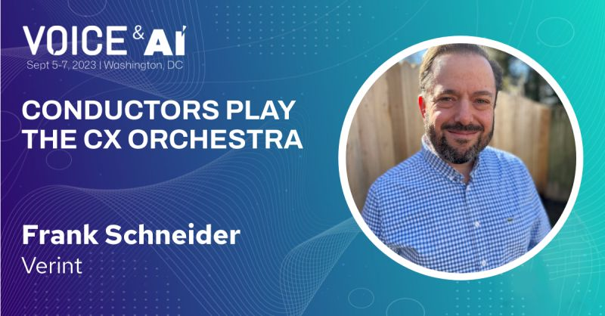

Slide 2
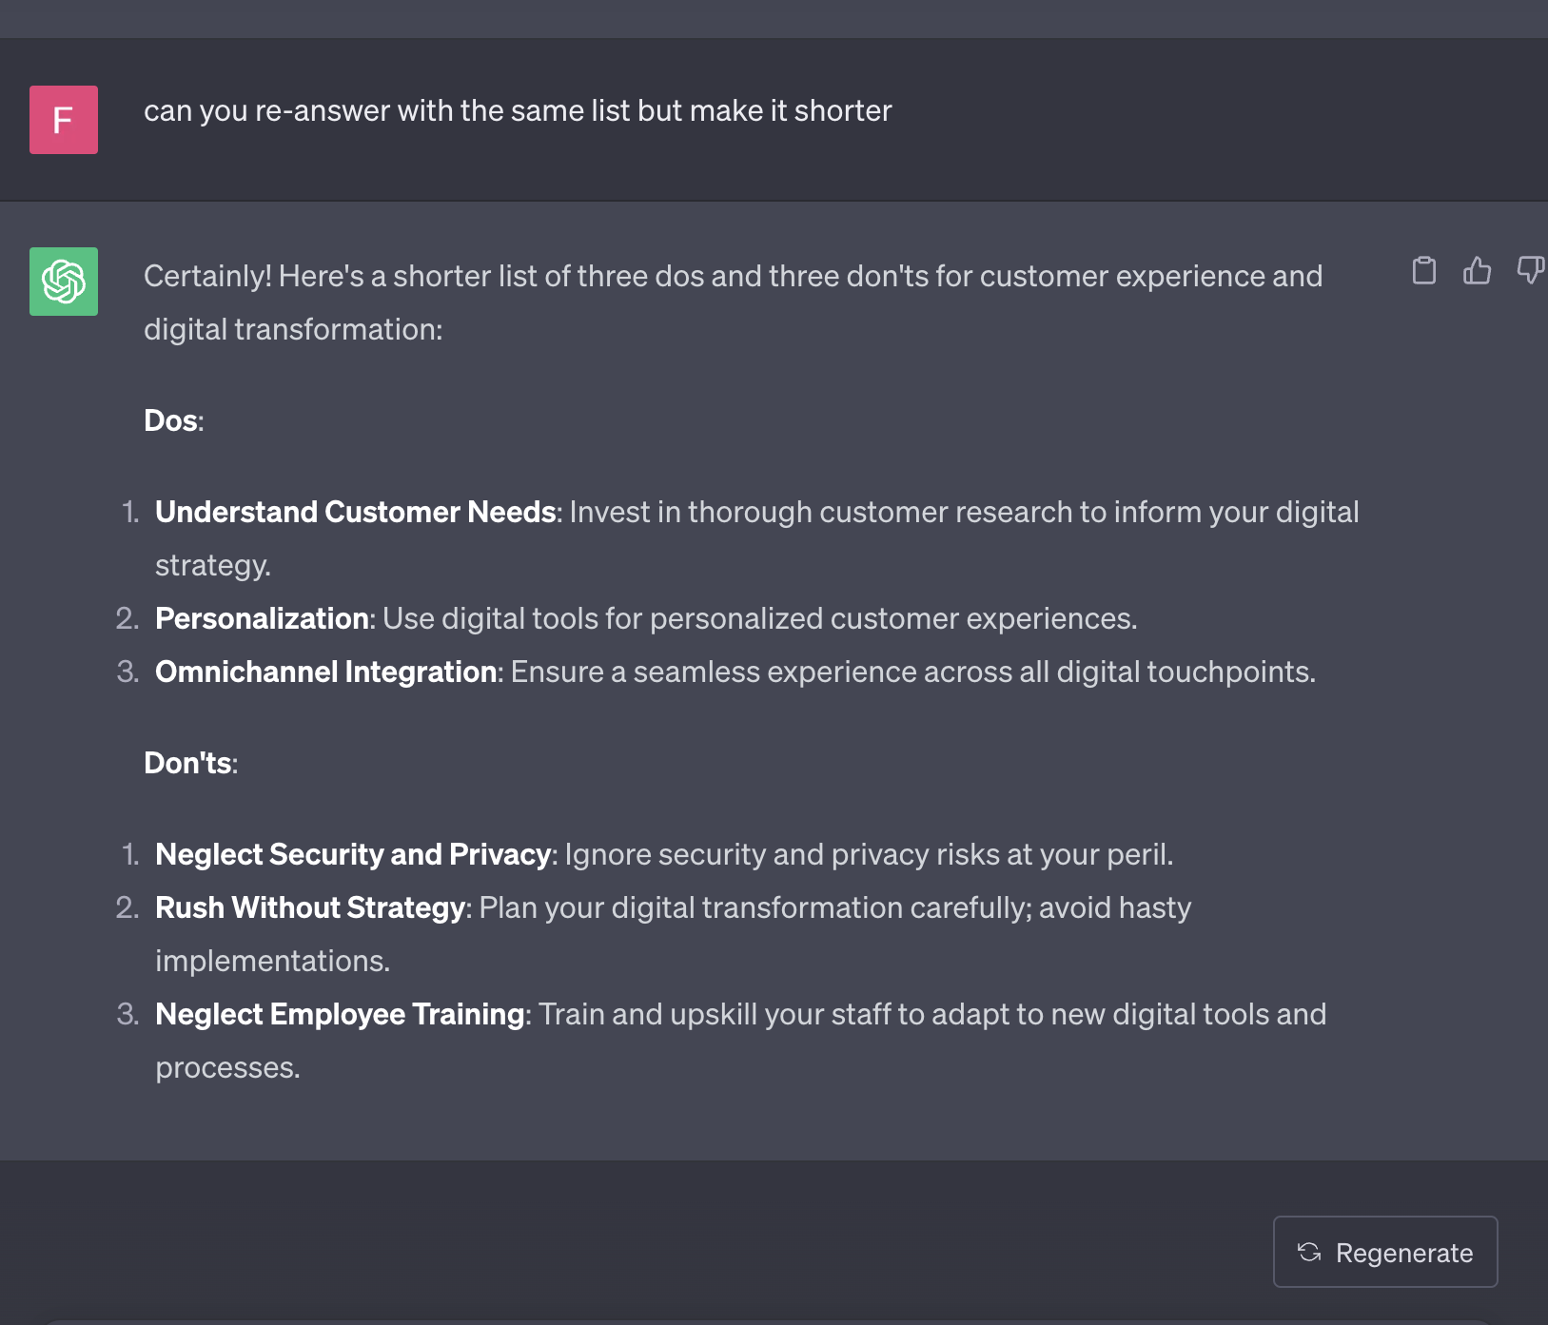
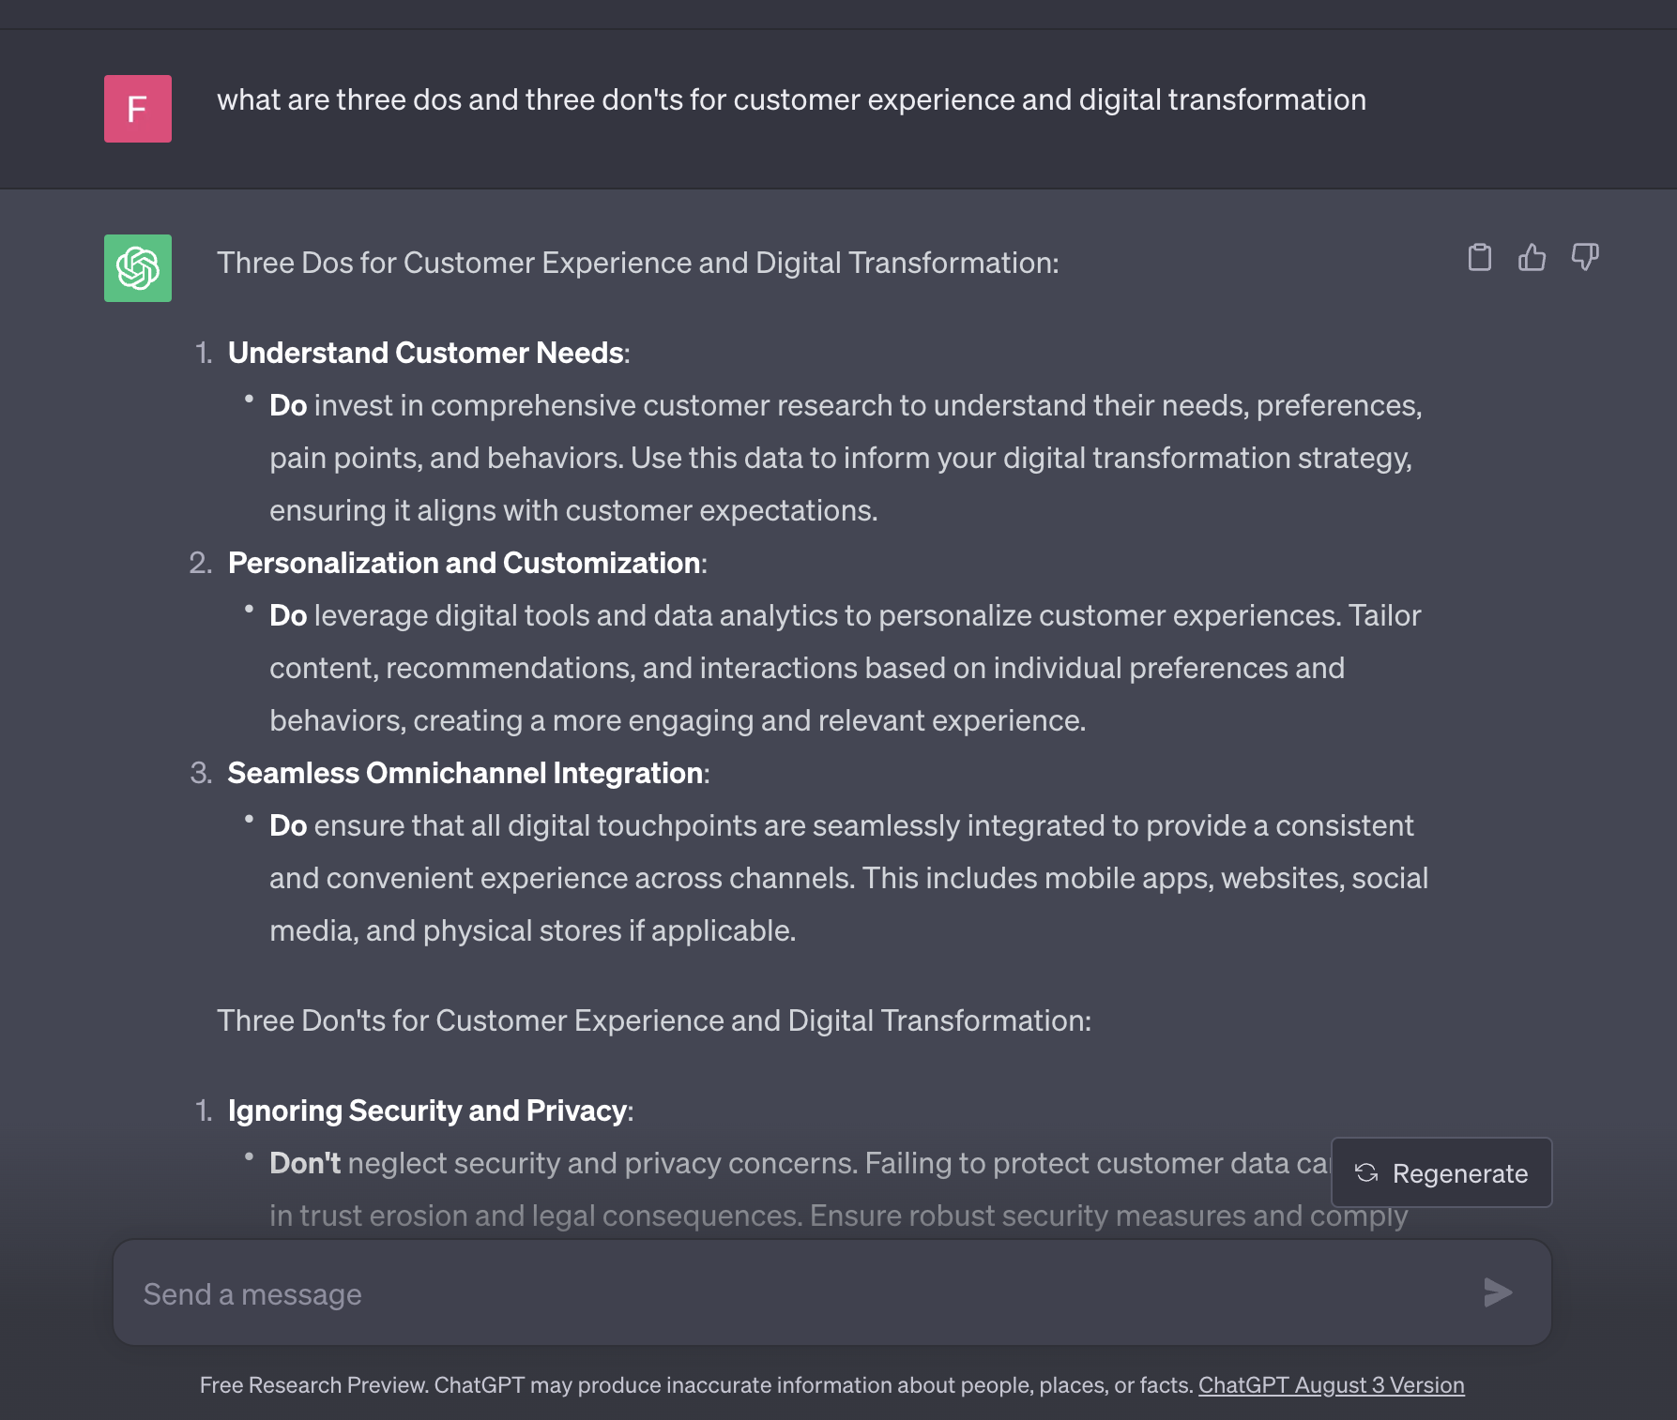
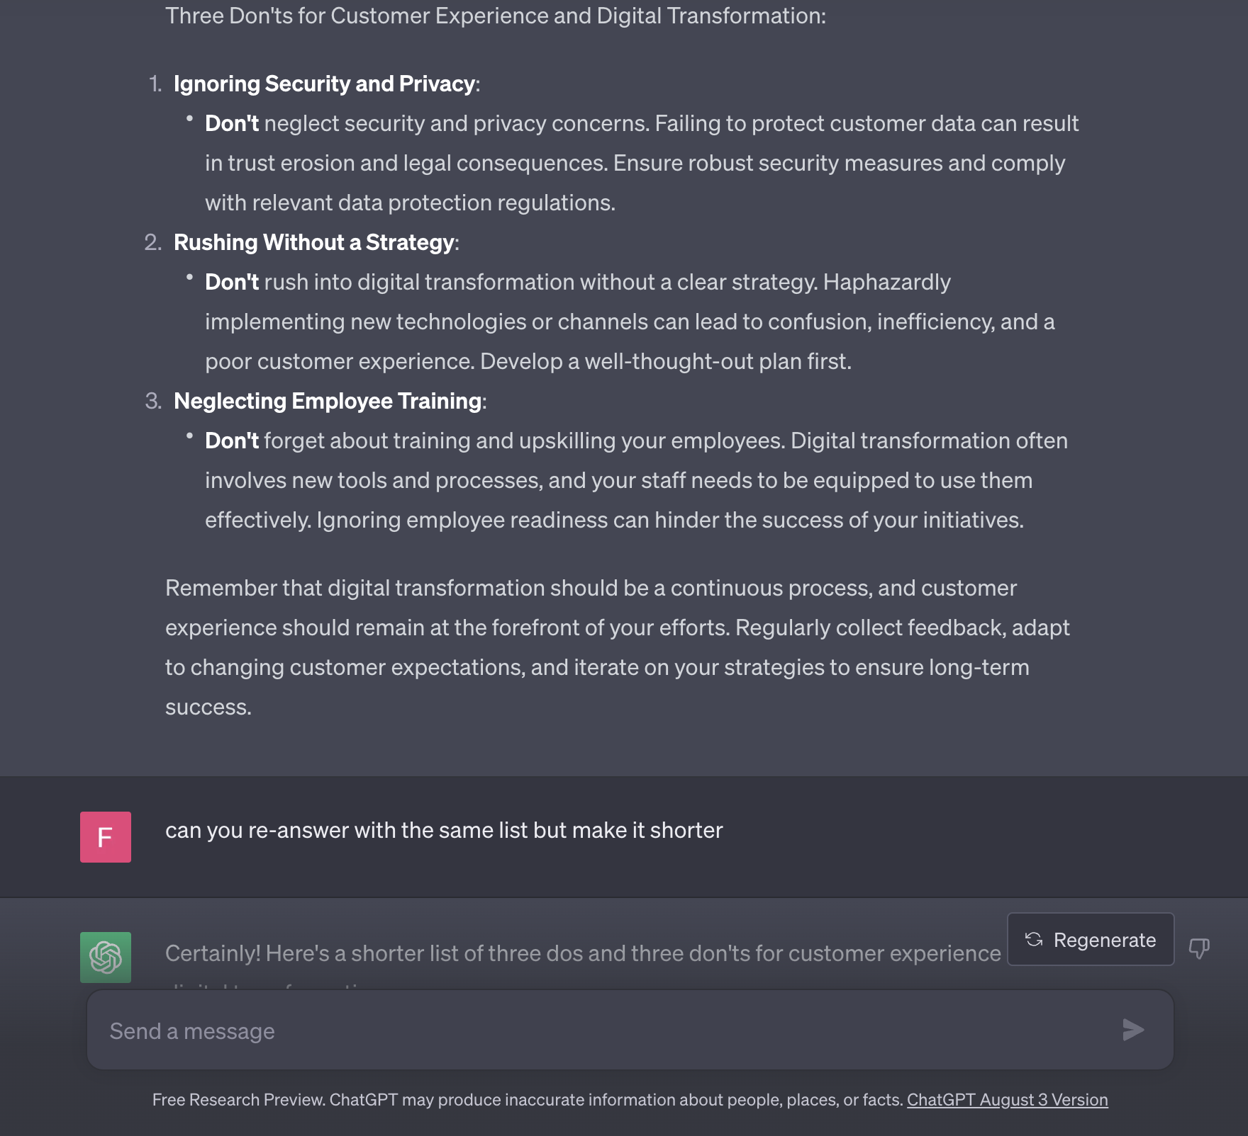
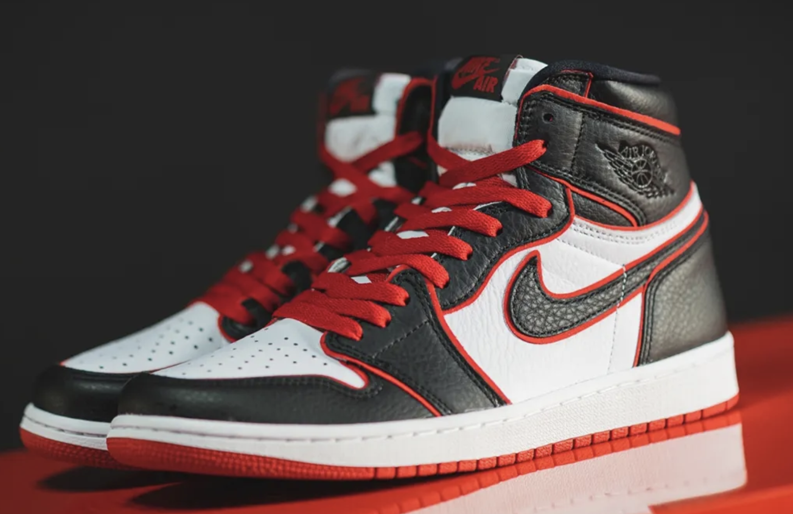
Three Do’s & Don’ts
Chat GPT 3.5 Style

Slide 3
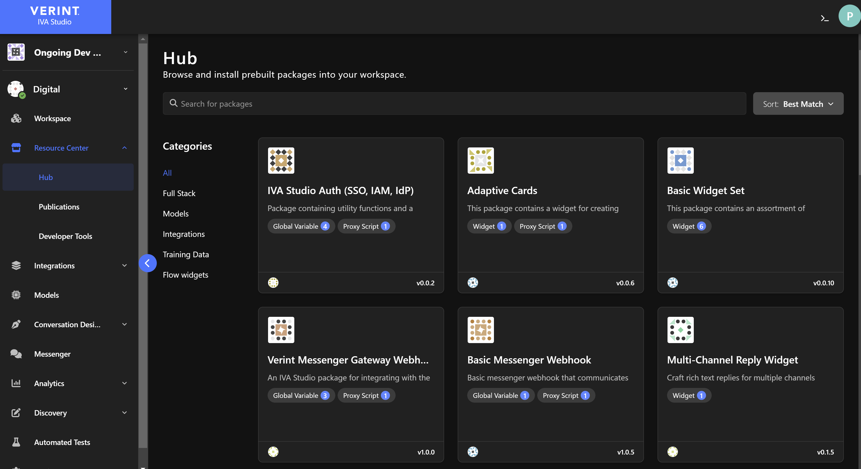

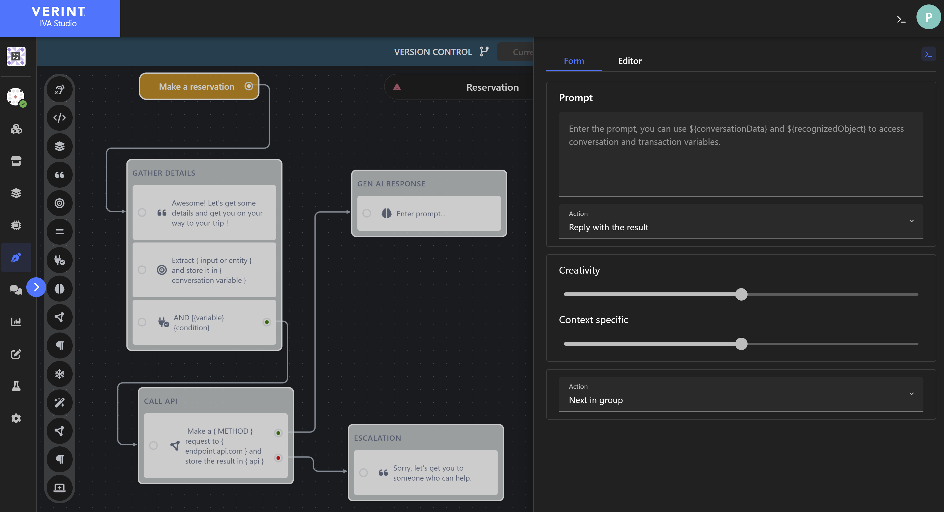
Three Do’s & Don’ts
CX Orchestration Edition
Orchestration Platform…do choose Open In the Box (OITB), don’t expect everything Out Of The Box (OOTB).
Measure business metrics (even your own OKRs), don’t just focus on chatbot analytics.
”Conduct” & design experiences that are supercharged with LLMs, don’t only make bot flows for LLMs.

Slide 4
Thank You

