Slide 1
How AI and Human Computer Interaction Will Shape the Future of Design
Brenda Velázquez Santiago

Slide 2
What is HCI?
Study of how people interact with computers
Composed of 4 essential elements:
  The User
  The Goal-Oriented Task
  The Interface
  The Context
Notes:
Human Computer Interaction. What is it? Well, it is the study of how people interact with computers. Specifically, it focuses on the design of technologies. Interaction design, user interface, and user experience are part of the field of HCI. Even though the fields of UI/UX are part of Human Computer Interaction, HCI is more than that.
We can say that HCI is composed of four essential elements:
The User → HCI performs research on the needs of the USER. It focuses on the user’s objectives and interaction styles.
The Goal-Oriented Task → The Goal-Oriented task reminds us that the user always has a purpose, the computer is only a tool to achieve this task.
The Interface → The Interface is an element of HCI, this is essential to improve the quality of the users’ interaction.
The Context → And lastly, the context. Not only is the goal of HCI providing a better experience between users and computers, but considering the context where the system is accessed.

Slide 3
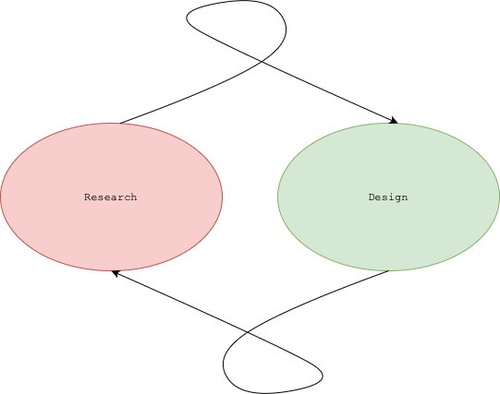
What does HCI encompass?
Prototyping and iterative development from software engineering
Software Psychology and Human Factors of Computing Systems
User Interface Software from Computer Graphics and Models
Theories and Frameworks from Cognitive Science
Research
“The results of our user research inform the designs we construct, and the results of our designs inform our ongoing research.” Dr. Andrew Joyner
Notes:
According to John M. Carroll. The parent of HCI. Human Computer Interaction is founded on four different threads.
1. Prototyping and iterative development from software engineering
2. Software Psychology and Human Factors of Computing Systems
3. User Interface Software from Computer Graphics and Models
4. Theories and Frameworks from Cognitive Science
Prototyping and iterative development from software engineering
HCI helped software engineers understand that design is a necessary iterative of the software engineering process. This was done by providing techniques to construct solutions quickly, as well as evaluate and change said solutions.
Prototyping has become a guide for system development. Think of it, as an agile or scrum process, where the developers iterate different versions of the proposed feature until everyone is in agreement. Well this is one of the threads of HCI.
Software Psychology and Human Factors of Computing Systems
Through the 70s there was a desire to understand how software design and programming developed. And in 1971 programming became recognized as an area of psychology. This is called the Psychology of Programming or PoP, this was widely researched in the 70s and 80s but not so much today. The psychology of programming studied how system response time affects the productivity, how aids like mnemonic variable names, flowcharts, and how in-line program comments support the action of programming. Even though the psychology of programming is not widely studied today, it paved the way for basic HCI guidelines.
User Interface Software from Computer Graphics and Models
As our use of technology has ticked up throughout the decades, researchers spend more and more time trying to understand the best ways that users can interface with computers. Compared to 1960s when the notion was unarticulated, and the focus was computation and not legibly presenting results. In the present user interfaces are very important, and hence this area is one of the main threads of HCI.
Theories and Frameworks from Cognitive Science
At the beginning, researchers believed HCI was to bring cognitive science methods to software development. Mostly researchers expected that cognitive science, could guide the early stages of the software development process. That didn’t end up happening as expected, but models were developed that are still used today.
One of those models is the GOMS or Goals, Operators and Methods model, is a model widely used to analyze the routine human-computer interactions. The intent of the GOMS model was to produce predictions of real tasks.
I would like to add another thread that HCI is founded on.
RESEARCH
It might be implicit in these four points mentioned, maybe more so in the 4th point Theories and Frameworks from Cognitive Science. But HCI is all research and design.
Design, to ensure a good interaction with the interfaces.
Research, to ensure what is the correct design to use in different situations.
It’s a never-ending loop.
“The results of our user research inform the designs we construct, and the results of our designs inform our ongoing research.” Dr. Joyner

Slide 4
HCI & Psychology
Without psychology there is no HCI.
HCI is not psychology, but HCI needs psychology.
Notes:
Well without psychology there is no HCI.
We need psychology to understand human perception, and to inform ourselves on the best ways we should design interfaces.
Psychology makes HCI what it is.
HCI is not psychology, but HCI needs psychology.
It is a symbiotic relationship.

Slide 5
HCI &
Design
Notes:
So, I mentioned that HCI is the study of how people interact with computers. One of the main goals is to ensure that the design of computer interfaces is in-line with the needs of the user.
It is widely acknowledged that HCI is comprised of UI Design, UX Design, and Interaction Design.
But many designers are not researchers. Some companies, usually big ones employ UX and UI researchers that work hand-in-hand with the designers to ensure a product is thoroughly researched and designed according to HCI and psychology guidelines. Regardless, in my experience this is rarely the case. In many companies the UX/UI designer works by themselves opting for designs that meet the companies branding and are aesthetically appealing.

Slide 6
Cognitive Psychology & Design
Cognitive Load
Mental Models
Chunking
Learning
Notes:
Let’s talk for a moment about cognitive psychology in design. For those of you that might not be familiar with the term. Cognitive psychology is a field within psychology that is focused on studying mental processes, such as memory, problem-solving, perception, learning, and emotions.
In design cognitive psychology is applied to different concepts to ensure the completed product is focused on providing the users with a positive experience.
Cognitive Load → Cognitive Load refers to the processing power being used by our brains. Although, this is debatable in some academic circles. Let’s work under the assumption that the brain gets overloaded with information, and there is a limited number of things we can process at the same time.
Goal of the designer: Reduce the cognitive load posed by the interface so the user can focus on the task. Understand what else is competing for the user’s cognitive resources to use the interface.
Better design:
Do not overload the user with too many choices
Break up long processes into multiple screens with few options
Mental models → what the user thinks they know about how a system works. Our brain forms a model of a system working and then we apply it to new situations. For example, driving a car; we know that the right-most pedal accelerates so when we get on a car-like vehicle like a go-kart or golf cart we use our mental model to find the accelerator.
Goal of the designer: match the user’s mental model to improve their experience. Shrink the gap between the user’s mental model and the designer’s mental model. The designer needs to think like the user.
Better design:
Do not re-invent the wheel
Try to follow experiences or interfaces that are tested to work
Do not change well known designs, for example the green button answers a call and the red button hangs-up. If these colors were switched there would be a lot of confusion for users that have established mental models.
There are other cognitive psychology concepts that are essential to good design like chunking or Miller’s law. Which focuses on visually grouping related information into small units.
Or learning, which ensure that the user has to learn as little as possible and that the interface teaches the user overtime how to use it more efficiently.

Slide 7
HCI & AI
Notes:
So, we’re in an AI conference. Let’s discuss that, how AI can help designers integrate HCI that leads to better design.
Right now, many UI and UX designers are graphic designers, which is not a bad thing since they study color theory, design principles, typography, illustration, among other concepts. But many of them don’t study HCI, or the psychology of design. UI and UX design is a field that has been growing immensely fast in the past few years and it is expected to continue to do so. But for that reason many of the people that assume this roles might not have any formal preparation in that area. This is not a criticism to that, just a proposal to help that area grow.
I believe AI needs to be integrated in design software’s like Adobe XD, Canva and Figma to aid designers in creating designs that are inclusive of important HCI concepts.
Not that I have any complaints about current designs, but we should always be thinking of ways to improve. Having AI integrated in design software can help designers design for accessibility and take into consideration some psychology concepts that are crucial to good design. I think the main benefit of this will be designing with core concepts of cognitive psychology first, and helping designers notice small details that might be overlooked, as well as providing some feedback to the designer without having to go through a long agile process.

Slide 8
Proof of Concept
Data collection
Data preprocessing
Feature extraction
Opinion labeling
Model training
Evaluation and fine-tuning
Deployment and integration
Iterative improvement
Notes:
Well, we need a Machine Learning model that uses data of what is a good design according to the principles of HCI.
So a high-level overview of the steps involved:
Data collection: We need to gather a data set of design examples. This should be a wide range of designs, so the AI model has different perspectives.
Data preprocessing: Clean the collected data and preprocess it to remove inconsistencies. This may involve???
Feature extraction:
Opinion labeling
Model training
Evaluation and fine-tuning
Deployment and integration
Iterative improvement

Slide 9
How do we implement this?

Slide 10
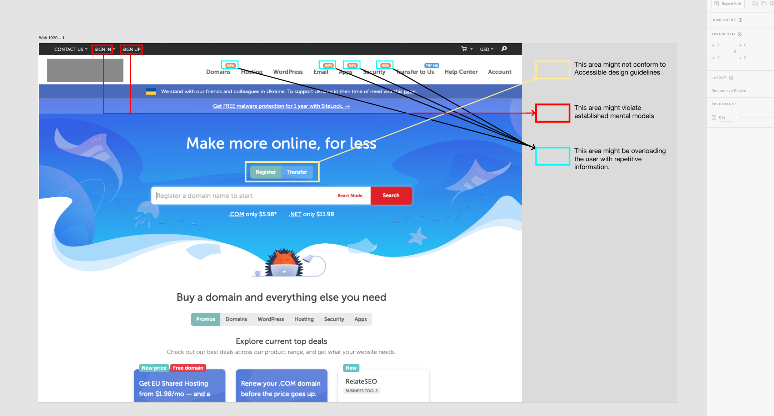

Slide 11
References
J. M. Carroll, "The Evolution of Human-Computer Interaction," Annual Review of Psychology, vol. 48, pp. 501-522, 1997.
J. Yablonski, "A List Apart," 05 10 2018. [Online]. Available: https://alistapart.com/article/psychology-of-design/. [Accessed 30 08 2023].
"Interaction Design Foundation," [Online]. Available: https://www.interaction-design.org/literature/topics/human-computer-interaction. [Accessed 30 08 2023].
"Interaction Design Foundation," [Online]. Available: https://www.interaction-design.org/courses/hci-foundations-of-ux-design. [Accessed 30 08 2023].
J. M. Carroll, "Human-Computer Interaction: Psychology as a Science of Design," Annu. Rev. Psychol., vol. 48, pp. 61-83, 1997.

