Slide 1



Keep It Simple: Seamless, Best-of-Breed Voice AI Integration
Brandon everett Smith
Director, Contact Center Business Development & Sales

Slide 2






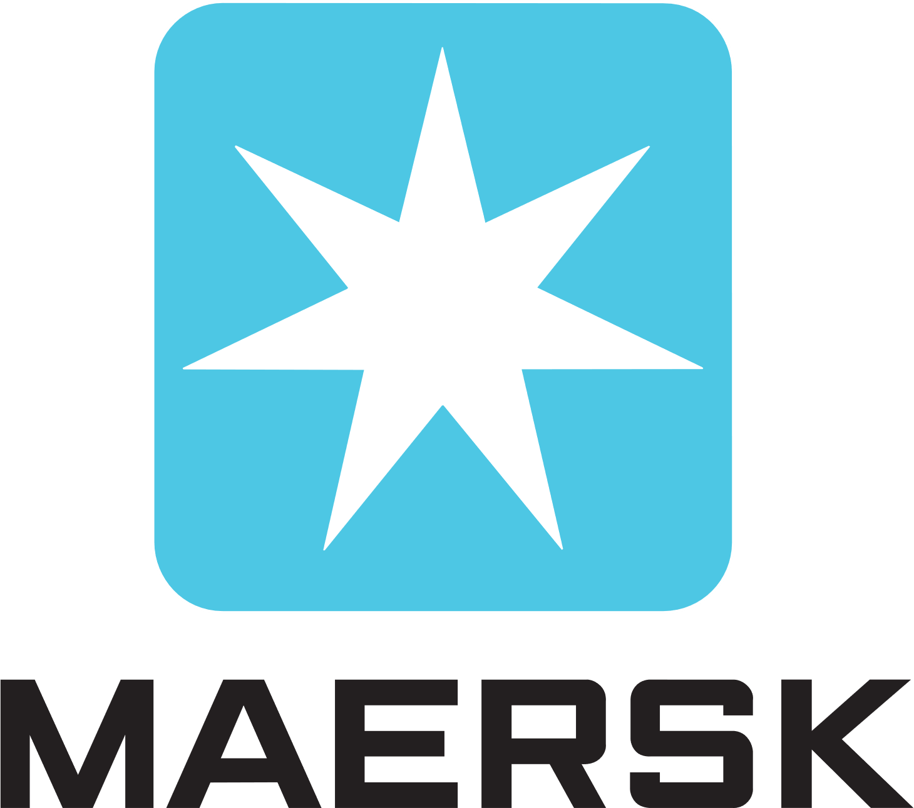


















AudioCodes is a Global Leader in UC and CC Integration and Transformation
9/10
FORTUNE TOP 10 ENTERPRISES
8/10
GLOBAL TOP
TELECOM OPERATORS
4/10
TOP
MULTINATIONAL BANKS
2

Slide 3


Conversational AI in 2022 - Forrester New Tech Study
סעיף מספר 3 חסר
התאמה לשפה החדשה
2022 to do list
2024
TO DO LIST
1
Reduce the number of contacts reaching agents
2
Improve agent efficiency & cut costs
3
Improve customer experience
Improving customer experience

Slide 4




Voicebot Use Cases
Conversational IVR
Virtual Agent
Agent assist
Superb user experience
Flatten hierarchical menus
Easy to build
  Offloads tasks from live agents
  Reduces service costs
  Quick answering
Better & quicker query resolution
Greater agent productivity
Real-time notification to supervisors

Slide 5






Why Voice First Conversational AI
Cost & Time Savings
Valuable data insights
Early adopter
brand differentiation
Contextual & Emotional Understanding
Enhanced, More Personalized User Experience
Hands-Free Convenience

Slide 6


For most consumers, phone calls are still the preferred channel of choice, especially for:
70%+
of customer interactions end up on a voice call
*Metrigy - Customer Experience Transformation, May 2022
Complex service
Time-sensitive issues
Notes:
Voice engagement is what really differentiates your customer service.
Voice allows you to resolve problems efficiently, exhibit humanity and care.
Conversational AI success also depends on excellent voice infrastructure

Slide 7
Voicebot Expertise
A voice bot is not a chat bot that speaks
No disruption allowed – stay flexible
No single solution can do everything – best of breed approach
Voice is complex, VoIP protocols & codecs; quality, security & privacy
Integration with existing telephony infrastructure is complex, escalation to human agent, crosstalk and customer input
Customer support requires the integration of voice bots with existing business processes
Speaking
Intents
Technology
Psychology

Slide 8
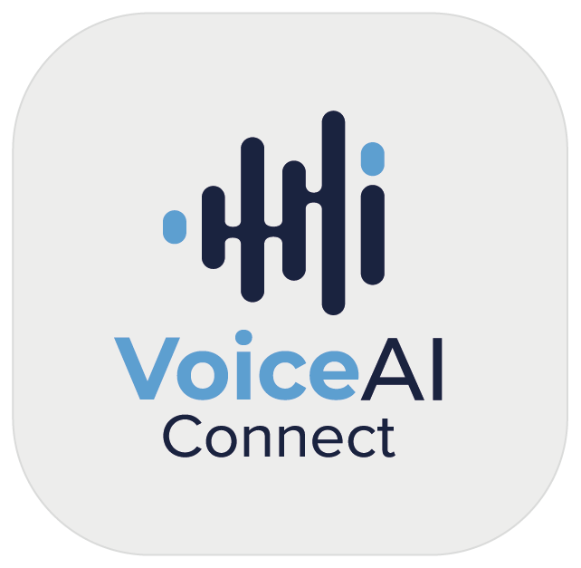










How Do I Give a Voice to My Bot?
Any Voice Engagement Channel
Any Bot/Conversational AI
Public Telephony Provider
Enterprise Communication
VoIP
Protocols
Bot Framework APIs
Contact Center
WebRTC
Speech Service
APIs
Any Cognitive Speech Services
Speaker Verification
Text-to-Speech
Services
Speech-to-Text
Services
Voice Recording
Language Identification

Slide 9




Agent Assist
VoIP
Protocols
Customer
SIP-REC
Agent
Speech APIs
Bot framework text APIs
Real-time insight
Agent Assistant Bot
Real-Time insight

Slide 10
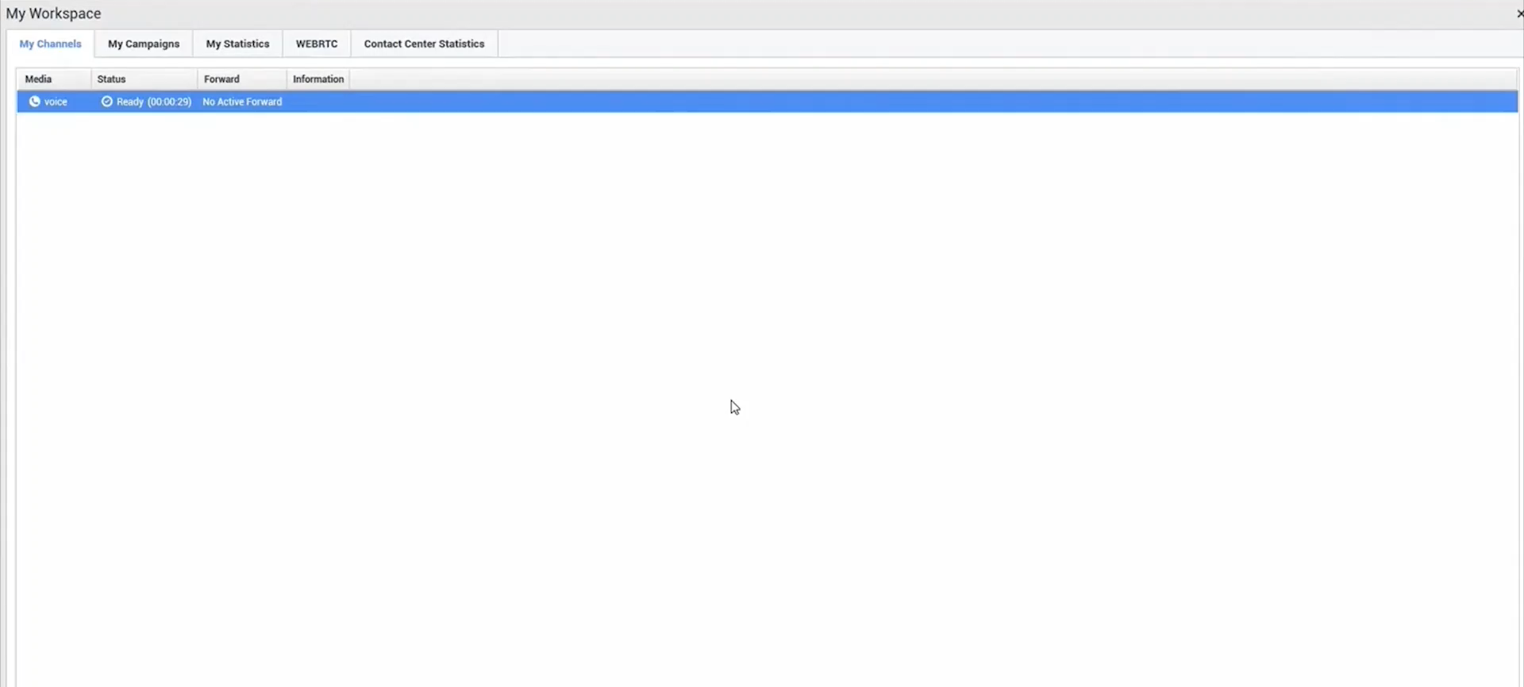

Agent Assist
Notes:
Let’s see and listen to how Agent Assist would look like.
Here based on the Kore.ai conversational AI solution and integrated with Genesys Engage using a webrtc softphone integrated in WDE

Slide 11
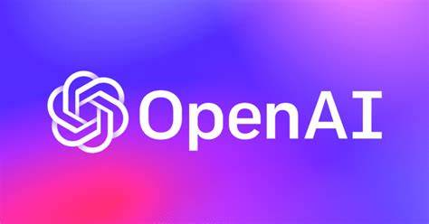
Large Language Models

Slide 12
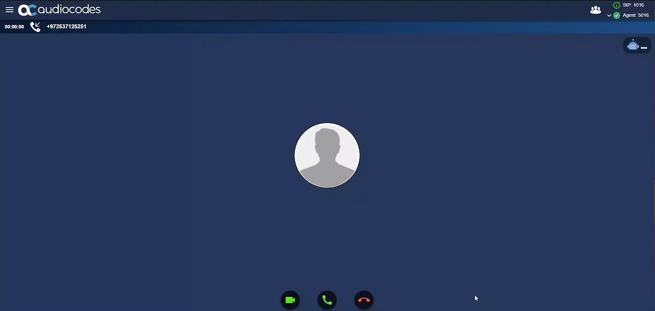

Slide 13
Connectivity Services
to Reduce Voice Complexity
Telephony service providers (BYOC)
Connectivity between contact center platforms
Connectivity with corporate unified communications
Connectivity to recording platforms
Connectivity of existing third-party voice apps
Remote & WFA agents
CCaaS survivability

Slide 14
AudioCodes is
Your trusted voice partner
Let’s talk!

