Slide 1


The rapid -and accelerating- emergence of AI in the Enterprise
Adam S. Goldberg
OpenAI Go-to-Market Team
ChatGPT Enterprise
@theRealAdamG
Notes:
James
We thought we’d start very quickly with the high level on us
We are a research and a deployment company

Slide 2
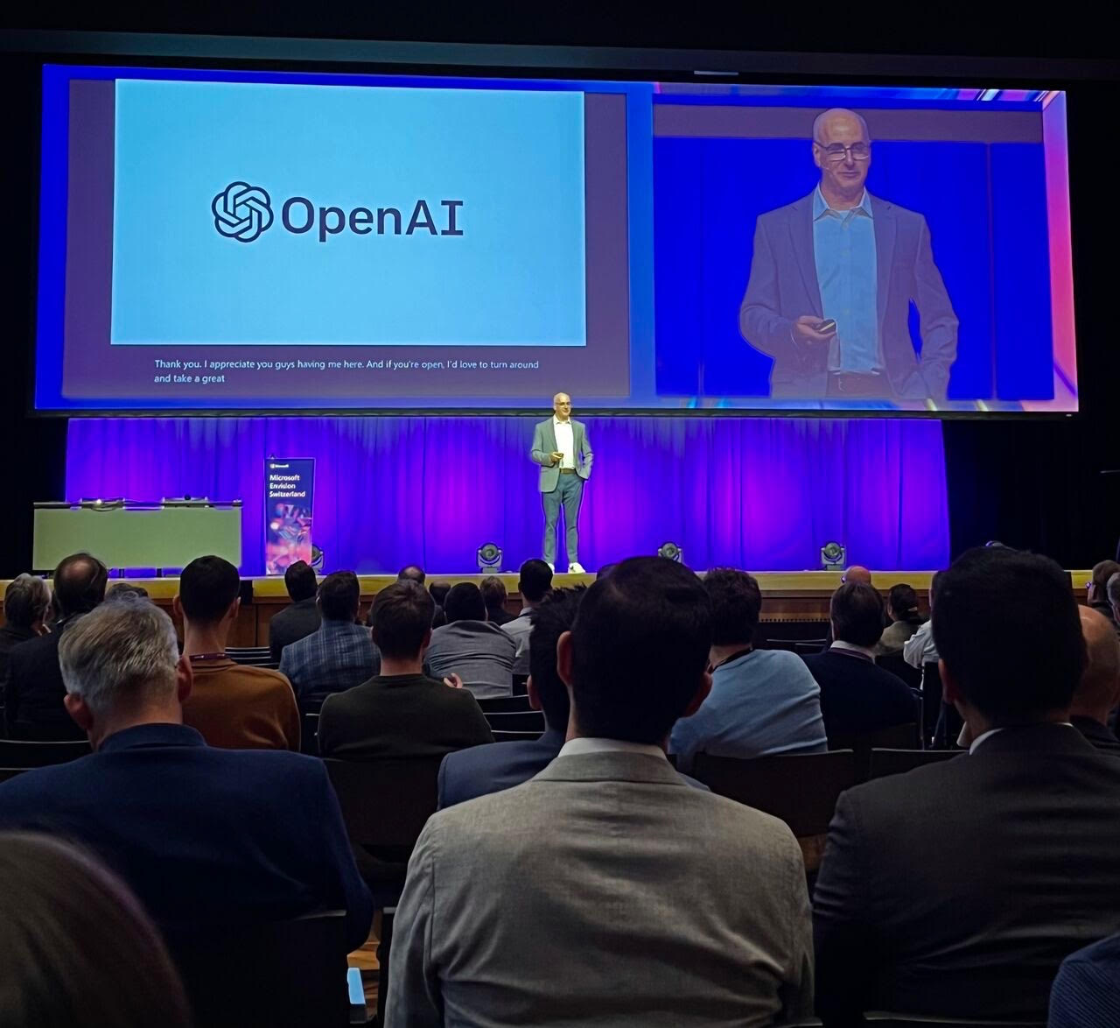
is my career arc
Notes:
James
We thought we’d start very quickly with the high level on us
We are a research and a deployment company

Slide 3

Business Systems
IT &
FLOps Systems
Collaboration & Workplace Tools
AI is emerging
everywhere
Consumer Apps
App Dev Tools

Slide 4


Confidential
How it started…
ChatGPT
Consumer centric:
An AI-native app for
everyday users,
free and Plus versions available
Developer centric:
Used to AI-enable
existing products and build new
AI-native products
Notes:
James
We thought we’d start very quickly with the high level on us
We are a research and a deployment company
?/Notes for ie/EmmMagga:
Can you help me identify the audiences for each product? I think Chat GPT is everyone? OpenAI API and Enterprise are for businesses? Is there any more specificity here?
ECL:
ChatGPT - consumers / everyday users. We have a free and a “plus” version for $20/month. This is what everyone is using today. We don’t want to emphasize this, but we may train our models on consumer data unless the user specifically opts out in their admin profile page.
OpenAI API’s - this is for companies (big and small) who want to build AI features into their products with our models. Here’s examples of what types of companies are building with OpenAI : - https://openai.com/customer-stories
https://twitter.com/tryramp/status/1659202525315362818
We have specific “enterprise grade / industry standard” security guarantees with the API’s: https://openai.com/api-data-privacy
Such as: we will never train your data that is sent through the API’s. We are SOC2 type 1 compliant, we are GDPR/CCPA compliant etc.
ChatGPT Enterprise: companies larger than 150 employees. This is the “enterprise grade” version of ChatGPT.
We offer you a premium experience (faster and unlimited conversations), an admin panel so companies can manage who is using the product, and similar security guarantees as the API’s, not only will we never train on your data, it’s housed in a completely separate infrastructure that’s secure.

Slide 5
...how’s it going
We’re building an AI assistant for work
It helps you with any task, is customized for your organization, and protects your company data.
Capabilities will approach AGI over time — a system that outperforms humans at most economically valuable work
Notes:
James
And our mission is to ensure that AGI benefits all of humanity
Everything we are doing is centered around this mission and its critically important to us that we get this right
Core to that mission is also understanding the economic impacts that our models have on the businesses and users that interact with them

Slide 6

Notes:
James
We thought we’d start very quickly with the high level on us
We are a research and a deployment company

Slide 7














The journey to
Confidential
with the
brand new GPT-3
API
launches
June 2020
ChatGPT
Custom Data Handling
Embeddings v1
DALLE-2
ChatGPT Plus
GPT-4
Function Calling
August
2023
2021
2022
2023
Codex
Instruction Following
ChatGPT,
GPT-3.5
and
Embeddings v2
Whisper &
ChatGPT API
ChatGPT
Browsing, Code Interpreter and
3rd Party Plugins
ChatGPT
IOS App
Custom Instructions
and
ChatGPT Android App
Notes:
James
We thought we’d start very quickly with the high level on us
We are a research and a deployment company

Slide 8



“ChatGPT Enterprise has cut down research time by an average of an hour per day, increasing productivity for people on our team. It’s been a powerful tool that has accelerated testing hypotheses and improving our internal systems”
-Jorge Zuniga
Head of Data Systems and Integrations at Asana
“From engineers troubleshooting bugs, to data analysts clustering free-form data, to finance analysts writing tricky spreadsheet formulas—the use cases for ChatGPT Enterprise are plenty. It’s become a true enabler of productivity, with the dependable security and data privacy controls we need.”
-Danny Wu
Head of AI Products at Canva

Slide 9
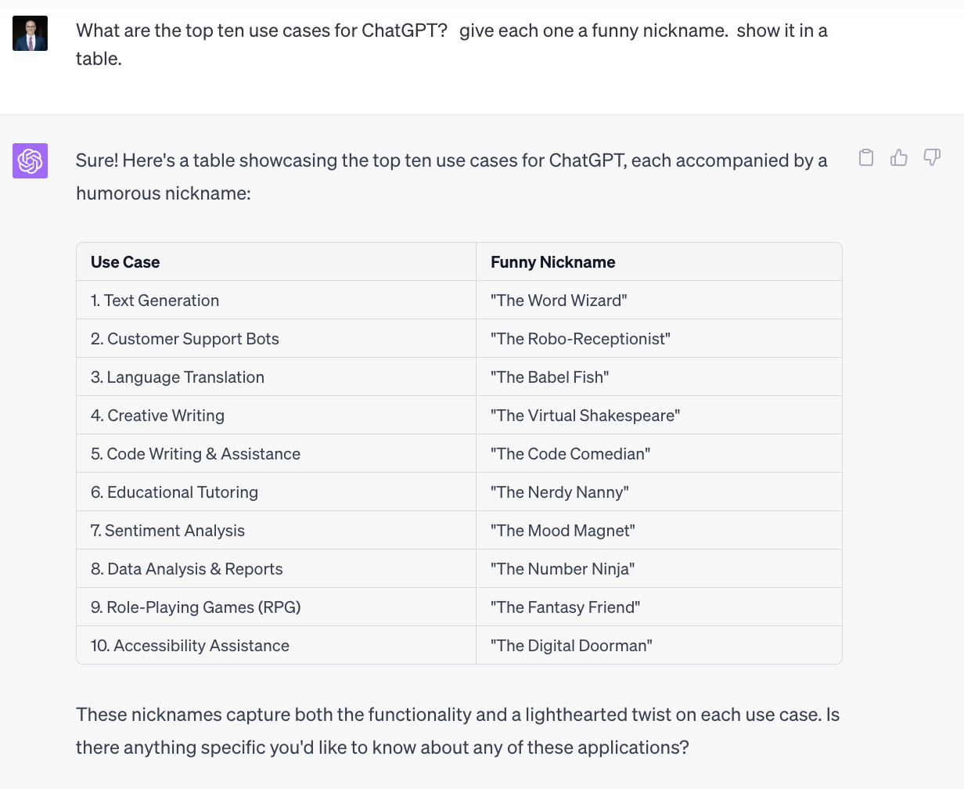
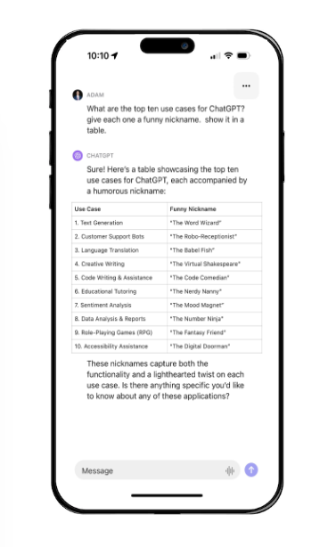

Slide 10
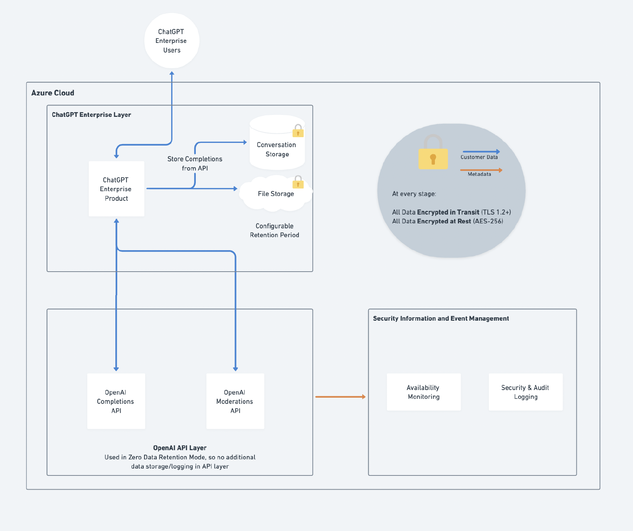
ChatGPT Enterprise
Secure & Private
Confidential
Encrypted in Transit and at Rest
Data Privacy Assurance
  we do not train on your data
  you own & control your data
Custom Data Retention
SAML Single Sign On (SSO)
Domain Verification
SOC2 compliant
Dedicated Workspace
Roles & Permissions (RBAC)
User Insights & Reporting
Notes:
\
ChatGPT has knowledge with the BingPlug-in can take your request, convert it into a search query, get the search results, read and understand the search results and then use that to generate a response.
Not only that, ChatGPT Browse with Bing, allows you cite your sources.

Slide 11
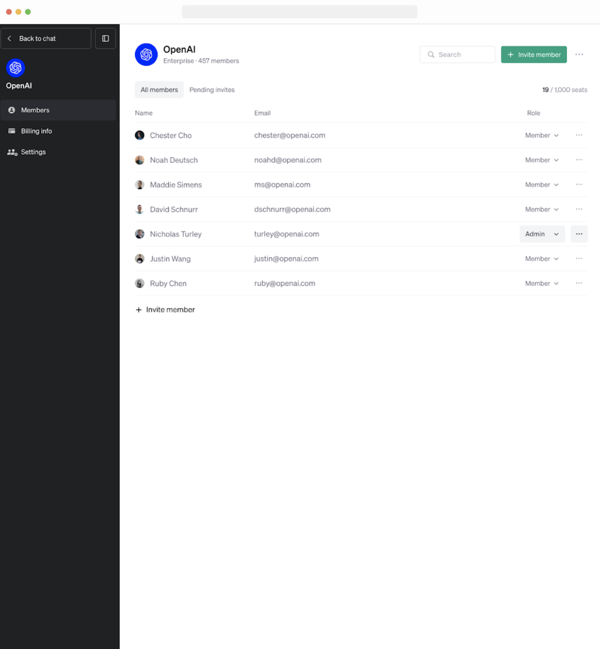
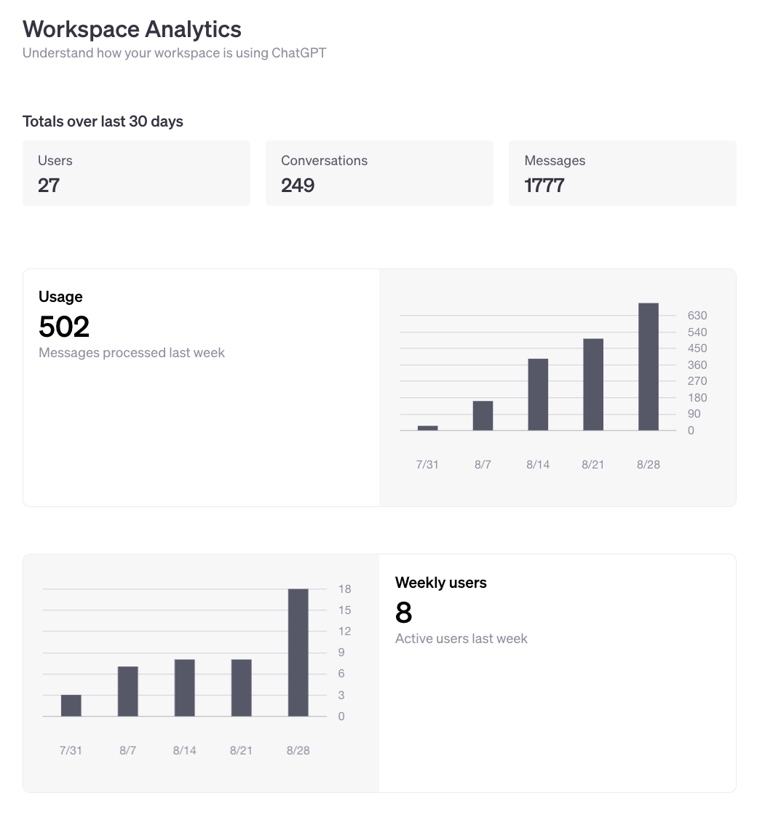
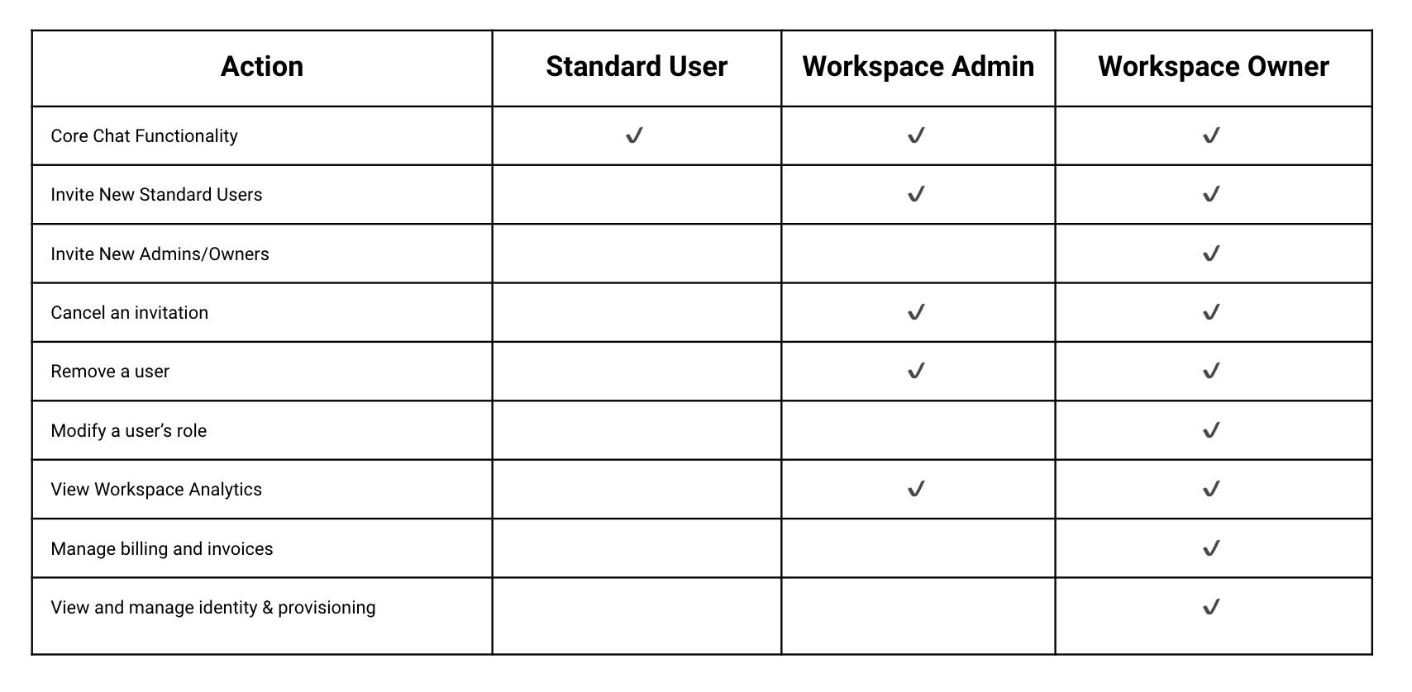
ChatGPT Enterprise
Built for the Enterprise
Confidential
Confidential

Slide 12
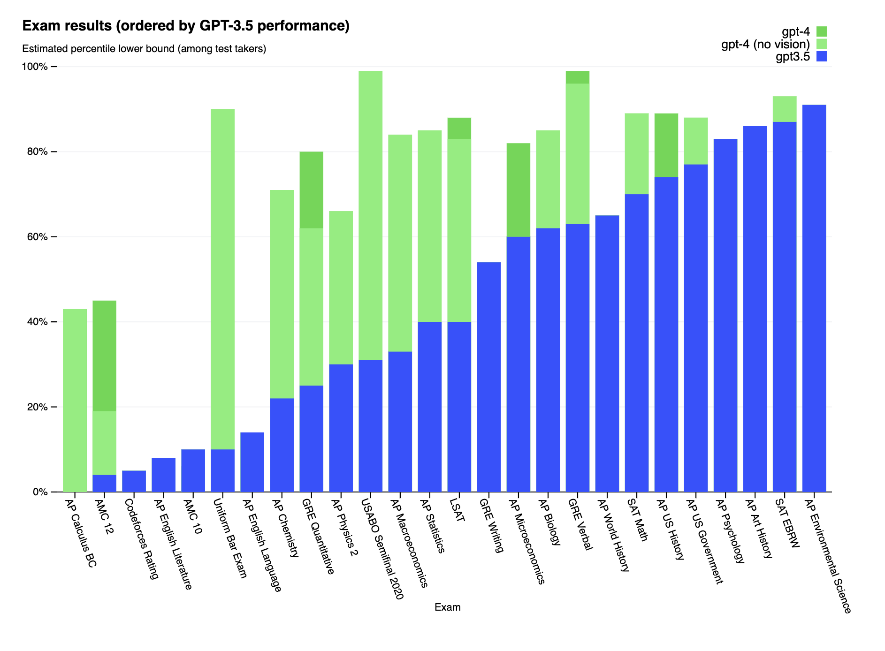
ChatGPT Enterprise
Our Best Models
Confidential
GPT-4
Faster GPT-4 (up to 2x)
Uncapped GPT-4 usage
32K Context Window
Advanced Data Analysis
Explore, Transform, Analyze, Visualize any data
Multiple files, up to 512MBs in file size
Notes:
ChatGPT has knowledge with the BingPlug-in can take your request, convert it into a search query, get the search results, read and understand the search results and then use that to generate a response.
Not only that, ChatGPT Browse with Bing, allows you cite your sources.

Slide 13
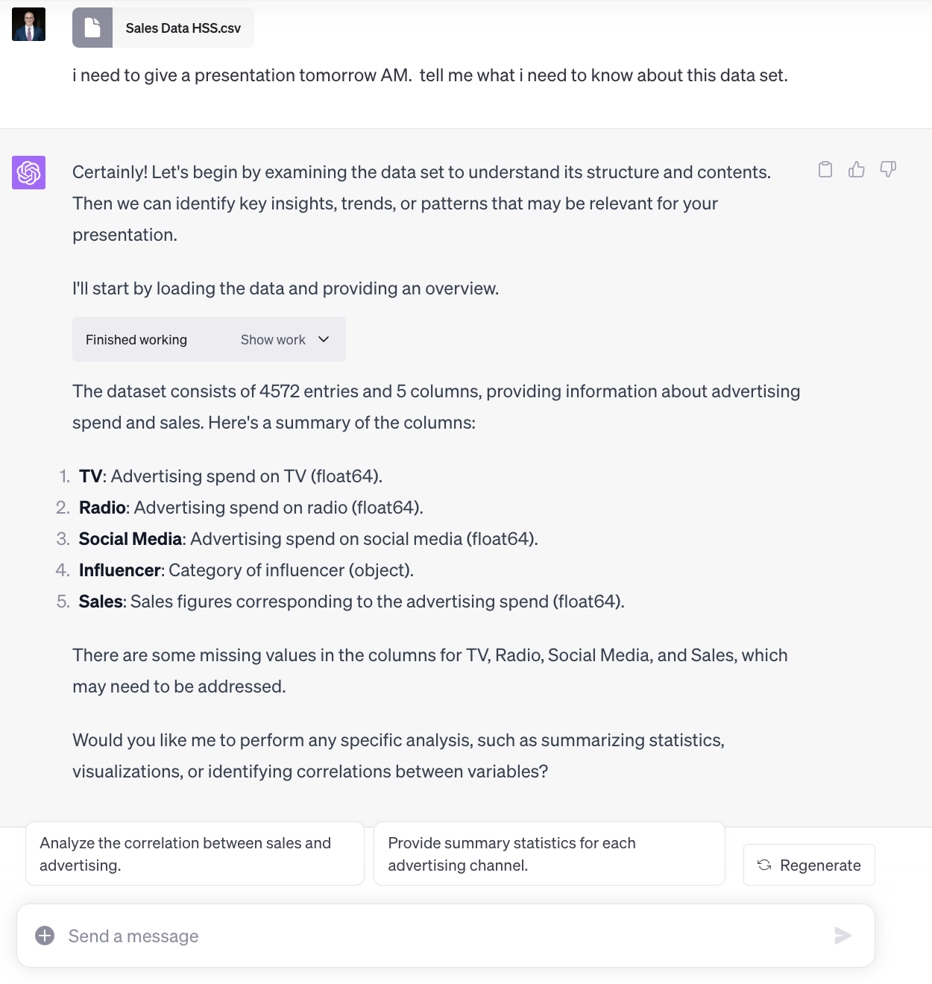
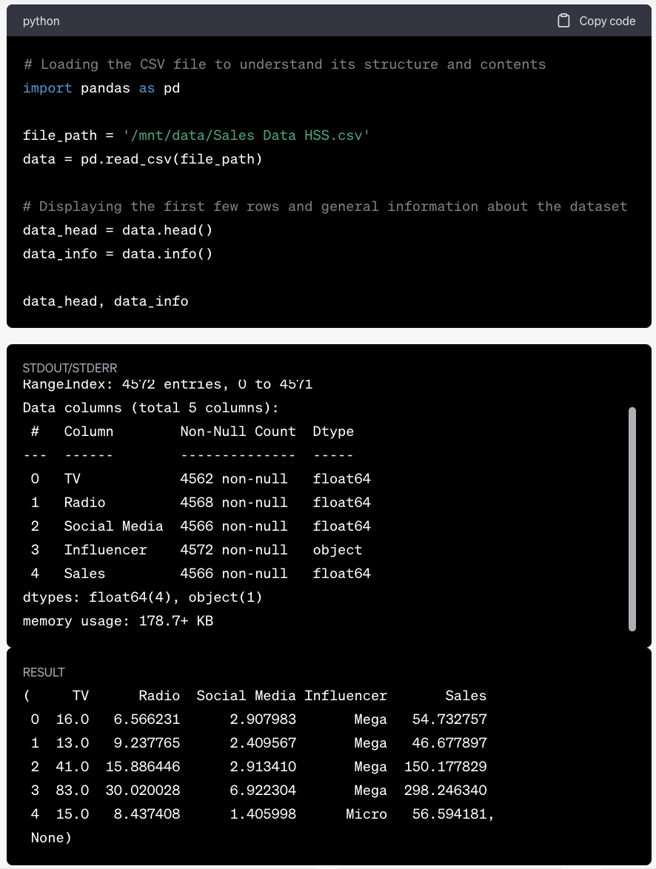
ChatGPT Enterprise
Advanced Data Analysis - Explore Data
Confidential
Notes:
Browse with Bing allows our models to be up to date with realtime knowledge.
ChatGPT has knowledge with the BingPlug-in can take your request, convert it into a search query, get the search results, read and understand the search results and then use that to generate a response.
Not only that, ChatGPT Browse with Bing, allows you cite your sources.

Slide 14
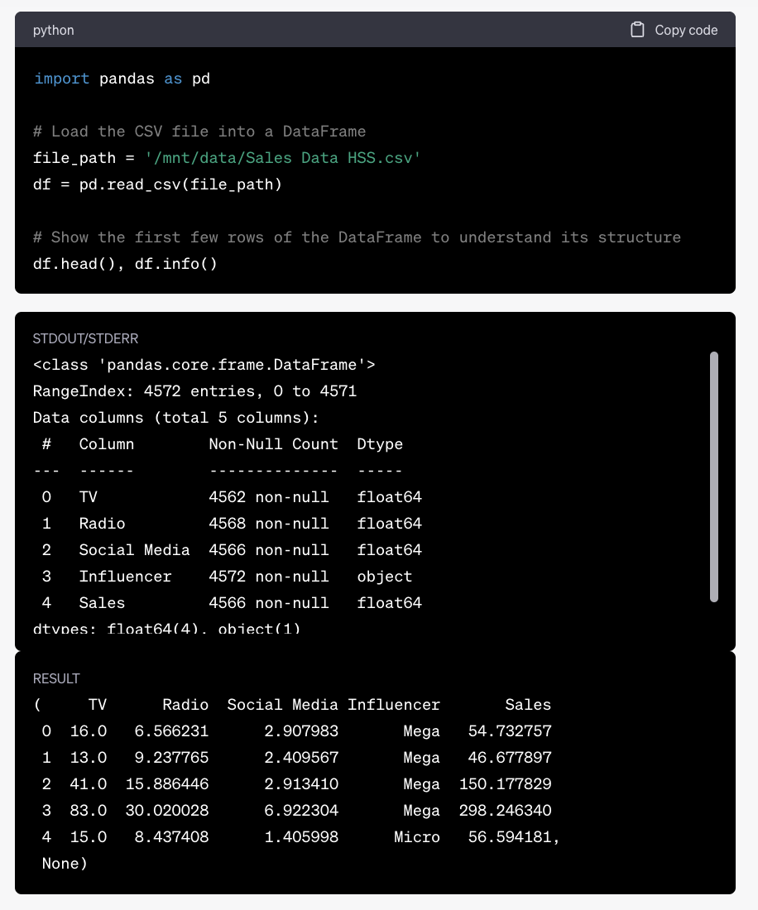
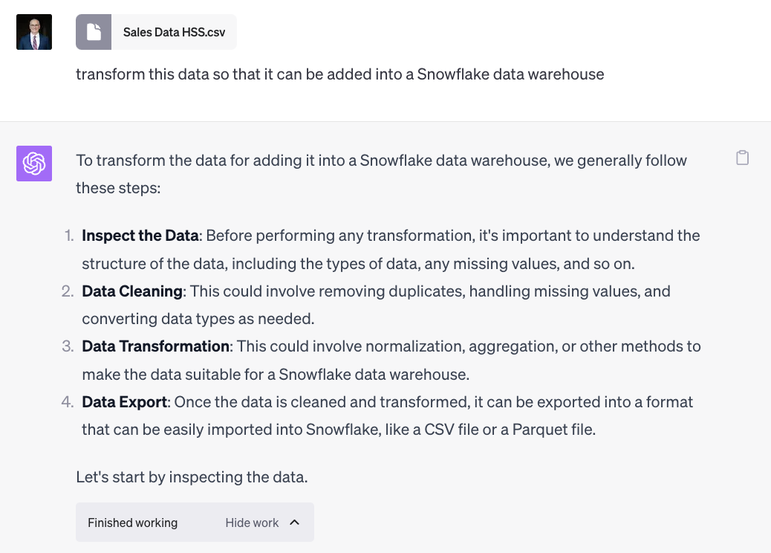
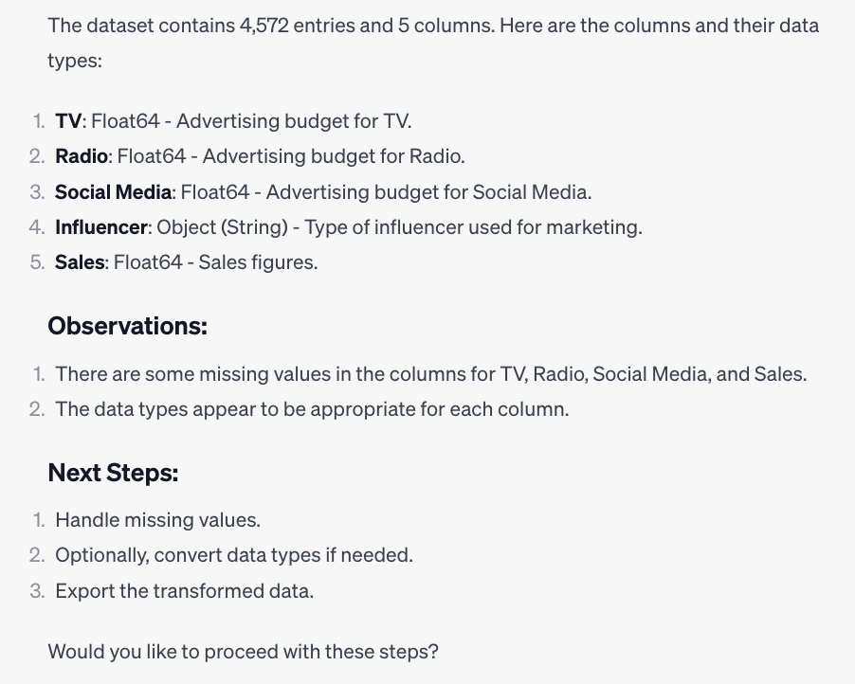
ChatGPT Enterprise
Advanced Data Analysis - Transform Data
Confidential
Notes:
Browse with Bing allows our models to be up to date with realtime knowledge.
ChatGPT has knowledge with the BingPlug-in can take your request, convert it into a search query, get the search results, read and understand the search results and then use that to generate a response.
Not only that, ChatGPT Browse with Bing, allows you cite your sources.

Slide 15
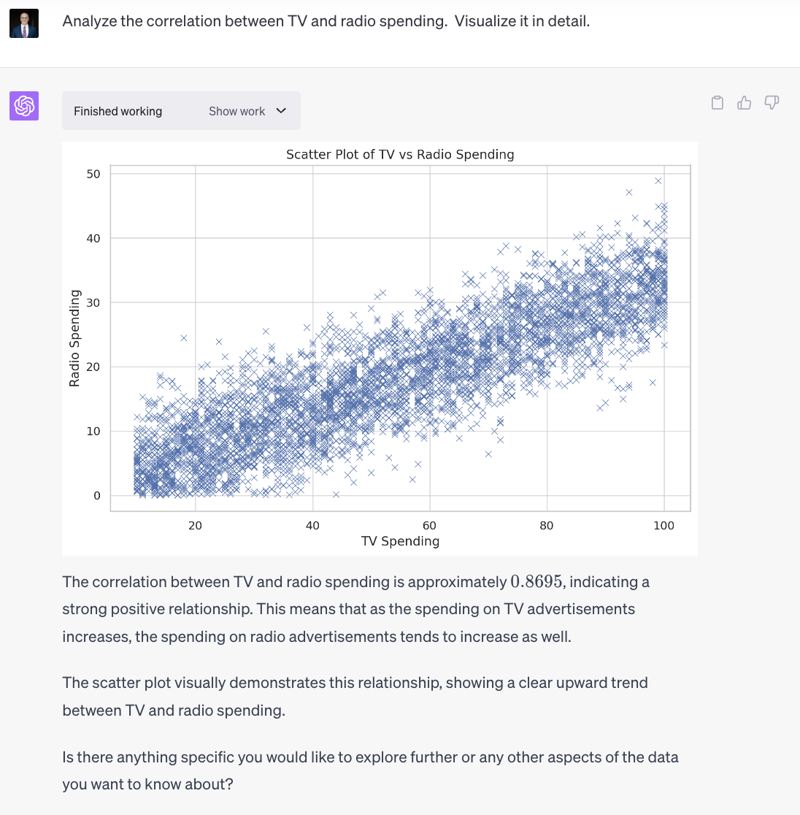
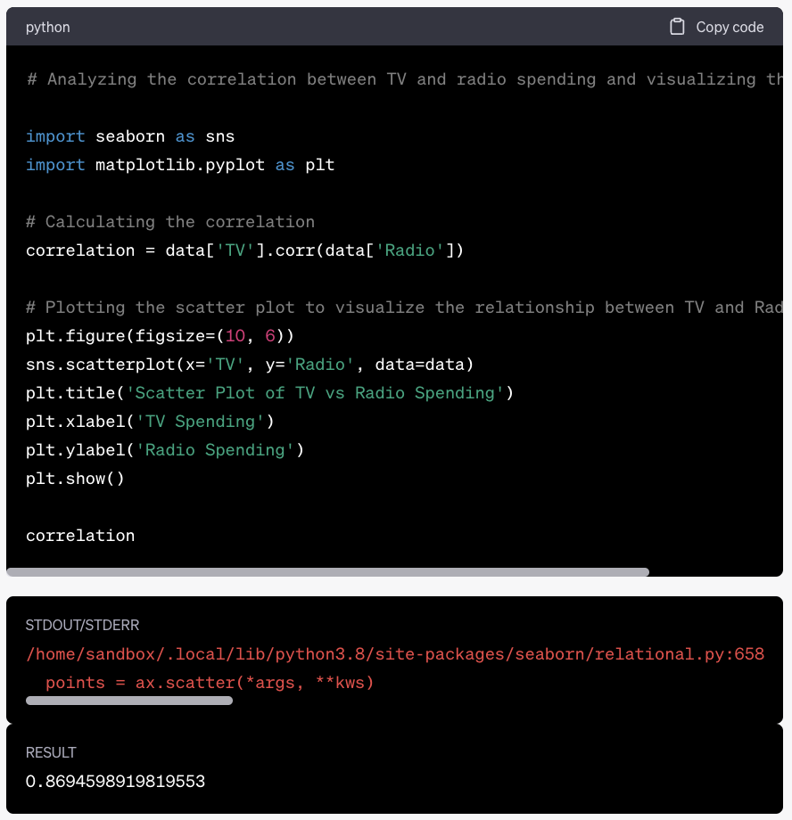
ChatGPT Enterprise
Advanced Data Analysis - Analyze & Visualize Data
Confidential
Notes:
Browse with Bing allows our models to be up to date with realtime knowledge.
ChatGPT has knowledge with the BingPlug-in can take your request, convert it into a search query, get the search results, read and understand the search results and then use that to generate a response.
Not only that, ChatGPT Browse with Bing, allows you cite your sources.

Slide 16
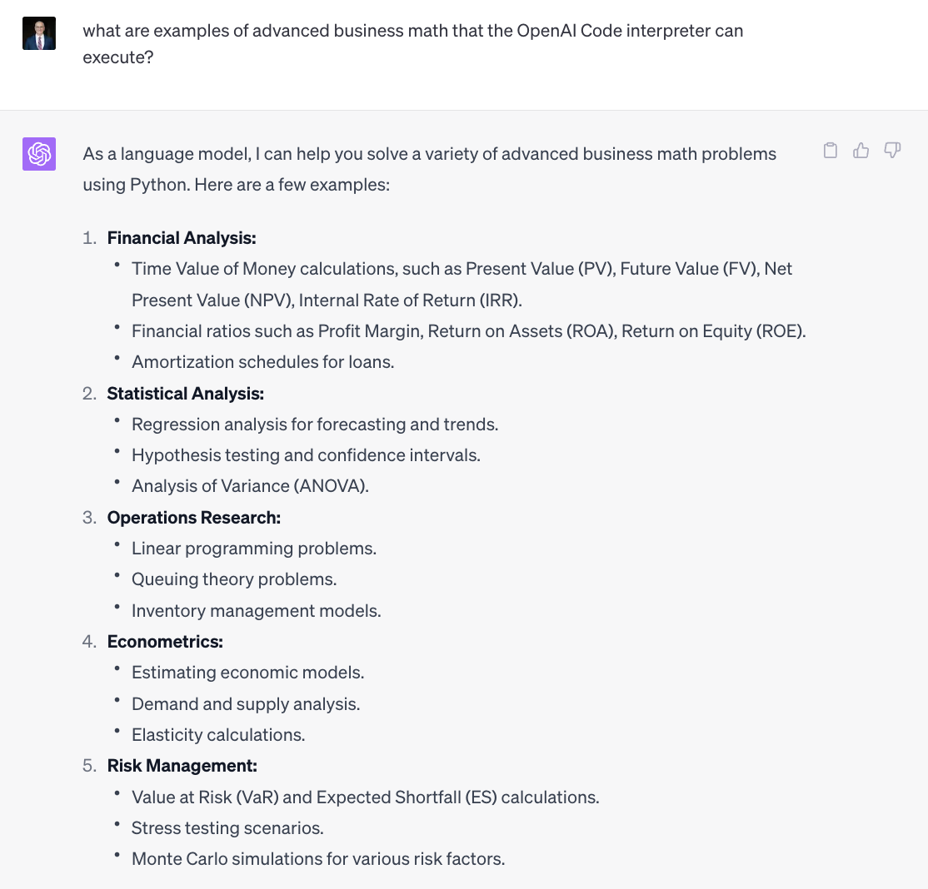
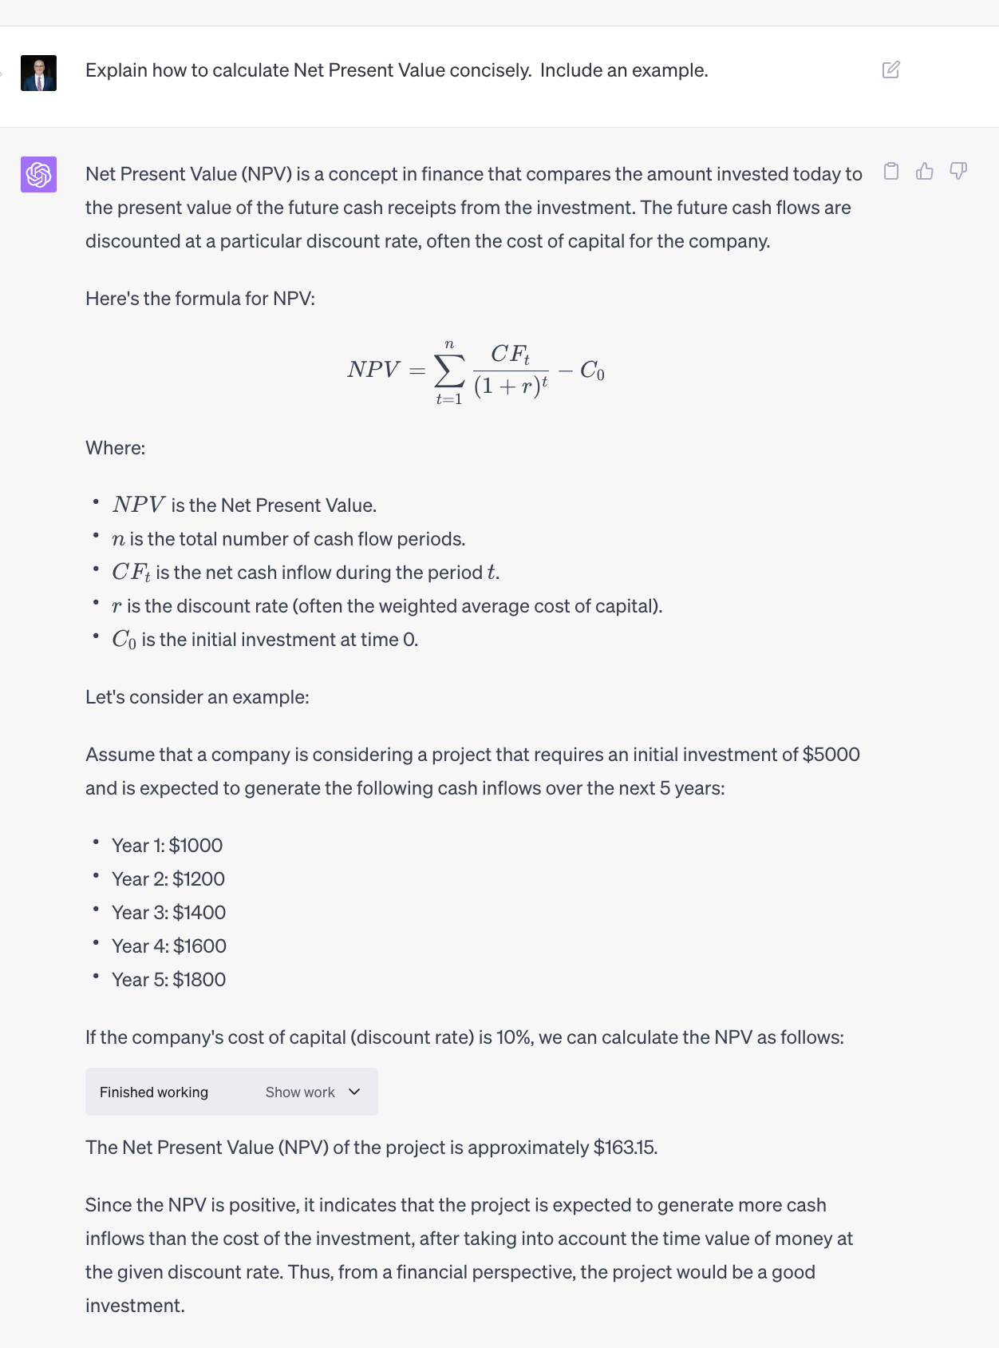
ChatGPT Enterprise
Advanced Data Analysis - Advanced Math
Confidential
Notes:
Browse with Bing allows our models to be up to date with realtime knowledge.
ChatGPT has knowledge with the BingPlug-in can take your request, convert it into a search query, get the search results, read and understand the search results and then use that to generate a response.
Not only that, ChatGPT Browse with Bing, allows you cite your sources.

Slide 17
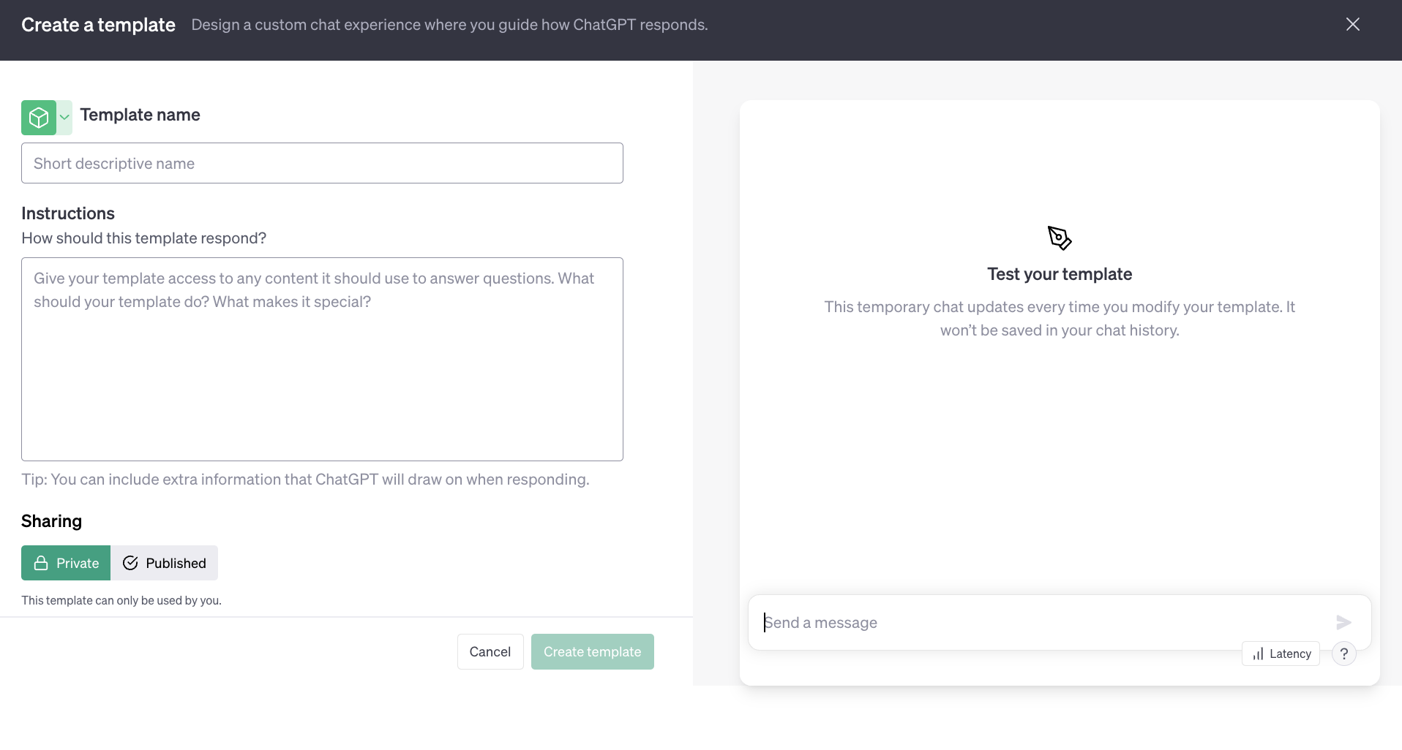
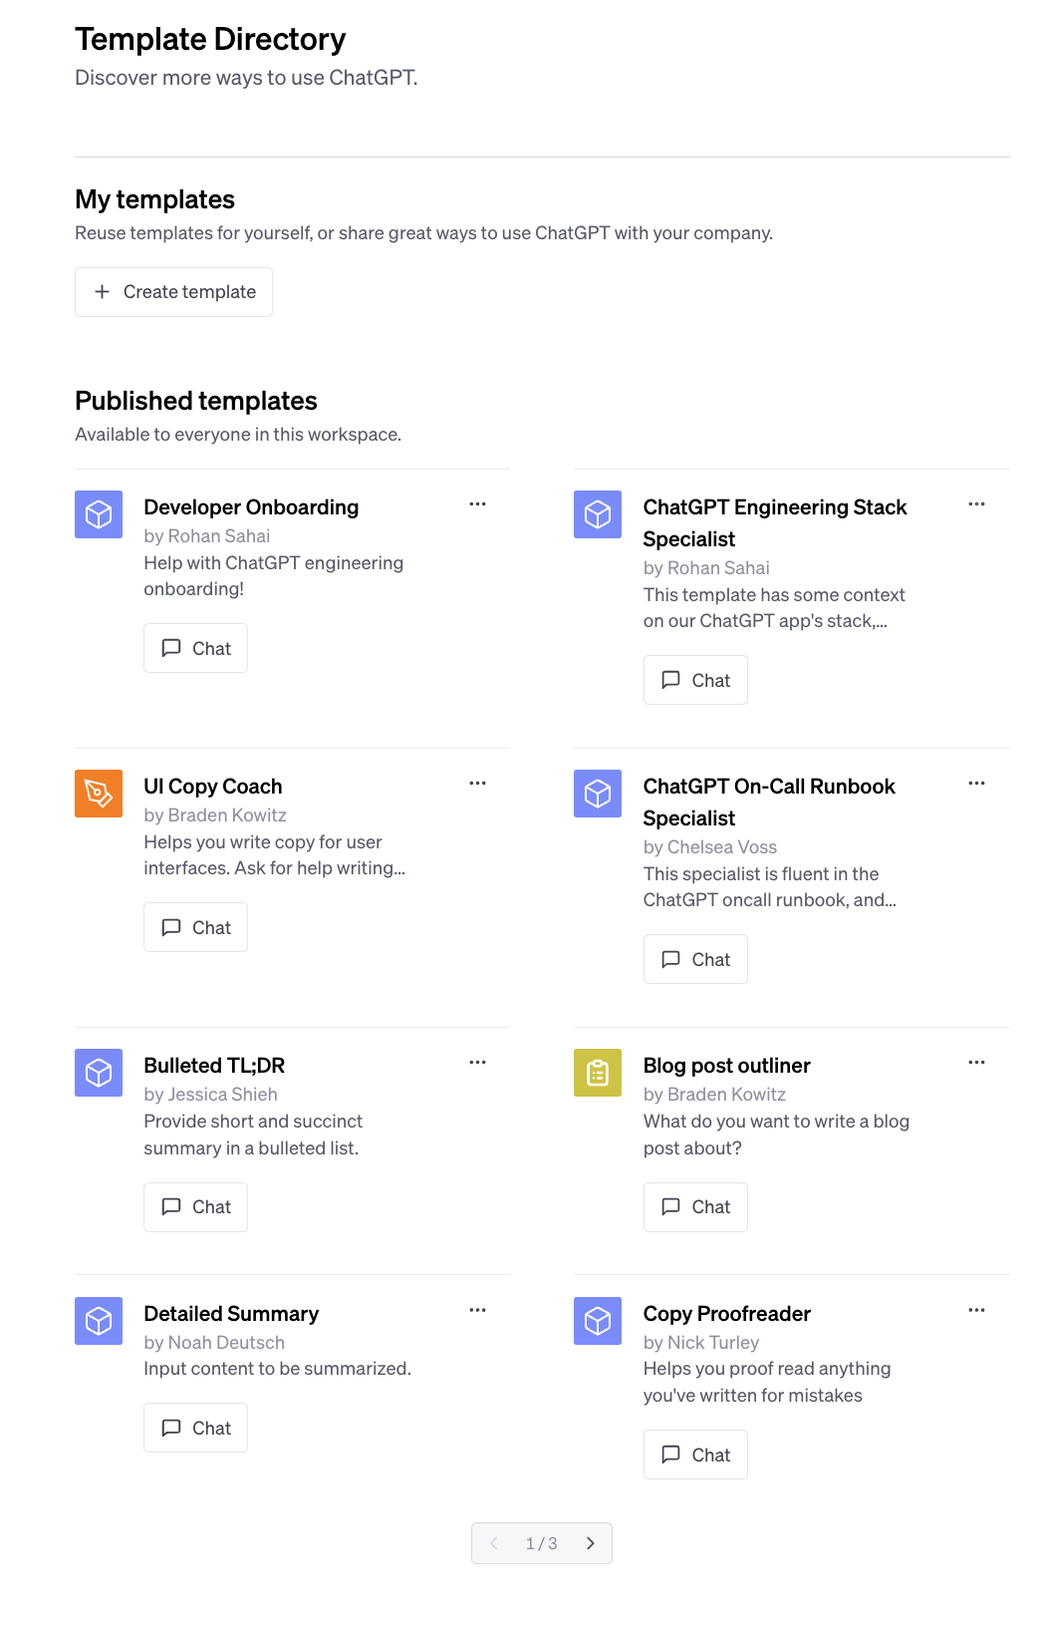
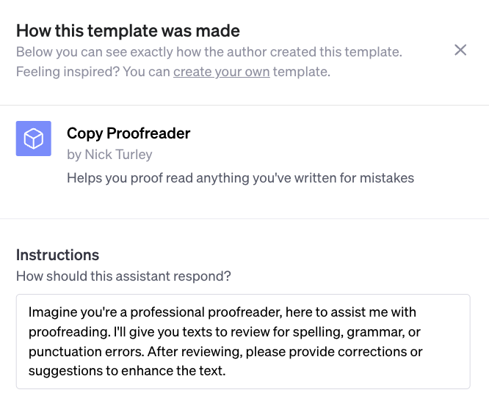
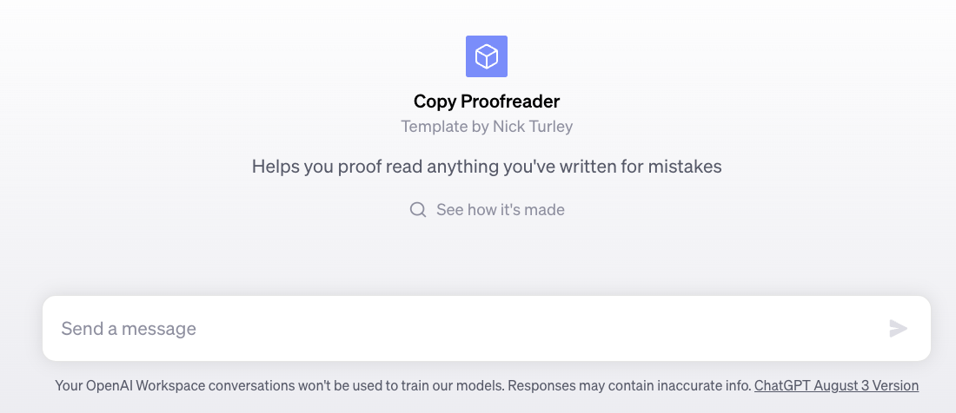
ChatGPT Enterprise
Template Library
Confidential
Notes:
ChatGPT has knowledge with the BingPlug-in can take your request, convert it into a search query, get the search results, read and understand the search results and then use that to generate a response.
Not only that, ChatGPT Browse with Bing, allows you cite your sources.

Slide 18
A small sampling of what’s possible with
ChatGPT Enterprise
Confidential
Confidential
Idea Generation & Exploration
Text Generation
Question Answering
Language Translation
Summarization
Market Research
Mathematical Problem Solving
Event or Meeting Planning
Scientific Explanation
Value Innovation
Brainstorm & Strategize
Educational Research & Personalized Tutoring
Conversational Engagement
Sentiment, Emotion & Tone Recognition
Philosophical Discussion
Cultural and Social Context Understanding
Ethical Consideration and Guidance
Write & Explain Code
Translate Code
Optimize Code
Code Refactoring
Syntax Checking
Analyze Code Complexity
Code Testing
Code Documentation
Code Conversion to Pseudocode
Code Review and Feedback
Code Integration with APIs
Code Security Analysis
Code Compatibility Check
Code Deployment Guidance
Database Query Generation
Text to SQL or Spark
ML Model Implementation
Data Extraction
Data Transformation
Data Loading
ETL Pipeline Creation
Data Cleaning
Data Analysis
Data Visualization
Interactive Dashboard Creation
ML Preprocessing
Data Aggregation & Processing
Geospatial Data Visualization
Time Series Analysis
Data Anonymization
Data Integration
Data Mining
Data Quality Assessment
Sample Data Generation

Slide 19
Confidential
Empowering everyone, everywhere
ChatGPT
Empowering consumers
Empowering developers
& their platforms
Empowering employees
& their enterprises
Notes:
James
We thought we’d start very quickly with the high level on us
We are a research and a deployment company
?/Notes for ie/EmmMagga:
Can you help me identify the audiences for each product? I think Chat GPT is everyone? OpenAI API and Enterprise are for businesses? Is there any more specificity here?
ECL:
ChatGPT - consumers / everyday users. We have a free and a “plus” version for $20/month. This is what everyone is using today. We don’t want to emphasize this, but we may train our models on consumer data unless the user specifically opts out in their admin profile page.
OpenAI API’s - this is for companies (big and small) who want to build AI features into their products with our models. Here’s examples of what types of companies are building with OpenAI : - https://openai.com/customer-stories
https://twitter.com/tryramp/status/1659202525315362818
We have specific “enterprise grade / industry standard” security guarantees with the API’s: https://openai.com/api-data-privacy
Such as: we will never train your data that is sent through the API’s. We are SOC2 type 1 compliant, we are GDPR/CCPA compliant etc.
ChatGPT Enterprise: companies larger than 150 employees. This is the “enterprise grade” version of ChatGPT.
We offer you a premium experience (faster and unlimited conversations), an admin panel so companies can manage who is using the product, and similar security guarantees as the API’s, not only will we never train on your data, it’s housed in a completely separate infrastructure that’s secure.

Slide 20


AI
enabled
Build
Buy
AI
native
It is an “AND”, not an “OR”

Slide 21
Thank you!
Notes:
James
We thought we’d start very quickly with the high level on us
We are a research and a deployment company

